Slide 1
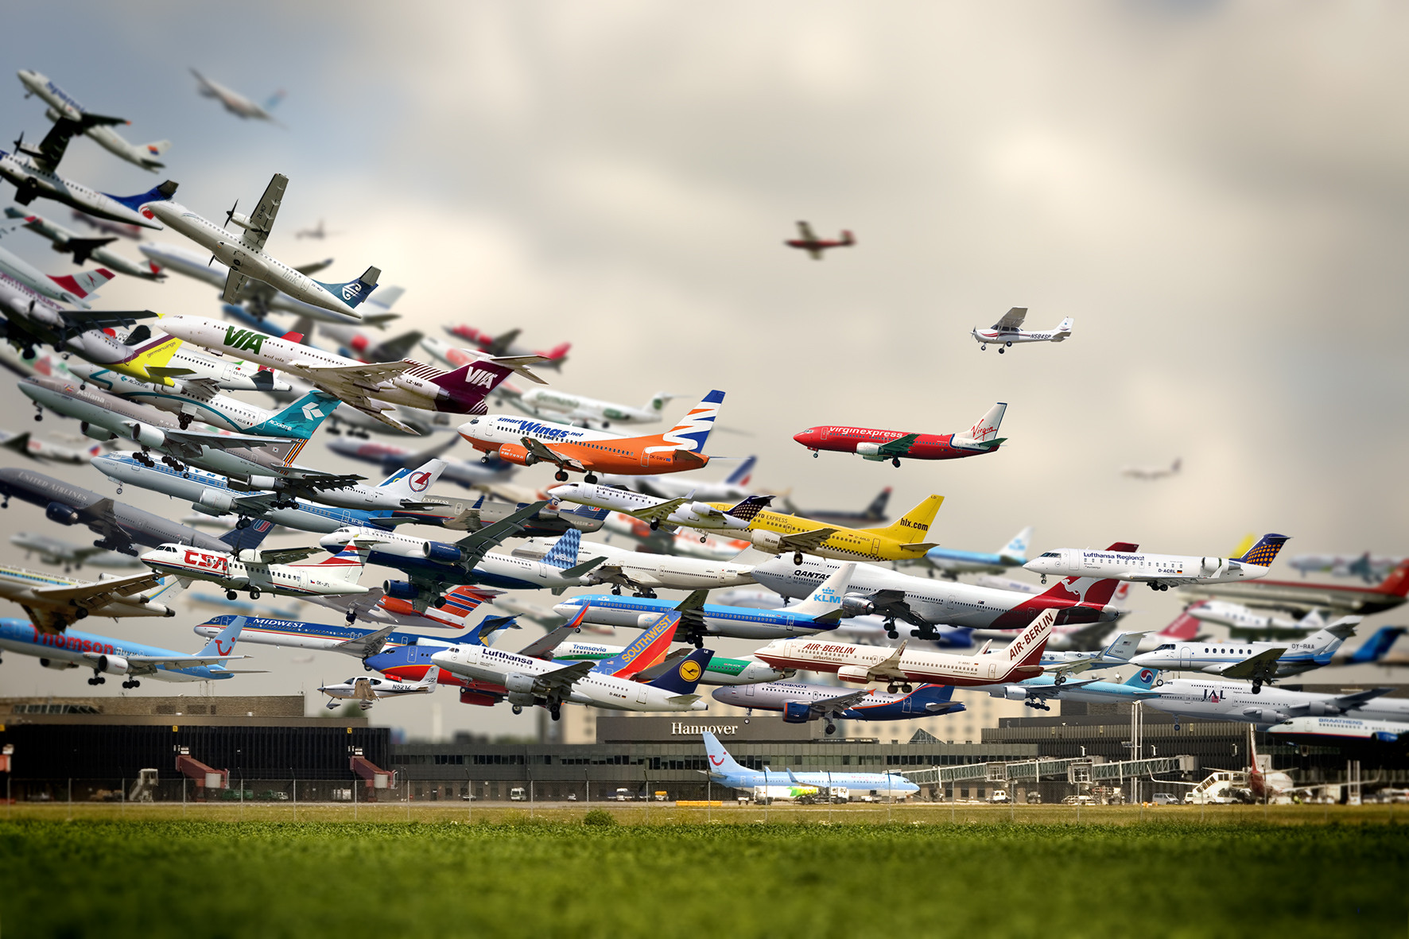
Notes:
Not a real composite of one location

Slide 2
Gradient Domain Blending
James Hays
CS 129 Fall 2012

Slide 3
target
source

Slide 4
target
source
It is impossible to faithfully preserve the gradients

Slide 5
Simple 2d example
.2 | .5 | .2 | .2
.7 | .7 | .7 | .7
.9 | .9 | .8 | .9
.8 | .6 | .6 | .6
.6 | .6 | .2 | .6
.6 | .8 | .6 | .6
target, t
source, s
mask
? | ? | ? | ?
? | ? | ? | ?
? | ? | ? | ?
output, x
What properties do we want x to have?

Slide 6
Simple 2d example
.2 | .5 | .2 | .2
.7 | .7 | .7 | .7
.9 | .9 | .8 | .9
.8 | .6 | .6 | .6
.6 | .6 | .2 | .6
.6 | .8 | .6 | .6
target, t
source, s
mask
For unmasked pixels, x_{i} = t_{i}
For masked pixels, we want the gradients at x_{i} to match the gradients at s_{i}
But how do we define the gradient? Instead of constraining one or many gradients, in this example we will use the Laplacian.
? | ? | ? | ?
? | ? | ? | ?
? | ? | ? | ?
output, x
0 | -1 | 0
-1 | 4 | -1
0 | -1 | 0

Slide 7
Simple 2d example
.2 | .5 | .2 | .2
.7 | .7 | .7 | .7
.9 | .9 | .8 | .9
.8 | .6 | .6 | .6
.6 | .6 | .2 | .6
.6 | .8 | .6 | .6
0 | -1 | 0
-1 | 4 | -1
0 | -1 | 0
target, t
source, s
mask
Laplacian
x₁ = t₁
x₂ = t₂
x₃ = t₃
x₄ = t₄
4x₅ – x₄ – x₂ – x₆ – x₈ = 4s₅ – s₄ – s₂ – s₆ – s₈
x₆ = t₆
x₇ = t₇
4x₈ – x₇ – x₅ – x₉ – x₁₁ = 4s₈ – s₇ – s₅ – s₉ – s₁₁
x₉ = t₉
x₁₀ = t₁₀
x₁₁ = t₁₁
x₁₂ = t₁₂
? | ? | ? | ?
? | ? | ? | ?
? | ? | ? | ?
output, x
1 | 4 | 7 | 10
2 | 5 | 8 | 11
3 | 6 | 9 | 12
Pixel indexing

Slide 8
Simple 2d example
.2 | .5 | .2 | .2
.7 | .7 | .7 | .7
.9 | .9 | .8 | .9
.8 | .6 | .6 | .6
.6 | .6 | .2 | .6
.6 | .8 | .6 | .6
0 | -1 | 0
-1 | 4 | -1
0 | -1 | 0
target, t
source, s
mask
Laplacian
x₁ = 0.2
x₂ = 0.7
x₃ = 0.9
x₄ = 0.5
4x₅ – x₄ – x₂ – x₆ – x₈ = 0.2
x₆ = 0.9
x₇ = 0.2
4x₈ – x₇ – x₅ – x₉ – x₁₁ = -1.6
x₉ = 0.8
x₁₀ = 0.2
x₁₁ = 0.7
x₁₂ = 0.9
? | ? | ? | ?
? | ? | ? | ?
? | ? | ? | ?
output, x
1 | 4 | 7 | 10
2 | 5 | 8 | 11
3 | 6 | 9 | 12
Pixel indexing
Notes:
We could actually reduce this to two equations, because we only truly have two unknowns (x5 and x8), but the indexing is easier if we do it like this.

Slide 9
Simple 2d example
.2 | .5 | .2 | .2
.7 | .7 | .7 | .7
.9 | .9 | .8 | .9
.8 | .6 | .6 | .6
.6 | .6 | .2 | .6
.6 | .8 | .6 | .6
0 | -1 | 0
-1 | 4 | -1
0 | -1 | 0
target, t
source, s
mask
Laplacian
x₁ = 0.2
x₂ = 0.7
x₃ = 0.9
x₄ = 0.5
4x₅ – x₄ – x₂ – x₆ – x₈ = 0.2
x₆ = 0.9
x₇ = 0.2
4x₈ – x₇ – x₅ – x₉ – x₁₁ = -1.6
x₉ = 0.8
x₁₀ = 0.2
x₁₁ = 0.7
x₁₂ = 0.9
? | ? | ? | ?
? | ? | ? | ?
? | ? | ? | ?
In this simple case, we could solve for everything by hand.
output, x
4x₅ – 0.5 – 0.7 – 0.9 – x₈ = 0.2
4x₈ – 0.2 – x₅ – 0.8 – 0.7 = -1.6
1 | 4 | 7 | 10
2 | 5 | 8 | 11
3 | 6 | 9 | 12
4x₅– x₈ = 2.3
4x₈ – x₅ = 0.1
Pixel indexing
x₅ = 0.62
x₈ = 0.18
Notes:
We could actually reduce this to two equations, because we only truly have two unknowns (x5 and x8), but the indexing is easier if we do it like this.

Slide 10
Simple 2d example
.2 | .5 | .2 | .2
.7 | .7 | .7 | .7
.9 | .9 | .8 | .9
.8 | .6 | .6 | .6
.6 | .6 | .2 | .6
.6 | .8 | .6 | .6
0 | -1 | 0
-1 | 4 | -1
0 | -1 | 0
target, t
source, s
mask
Laplacian
1
 | 1
 |  | 1
 |  |  | 1
 | -1 |  | -1 | 4 | -1 |  | -1
 |  |  |  |  | 1
 |  |  |  |  |  | 1
 |  |  |  | -1 |  | -1 | 4 | -1 |  | -1
 |  |  |  |  |  |  |  | 1
 |  |  |  |  |  |  |  |  | 1
 |  |  |  |  |  |  |  |  |  | 1
 |  |  |  |  |  |  |  |  |  |  | 1
?
?
?
?
?
?
?
?
?
?
?
?
.2
.7
.9
.5
.2
.9
.2
-1.6
.8
.2
.7
.9
? | ? | ? | ?
? | ? | ? | ?
? | ? | ? | ?
x = A\b
output, x
*
=
1 | 4 | 7 | 10
2 | 5 | 8 | 11
3 | 6 | 9 | 12
Pixel indexing
A
x
b
Notes:
The same system of equations in matrix form
A is mostly an identity matrix.
In Matlab, building A (naively) is actually slower than solving for x.
We didn’t handle the case where the mask touches the border.

Slide 11
Simple 2d example
.2 | .5 | .2 | .2
.7 | .7 | .7 | .7
.9 | .9 | .8 | .9
.8 | .6 | .6 | .6
.6 | .6 | .2 | .6
.6 | .8 | .6 | .6
0 | -1 | 0
-1 | 4 | -1
0 | -1 | 0
target, t
source, s
mask
Laplacian
1
 | 1
 |  | 1
 |  |  | 1
 | -1 |  | -1 | 4 | -1 |  | -1
 |  |  |  |  | 1
 |  |  |  |  |  | 1
 |  |  |  | -1 |  | -1 | 4 | -1 |  | -1
 |  |  |  |  |  |  |  | 1
 |  |  |  |  |  |  |  |  | 1
 |  |  |  |  |  |  |  |  |  | 1
 |  |  |  |  |  |  |  |  |  |  | 1
.2
.7
.9
.5
.62
.9
.2
.18
.8
.2
.7
.9
.2
.7
.9
.5
.2
.9
.2
-1.6
.8
.2
.7
.9
? | ? | ? | ?
? | ? | ? | ?
? | ? | ? | ?
.2 | .5 | .2 | .2
.7 | .62 | .18 | .7
.9 | .9 | .8 | .9
output = reshape(x, 3, 4)
output, x
*
=
1 | 4 | 7 | 10
2 | 5 | 8 | 11
3 | 6 | 9 | 12
Pixel indexing
A
x
b

Slide 12
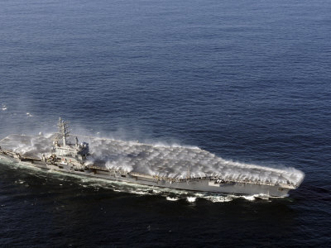
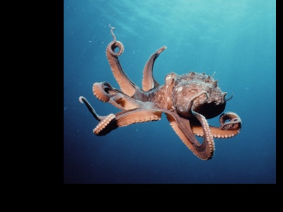
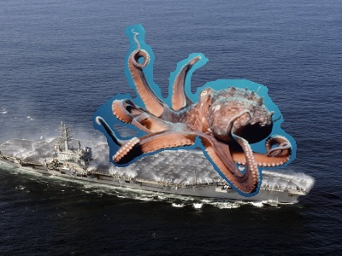
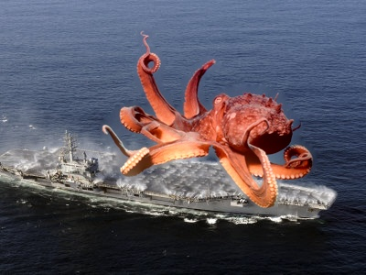
target
source
mask
no blending
gradient domain blending

Slide 13
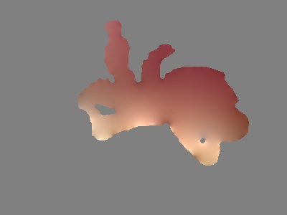
What’s the difference?
-
=
gradient domain blending
no blending

Slide 14
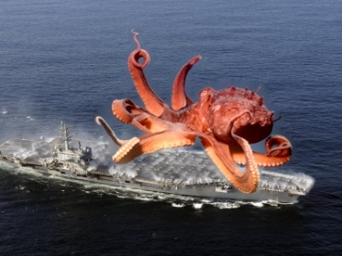
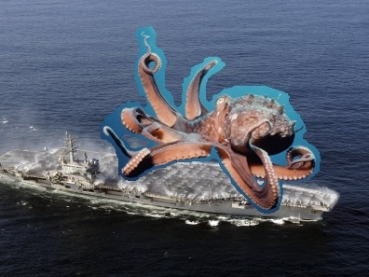
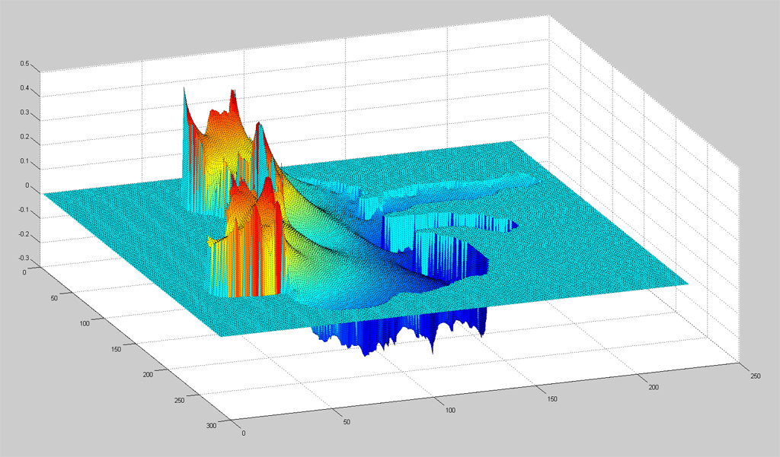
What’s the difference?
-
=
gradient domain blending
no blending

Slide 15
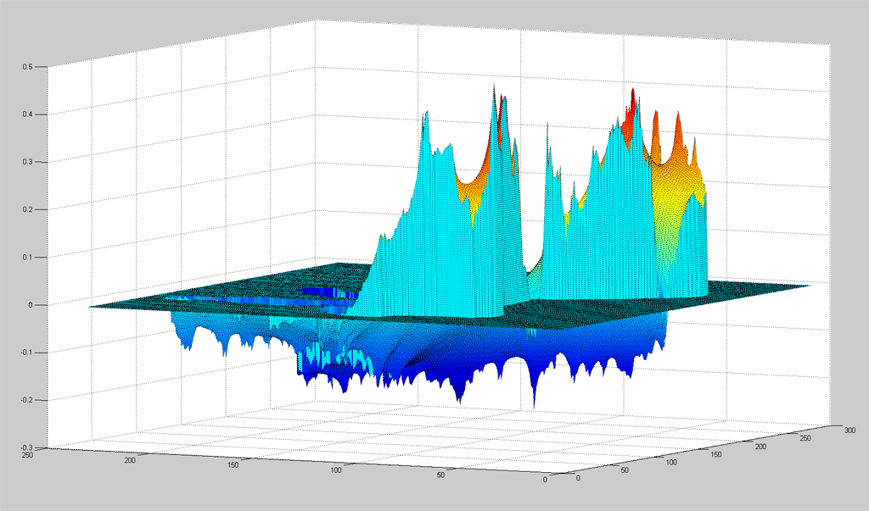
What’s the difference?
-
=
gradient domain blending
no blending

