Slide 1
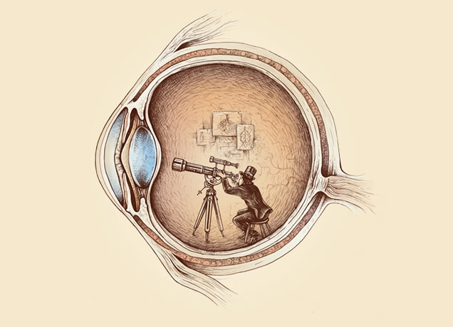
Computational Photography
CS 590 (future 572) Spring 2016
Prof. Alex Berg
(Credits to many other folks on individual slides)

Slide 2
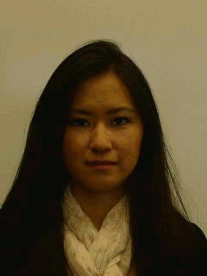

Morphing

Slide 3
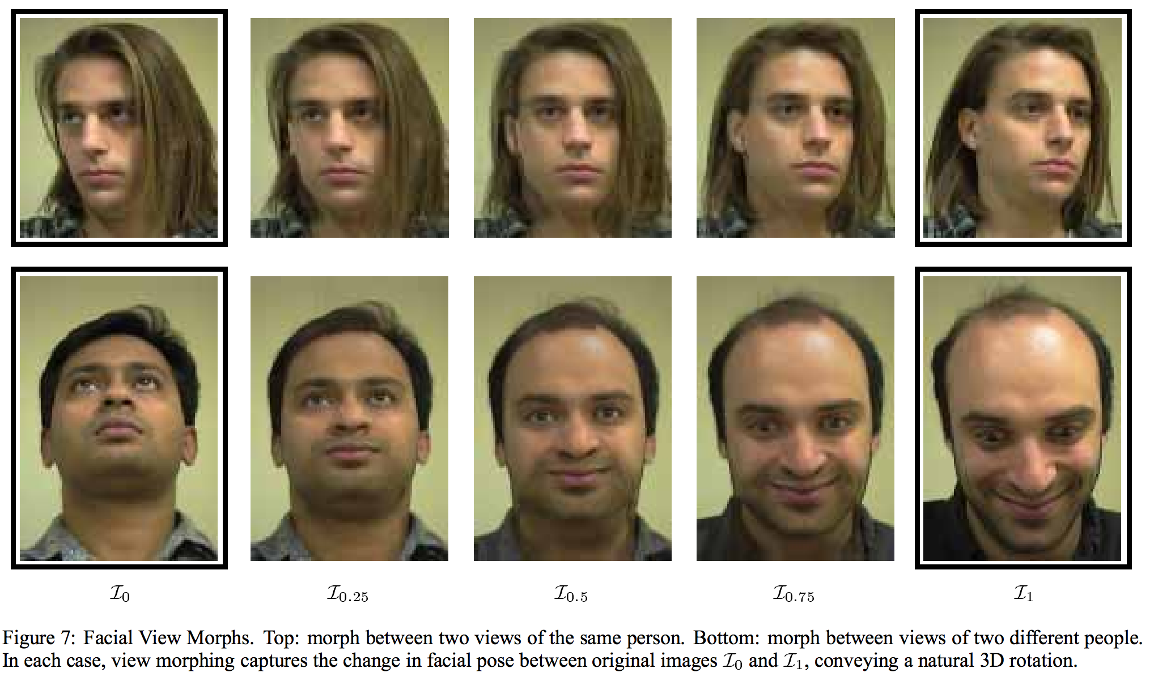
View morphing, Seitz and Dyer, Siggraph 1996

Slide 4
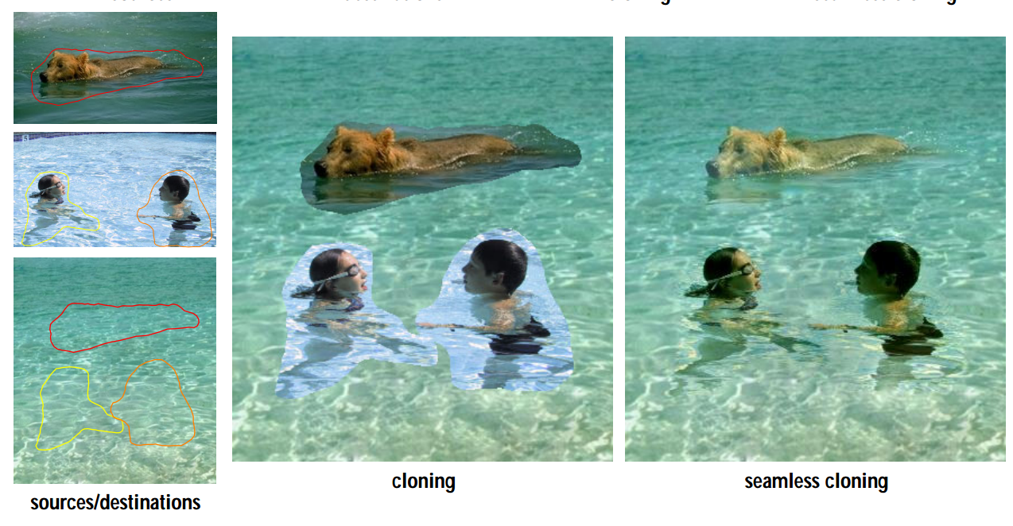
Poisson image editing, Perez et al., Siggraph 2003

Slide 5
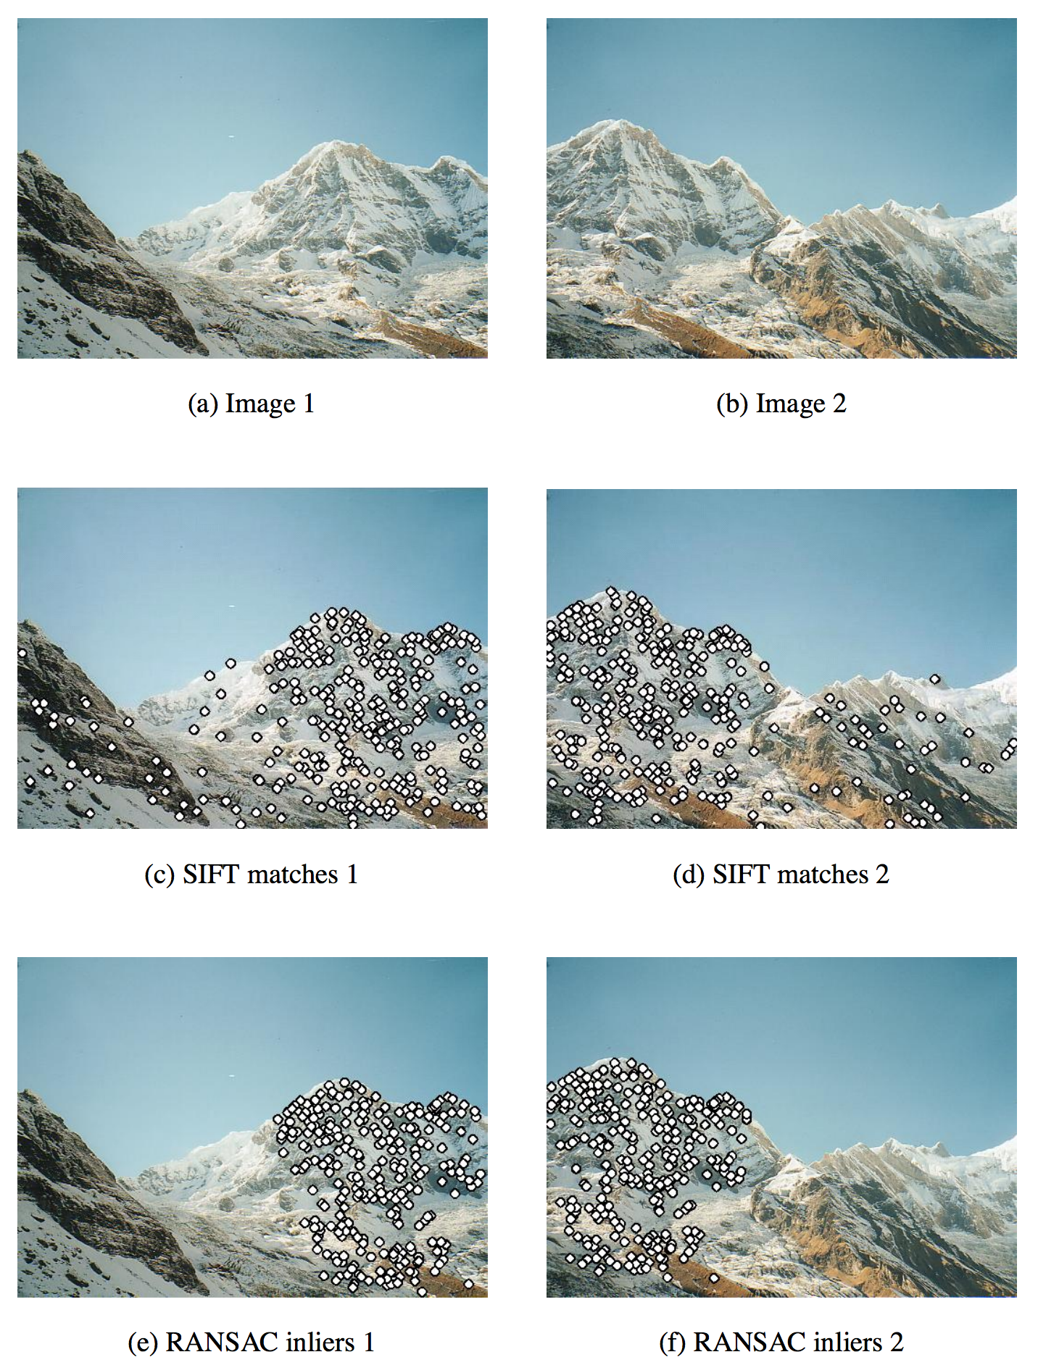
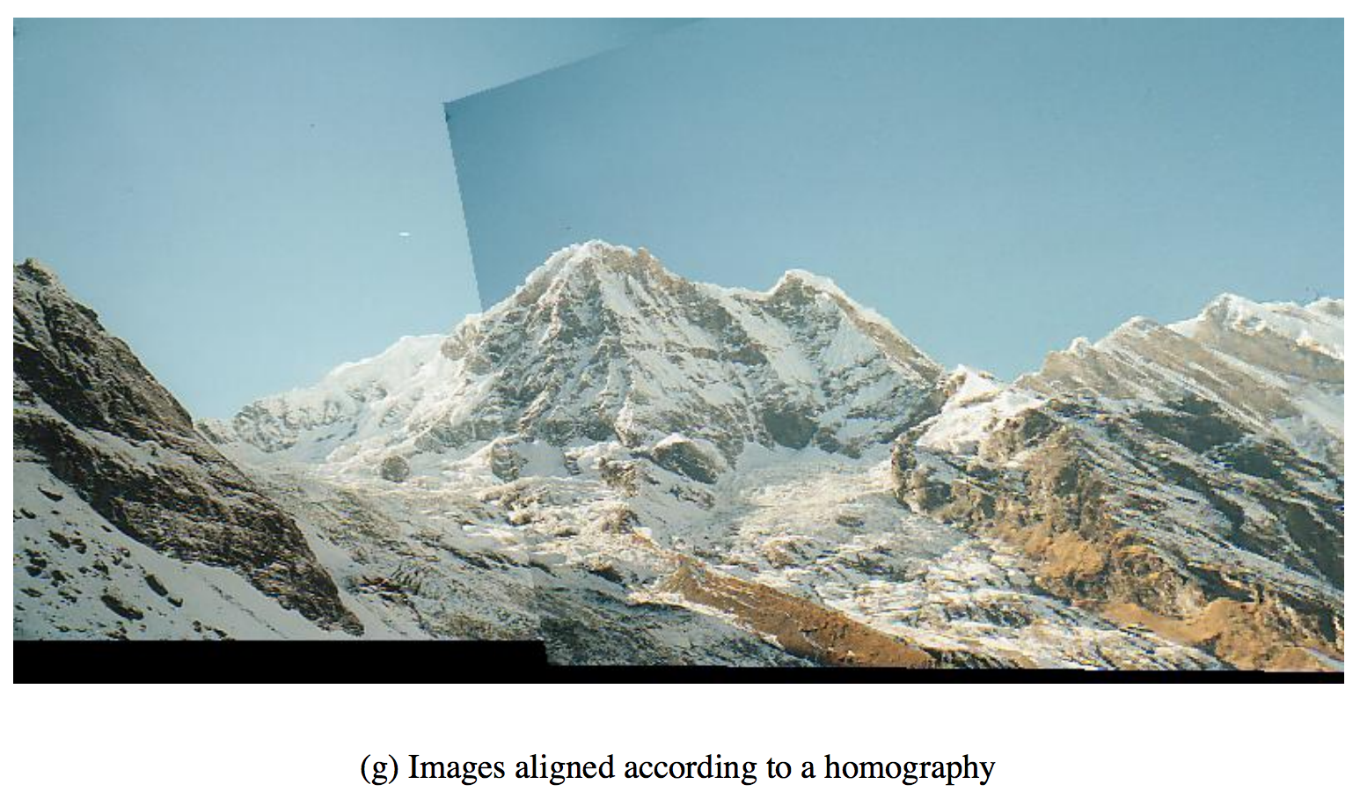
Automatic panoramic image stitching, Brown and Lowe, IJCV 2007`

Slide 6
Stabilized Ball Camera Video Link
BallCam!, Kitani et al., UIST 2012

Slide 7
Link to hyper-lapse video
First-person hyperlapse videos, Kopf et al Siggraph 2014

Slide 8
Link to Eulerian video magnification video
Eulerian video magnification, Wu et al Siggraph 2012

Slide 9
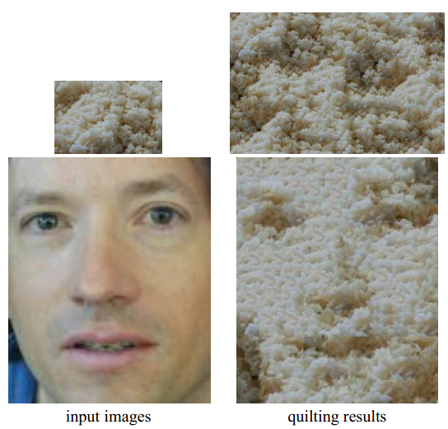
Image quilting, Efros and Freeman Siggraph 2001

Slide 10
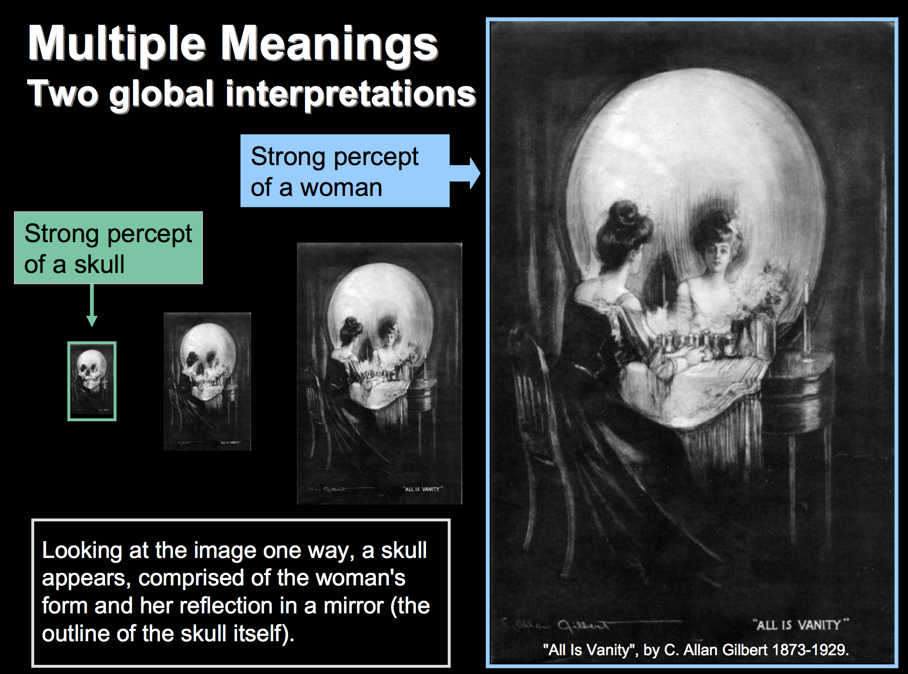
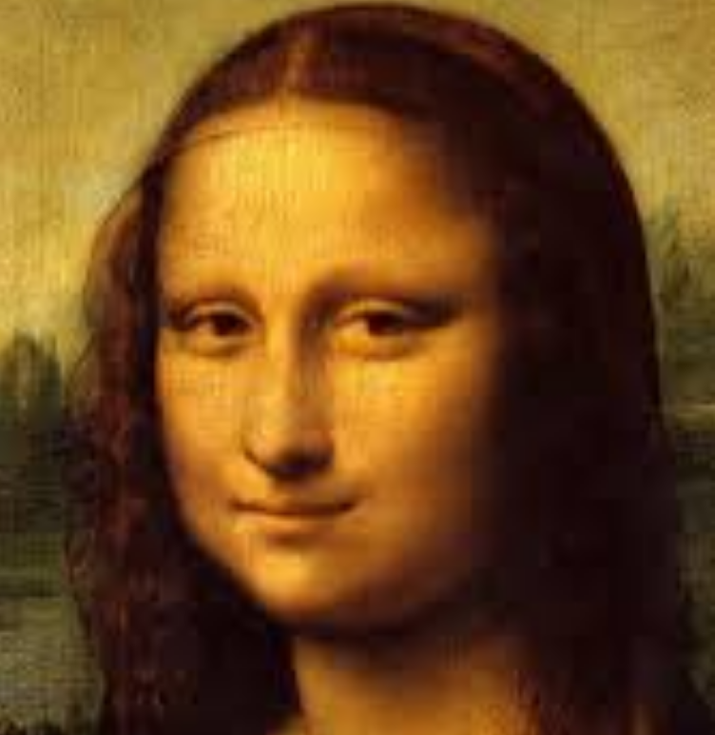
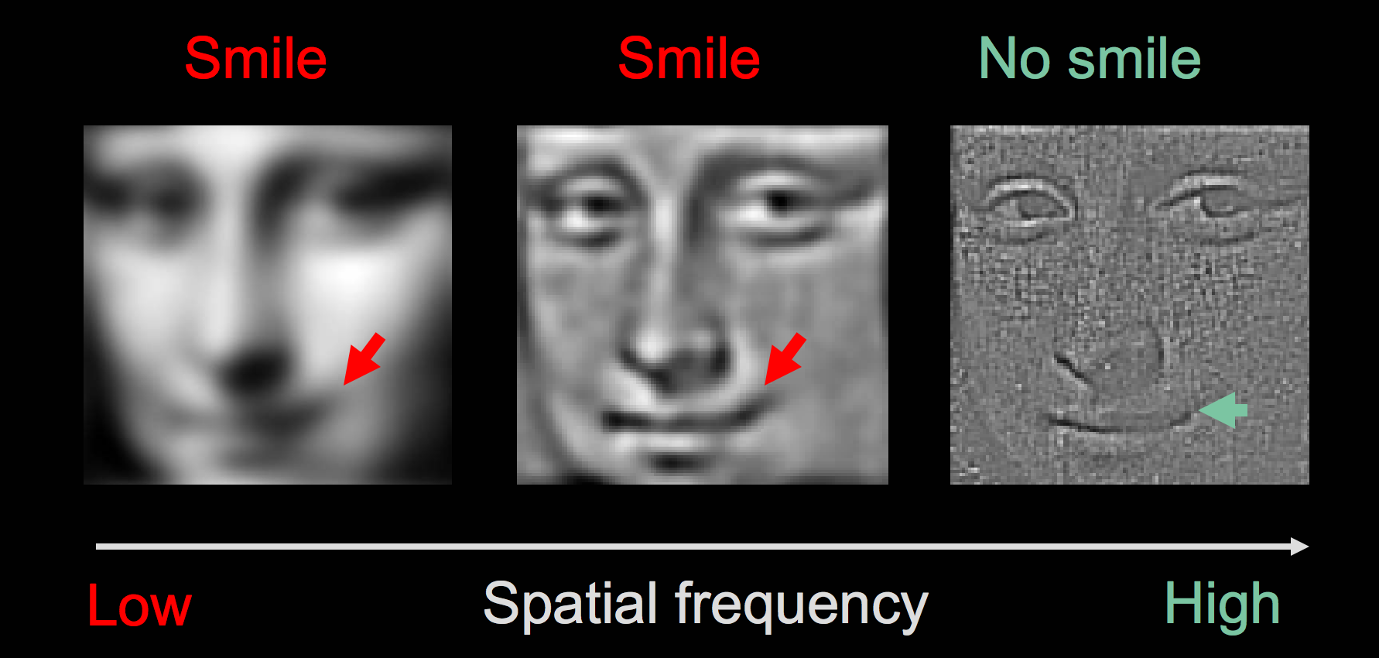
Hybrid images, Oliva et al., Siggraph 2006

Slide 11
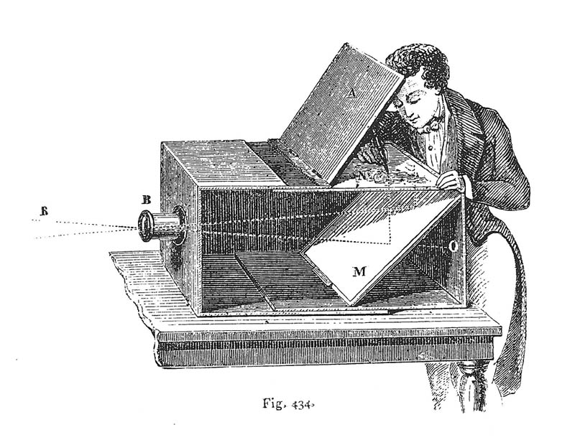
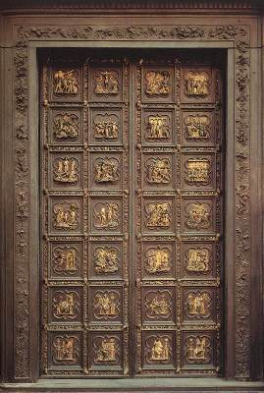
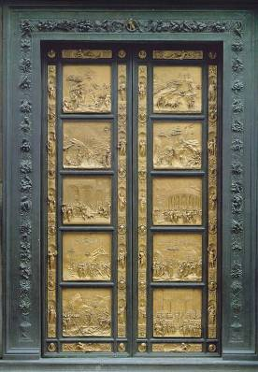
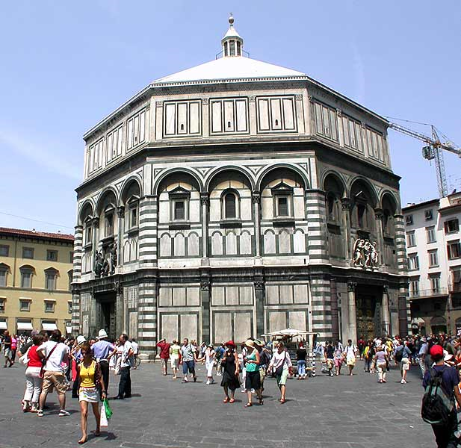
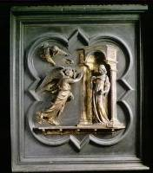
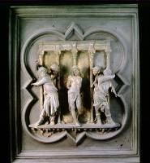
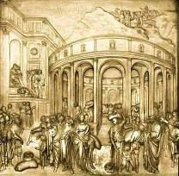
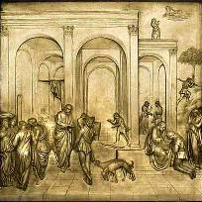
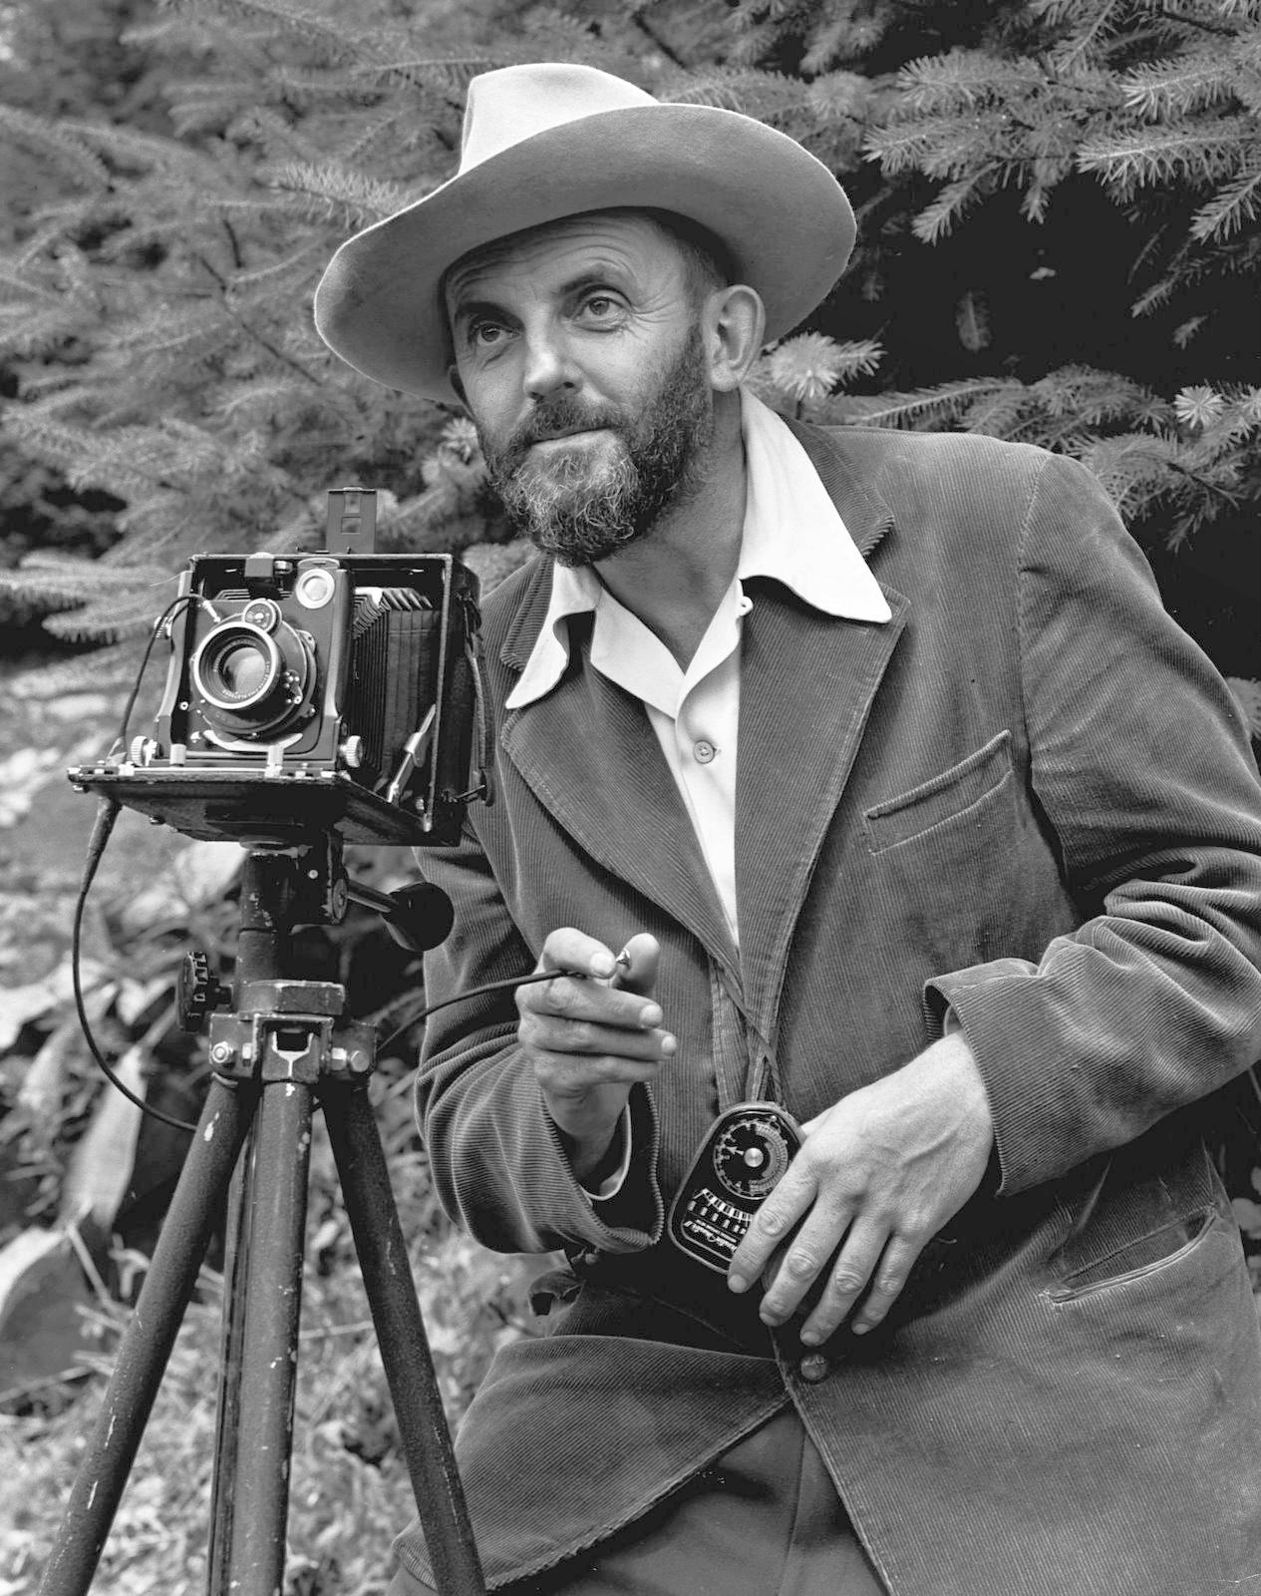
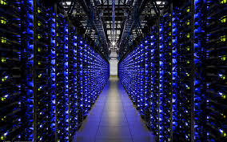
1. Artists as cameras
North Doors (1424)
Lorenzo
Ghiberti
(1378-1455)
East Doors (1452)
Lens Based Camera Obscura, 1568
2. Cameras as cameras
3. Computers as cameras

Slide 12






Introductions
I am Alex Berg. PhD 2005 from U.C. Berkeley in computer vision.
My research looks at recognition and large-scale machine learning in computer vision.
I worked at Yahoo! Research, Columbia University, Stony Brook University, and joined UNC computer science in Fall 2013.
This course is heavily derived from a course designed by Alexei Efros, an office-mate of mine in grad school many years ago, and the following slides in this lecture are from him and Steve Palmer at UC Berkeley except as noted.
Past Affiliations
Notes:
Add previous affiliations

Slide 13


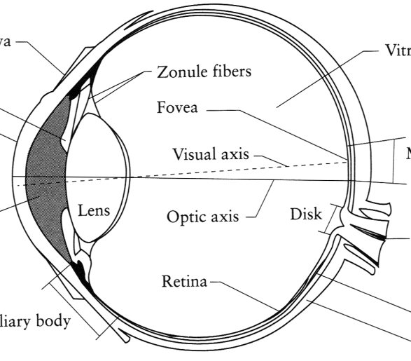
Image Formation
Digital Camera
Film
The Eye

Slide 14
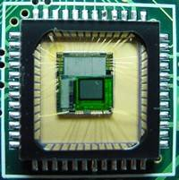
Sensor Array
CMOS sensor

Slide 15
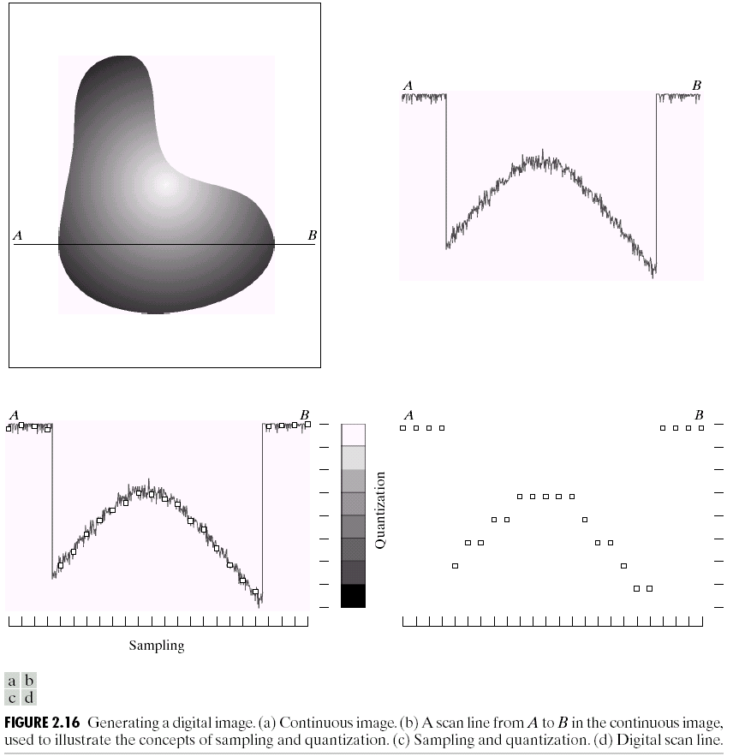
Sampling and Quantization

Slide 16
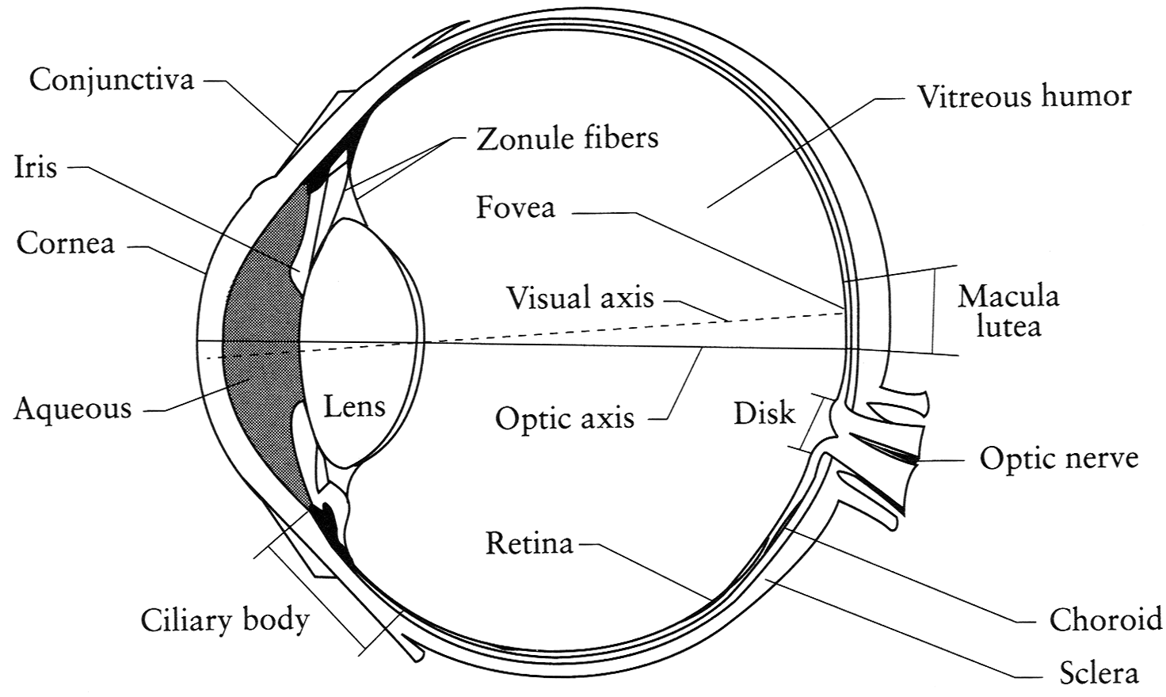
The Eye
The human eye is a camera!
  Iris - colored annulus with radial muscles
  Pupil - the hole (aperture) whose size is controlled by the iris
  What’s the “film”?
    photoreceptor cells (rods and cones) in the retina
Slide by Steve Seitz

Slide 17
The Retina

Slide 18
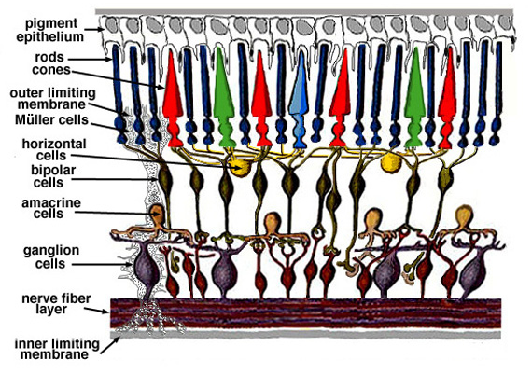
Retina up-close
Light

Slide 19
Two types of light-sensitive receptors
Cones
cone-shaped
less sensitive
operate in high light
color vision
Rods
rod-shaped
highly sensitive
operate at night
gray-scale vision
© Stephen E. Palmer, 2002

Slide 20
Distribution of Rods and Cones
Night Sky: why are there more stars off-center?
© Stephen E. Palmer, 2002

Slide 21
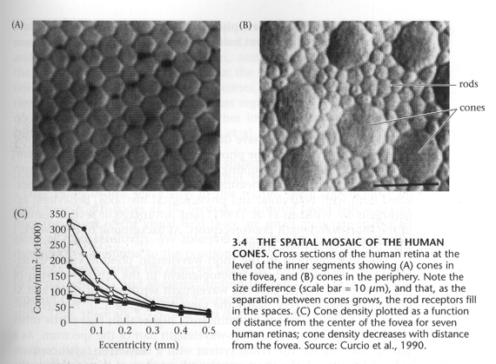
Foundations of Vision, by Brian Wandell, Sinauer Assoc., 1995

Slide 22
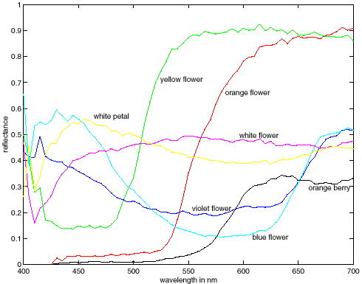
More Spectra
metamers

Slide 23
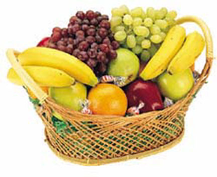
Color Constancy
The “photometer metaphor” of color perception:
Color perception is determined by the spectrum of light
on each retinal receptor (as measured by a photometer).
© Stephen E. Palmer, 2002

Slide 24
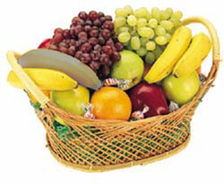
Color Constancy
The “photometer metaphor” of color perception:
Color perception is determined by the spectrum of light
on each retinal receptor (as measured by a photometer).
© Stephen E. Palmer, 2002

Slide 25
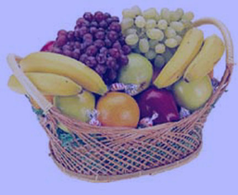
Color Constancy
The “photometer metaphor” of color perception:
Color perception is determined by the spectrum of light
on each retinal receptor (as measured by a photometer).
© Stephen E. Palmer, 2002

Slide 26
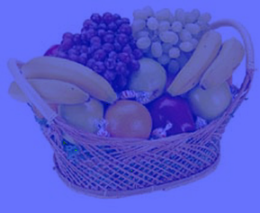
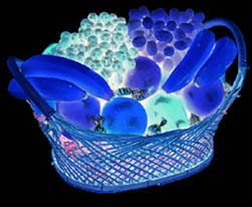
Color Constancy
Do we have constancy over
all global color transformations?
60% blue filter
Complete inversion
© Stephen E. Palmer, 2002

Slide 27
Color Constancy
Color Constancy: the ability to perceive the
invariant color of a surface despite ecological
Variations in the conditions of observation.
Another of these hard inverse problems:
Physics of light emission and surface reflection
underdetermine perception of surface color
© Stephen E. Palmer, 2002

Slide 28
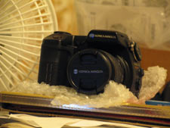
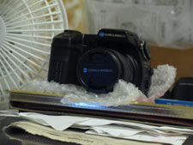
Camera White Balancing
Manual
  Choose color-neutral object in the photos and normalize
Automatic (AWB)
  Grey World: force average color of scene to grey
  White World: force brightest object to white

Slide 29
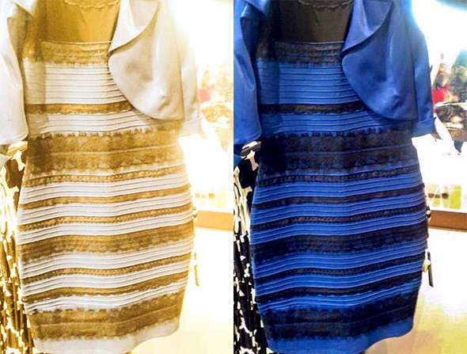
Recent real-world example
http://www.slate.com/blogs/the_slatest/2015/02/26/the_great_blue_and_black_versus_white_and_gold_dress_debate.html

Slide 30
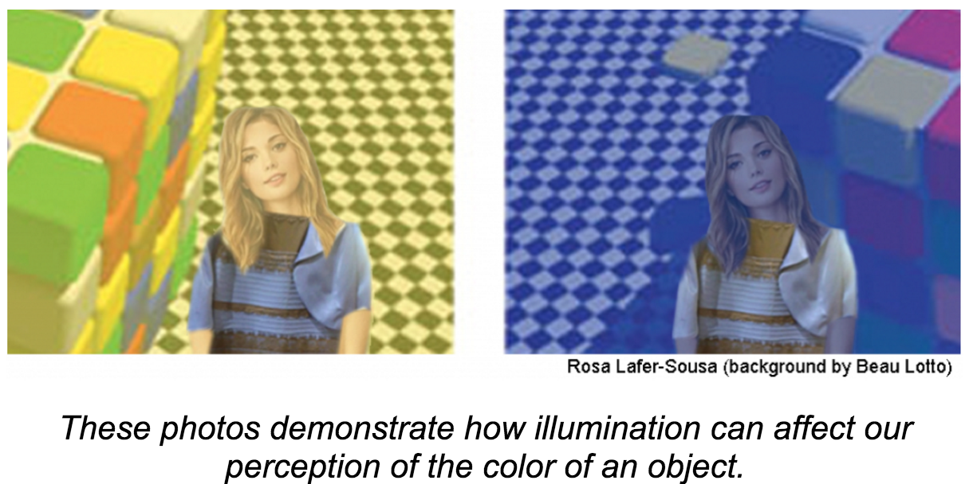
Recent real-world example
http://www.collegian.com/2015/03/dress-drama-debunked-the-explanation-behind-the-blue-black-or-white-gold-dress/115118/

Slide 31
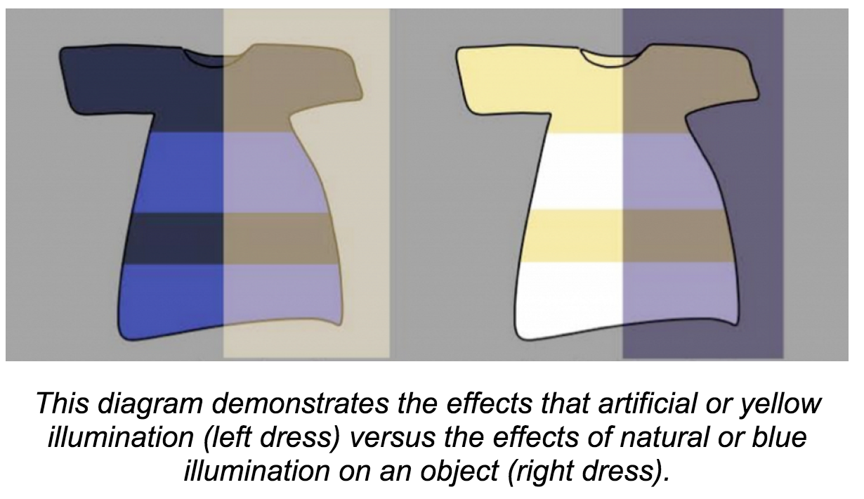
Recent real-world example
http://www.collegian.com/2015/03/dress-drama-debunked-the-explanation-behind-the-blue-black-or-white-gold-dress/115118/

Slide 32
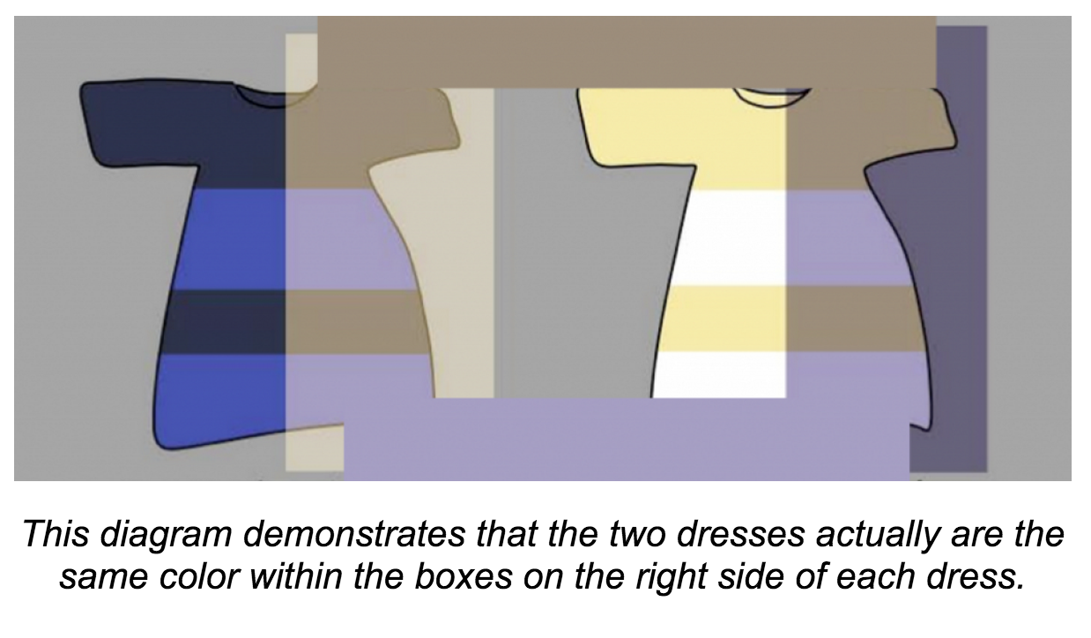
Recent real-world example
http://www.collegian.com/2015/03/dress-drama-debunked-the-explanation-behind-the-blue-black-or-white-gold-dress/115118/

Slide 33

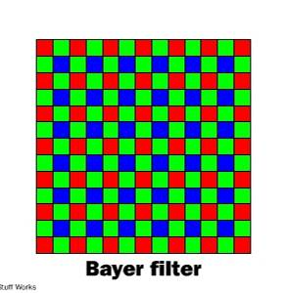
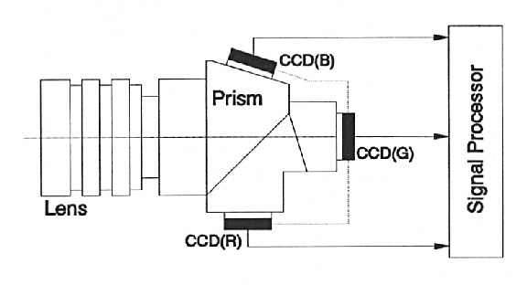
Color Sensing in Camera (RGB)
3-chip vs. 1-chip: quality vs. cost
Why more green?
Why 3 colors?
http://www.cooldictionary.com/words/Bayer-filter.wikipedia
Slide by Steve Seitz

Slide 34


Practical Color Sensing: Bayer Grid
Estimate RGB
at ‘G’ cels from neighboring values
http://www.cooldictionary.com/
words/Bayer-filter.wikipedia
Slide by Steve Seitz

Slide 35

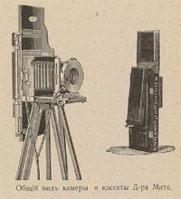
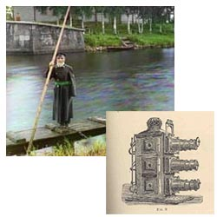
Programming Project #1
Prokudin-Gorskii’s Color Photography (1907)
Read in the three images for separate RGB channels.
Align the images and produce the color image.

Slide 36
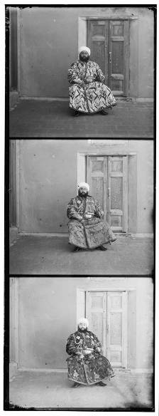
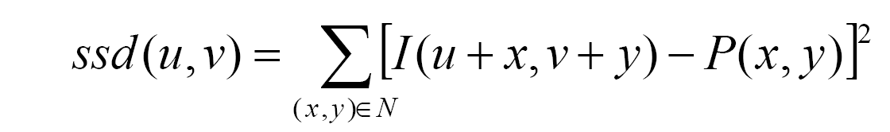
Programming Project #1
How to compare R,G,B channels?
No right answer
  Sum of Squared Differences (SSD):
  Normalized Correlation (NCC):

Slide 37
Other information
Course web page
http://acberg.com/comp_photog
Alexei Efros at CMU and U.C. Berkeley
http://inst.eecs.berkeley.edu/~cs194-26/fa15/
Derek Hoiem at University of Illinois Urbana Champaign
(Alyosha’s student, similar course)
https://courses.engr.illinois.edu/cs498dh3/fa2013/
Rick Szeliski’s textbook page
http://szeliski.org/Book/

Slide 38
For Next Class
Install matlab & image processing toolbox
https://software.sites.unc.edu/software/matlab/
Look over a matlab tutorial e.g.
  http://www.cs.unc.edu/~lazebnik/spring11/matlab.intro.html
Read chapter 1 in the Szeliski text

