Slide 1
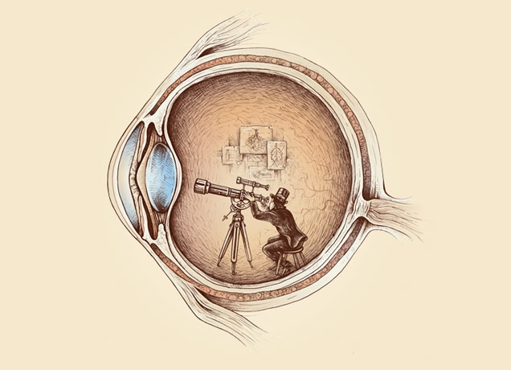
Computational Photography lecture 1-- recording light and filtering
CS 590 Spring 2016
Prof. Alex Berg
(Credits to many other folks on individual slides)

Slide 2






Introductions
I am Alex Berg. PhD 2005 from U.C. Berkeley in computer vision.
I work on recognition and large scale machine learning in computer vision.
I worked at Yahoo! Research, Columbia University, Stony Brook University, and joined UNC computer science in Fall 2013.
This course is heavily derived from a course designed by Alexei Efros, an office mate of mine in grad school many years ago.
Past Affiliations
Notes:
Add previous affiliations

Slide 3
From the reading
What is computer vision?
What is computer graphics?
What is computational photography?

Slide 4
Next section of slides from Alexei Efros, note many other sources for individual slides

Slide 5
PHOTOGRAPHY
Etymology
light
drawing
/ writing

Slide 6


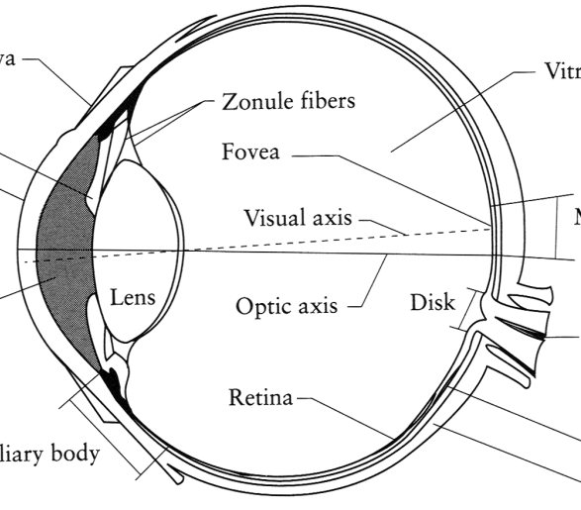
Image Formation
Digital Camera
Film
The Eye

Slide 7
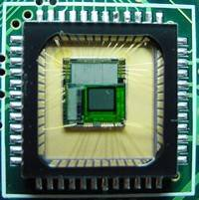
Sensor Array
CMOS sensor

Slide 8
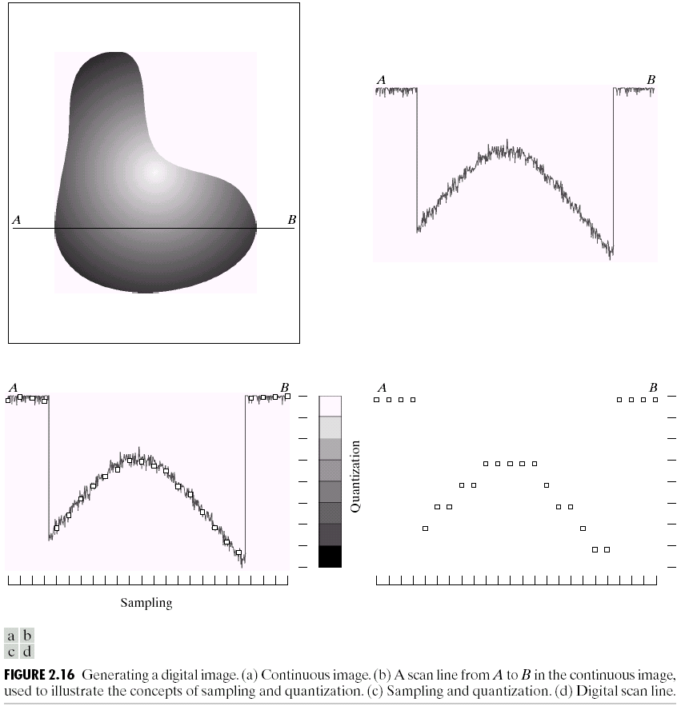
Sampling and Quantization

Slide 9
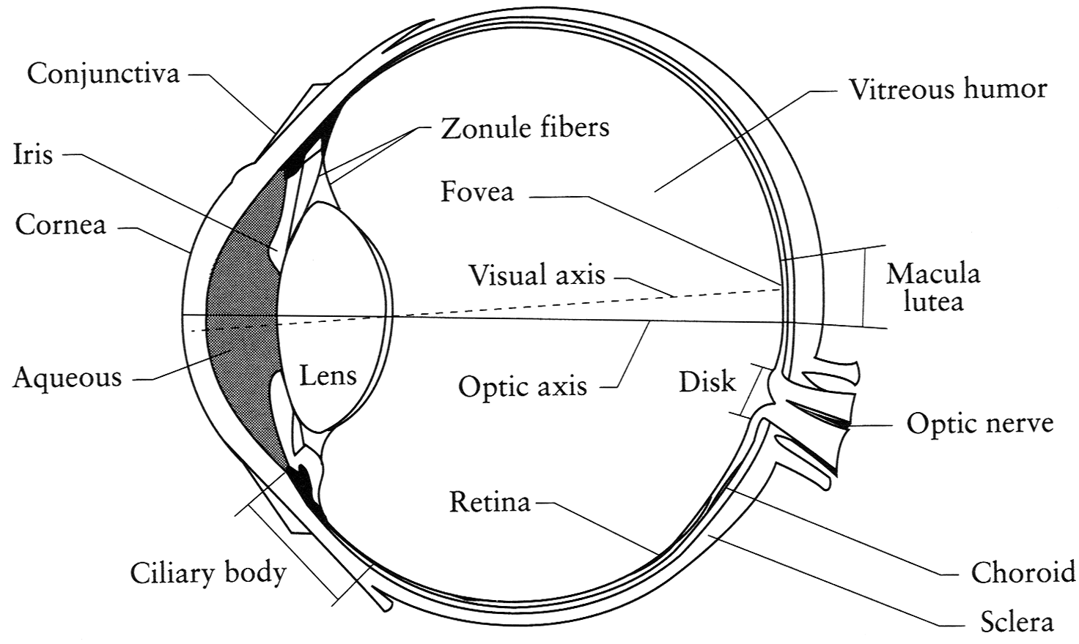
The Eye
The human eye is a camera!
  Iris - colored annulus with radial muscles
  Pupil - the hole (aperture) whose size is controlled by the iris
  What’s the “film”?
    photoreceptor cells (rods and cones) in the retina
Slide by Steve Seitz

Slide 10
The Retina

Slide 11
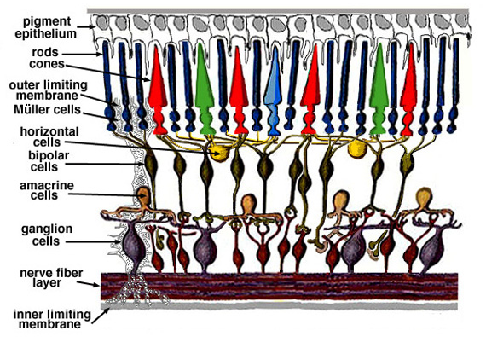
Retina up-close
Light

Slide 12
Two types of light-sensitive receptors
Cones
cone-shaped
less sensitive
operate in high light
color vision
Rods
rod-shaped
highly sensitive
operate at night
gray-scale vision
© Stephen E. Palmer, 2002

Slide 13
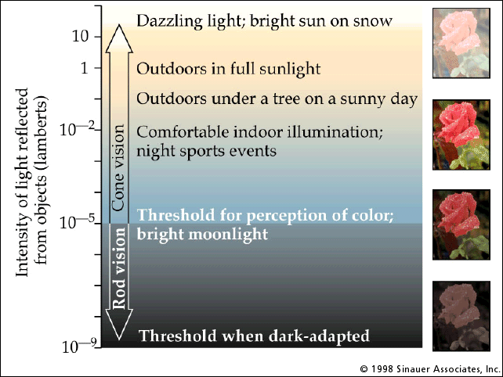
Rod / Cone sensitivity
The famous sock-matching problem…

Slide 14
Distribution of Rods and Cones
Night Sky: why are there more stars off-center?
© Stephen E. Palmer, 2002

Slide 15
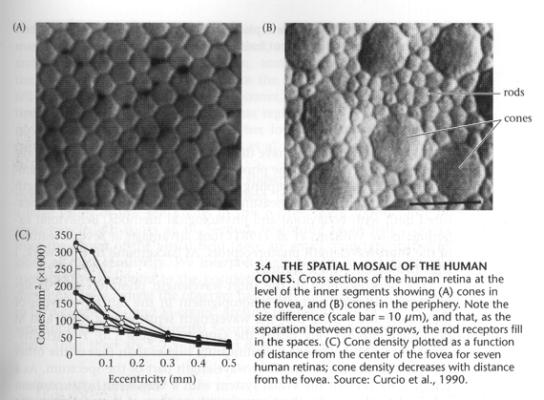
Foundations of Vision, by Brian Wandell, Sinauer Assoc., 1995

Slide 16
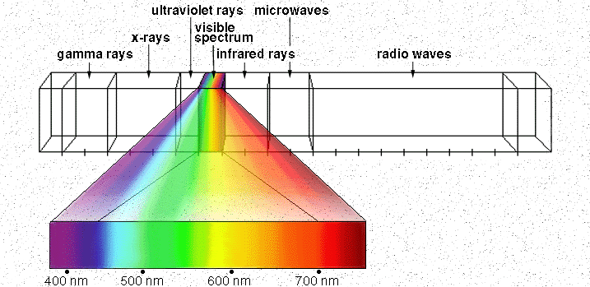

Electromagnetic Spectrum
Human Luminance Sensitivity Function
http://www.yorku.ca/eye/photopik.htm
Notes:
At least 3 spectral bands required (e.g. R,G,B)

Slide 17
Visible Light
Why do we see light of these wavelengths?
…because that’s where the
Sun radiates EM energy
© Stephen E. Palmer, 2002

Slide 18
The Physics of Light
Any patch of light can be completely described
physically by its spectrum: the number of photons
(per time unit) at each wavelength 400 - 700 nm.
© Stephen E. Palmer, 2002

Slide 19
The Physics of Light
Some examples of the spectra of light sources
© Stephen E. Palmer, 2002

Slide 20
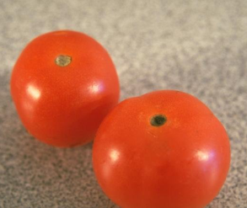
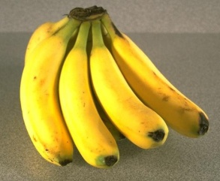
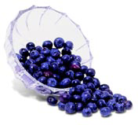
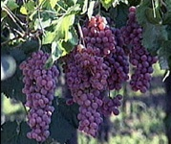
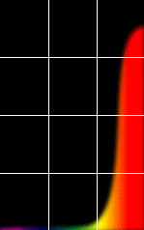
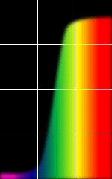
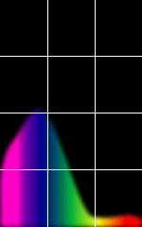
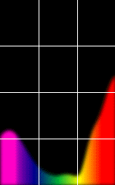
The Physics of Light
Some examples of the reflectance spectra of surfaces
Red
Yellow
Blue
Purple
% Photons Reflected
400 700
400 700
400 700
400 700
Wavelength (nm)
© Stephen E. Palmer, 2002

Slide 21
The Psychophysical Correspondence
There is no simple functional description for the perceived
color of all lights under all viewing conditions, but …...
A helpful constraint:
Consider only physical spectra with normal distributions
mean
area
variance
© Stephen E. Palmer, 2002

Slide 22
The Psychophysical Correspondence
Mean
Hue
# Photons
Wavelength
© Stephen E. Palmer, 2002

Slide 23
The Psychophysical Correspondence
Variance
Saturation
# Photons
Wavelength
© Stephen E. Palmer, 2002

Slide 24
The Psychophysical Correspondence
Area
Brightness
# Photons
Wavelength
© Stephen E. Palmer, 2002

Slide 25
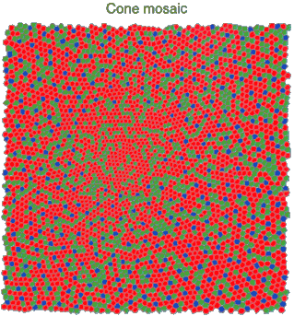
Physiology of Color Vision
Three kinds of cones:
Why are M and L cones so close?
Why are there 3?
© Stephen E. Palmer, 2002

Slide 26
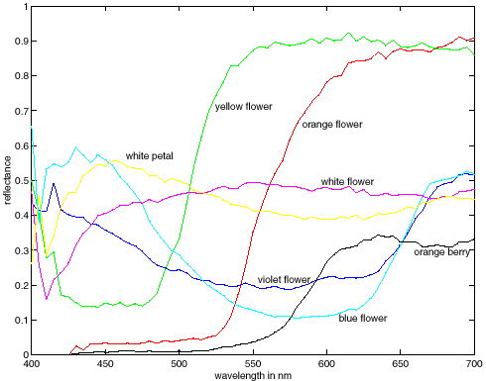
More Spectra
metamers

Slide 27
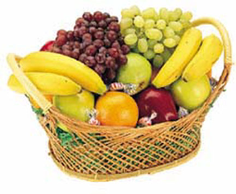
Color Constancy
The “photometer metaphor” of color perception:
Color perception is determined by the spectrum of light
on each retinal receptor (as measured by a photometer).
© Stephen E. Palmer, 2002

Slide 28
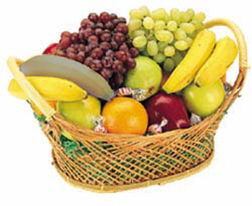
Color Constancy
The “photometer metaphor” of color perception:
Color perception is determined by the spectrum of light
on each retinal receptor (as measured by a photometer).
© Stephen E. Palmer, 2002

Slide 29
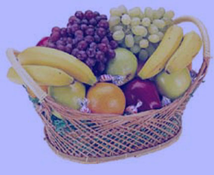
Color Constancy
The “photometer metaphor” of color perception:
Color perception is determined by the spectrum of light
on each retinal receptor (as measured by a photometer).
© Stephen E. Palmer, 2002

Slide 30
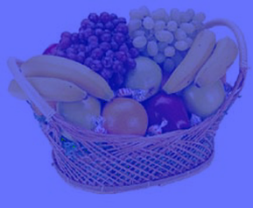
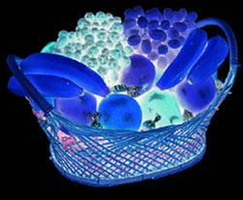
Color Constancy
Do we have constancy over
all global color transformations?
60% blue filter
Complete inversion
© Stephen E. Palmer, 2002

Slide 31
Color Constancy
Color Constancy: the ability to perceive the
invariant color of a surface despite ecological
Variations in the conditions of observation.
Another of these hard inverse problems:
Physics of light emission and surface reflection
underdetermine perception of surface color
© Stephen E. Palmer, 2002

Slide 32
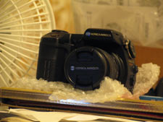
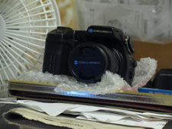
Camera White Balancing
Manual
  Choose color-neutral object in the photos and normalize
Automatic (AWB)
  Grey World: force average color of scene to grey
  White World: force brightest object to white

Slide 33
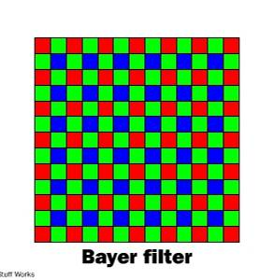
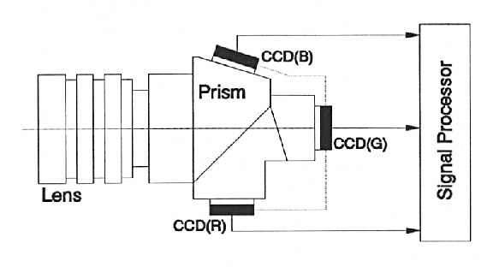
Color Sensing in Camera (RGB)
3-chip vs. 1-chip: quality vs. cost
Why more green?
Why 3 colors?
http://www.cooldictionary.com/words/Bayer-filter.wikipedia
Slide by Steve Seitz

Slide 34


Practical Color Sensing: Bayer Grid
Estimate RGB
at ‘G’ cels from neighboring values
http://www.cooldictionary.com/
words/Bayer-filter.wikipedia
Slide by Steve Seitz

Slide 35
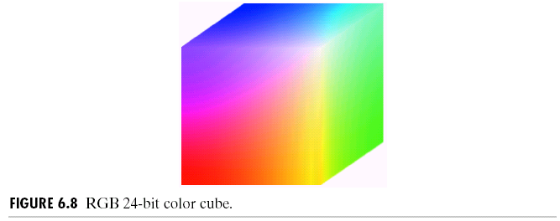
RGB color space
RGB cube
  Easy for devices
  But not perceptual
  Where do the grays live?
  Where is hue and saturation?
Slide by Steve Seitz

Slide 36
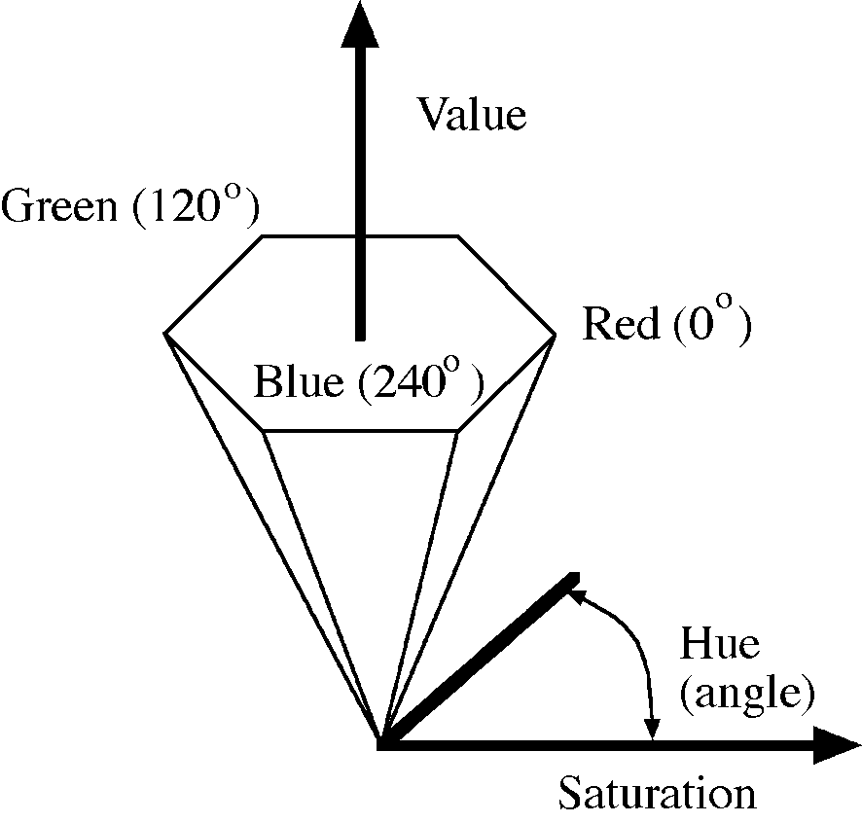
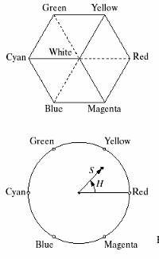
HSV
Hue, Saturation, Value (Intensity)
  RGB cube on its vertex
Decouples the three components (a bit)
Use rgb2hsv() and hsv2rgb() in Matlab
Slide by Steve Seitz

Slide 37

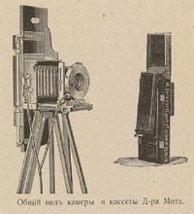
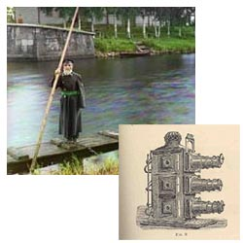
Programming Project #1
Prokudin-Gorskii’s Color Photography (1907)
Read in the three images for separate RGB channels.
Align the images and produce the color image.

Slide 38
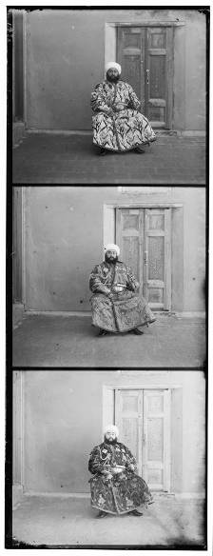
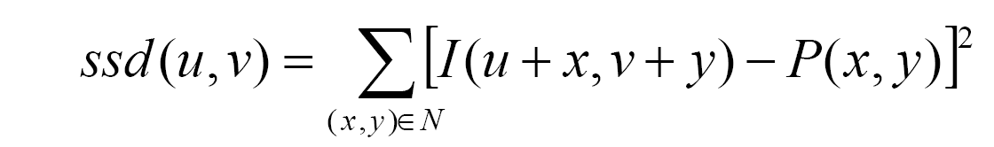
Programming Project #1
How to compare R,G,B channels?
No right answer
  Sum of Squared Differences (SSD):
  Normalized Correlation (NCC):

Slide 39
Next section of slides from Derek Hoiem, note many other sources for individual slides

Slide 40
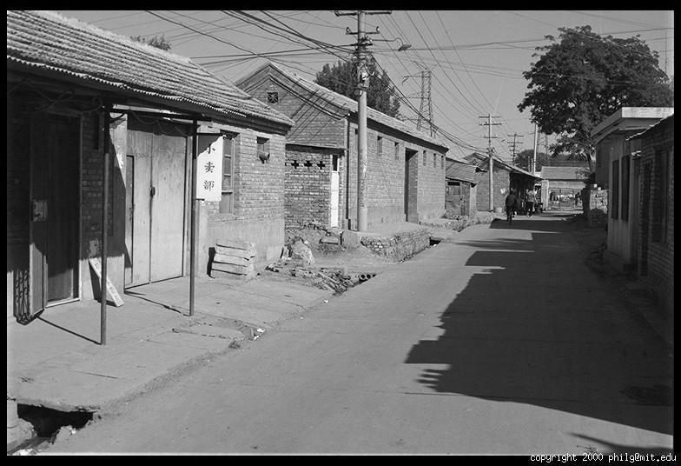
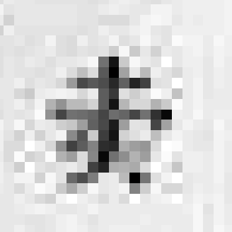
The raster image (pixel matrix)

Slide 41
The raster image (pixel matrix)
0.92 | 0.93 | 0.94 | 0.97 | 0.62 | 0.37 | 0.85 | 0.97 | 0.93 | 0.92 | 0.99
0.95 | 0.89 | 0.82 | 0.89 | 0.56 | 0.31 | 0.75 | 0.92 | 0.81 | 0.95 | 0.91
0.89 | 0.72 | 0.51 | 0.55 | 0.51 | 0.42 | 0.57 | 0.41 | 0.49 | 0.91 | 0.92
0.96 | 0.95 | 0.88 | 0.94 | 0.56 | 0.46 | 0.91 | 0.87 | 0.90 | 0.97 | 0.95
0.71 | 0.81 | 0.81 | 0.87 | 0.57 | 0.37 | 0.80 | 0.88 | 0.89 | 0.79 | 0.85
0.49 | 0.62 | 0.60 | 0.58 | 0.50 | 0.60 | 0.58 | 0.50 | 0.61 | 0.45 | 0.33
0.86 | 0.84 | 0.74 | 0.58 | 0.51 | 0.39 | 0.73 | 0.92 | 0.91 | 0.49 | 0.74
0.96 | 0.67 | 0.54 | 0.85 | 0.48 | 0.37 | 0.88 | 0.90 | 0.94 | 0.82 | 0.93
0.69 | 0.49 | 0.56 | 0.66 | 0.43 | 0.42 | 0.77 | 0.73 | 0.71 | 0.90 | 0.99
0.79 | 0.73 | 0.90 | 0.67 | 0.33 | 0.61 | 0.69 | 0.79 | 0.73 | 0.93 | 0.97
0.91 | 0.94 | 0.89 | 0.49 | 0.41 | 0.78 | 0.78 | 0.77 | 0.89 | 0.99 | 0.93

Slide 42
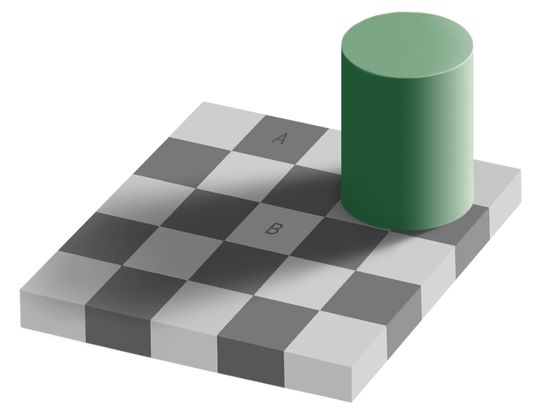
Perception of Intensity
from Ted Adelson

Slide 43
Perception of Intensity
from Ted Adelson

Slide 44
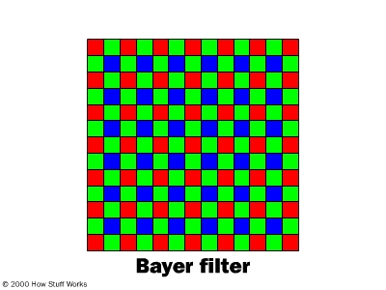
Digital Color Images

Slide 45
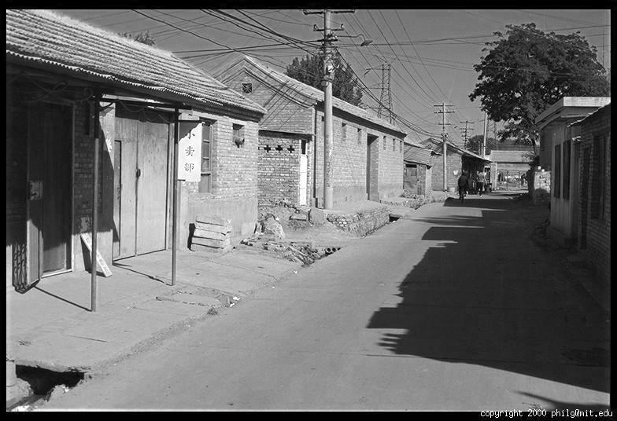
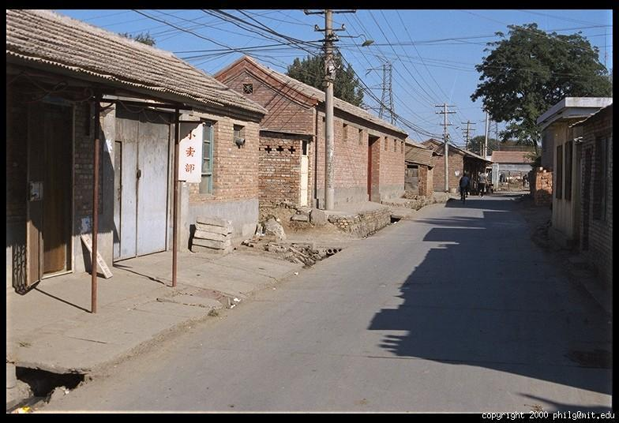
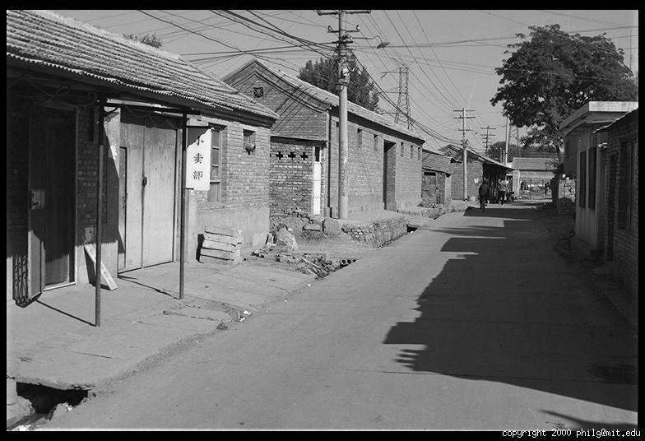
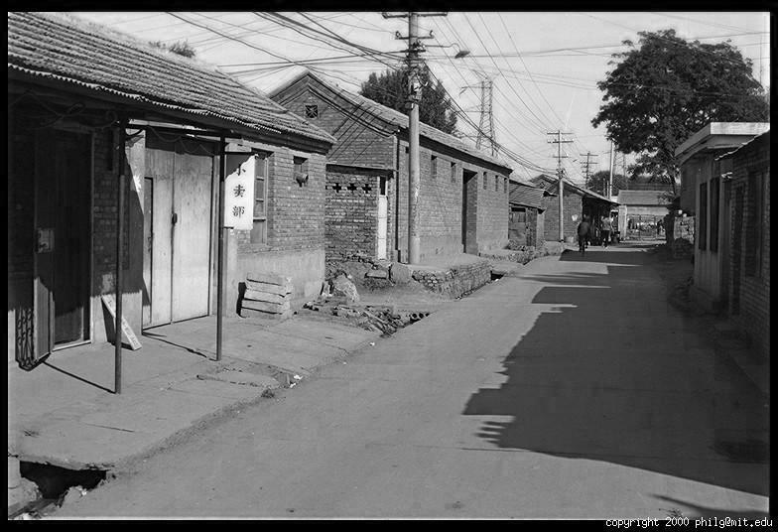
Color Image
R
G
B

Slide 46
Images in Matlab
Images represented as a matrix
Suppose we have a NxM RGB image called “im”
  im(1,1,1) = top-left pixel value in R-channel
  im(y, x, b) = y pixels down, x pixels to right in the b^{th} channel
  im(N, M, 3) = bottom-right pixel in B-channel
imread(filename) returns a uint8 image (values 0 to 255)
  Convert to double format (values 0 to 1) with im2double
column
row
R
0.92 | 0.93 | 0.94 | 0.97 | 0.62 | 0.37 | 0.85 | 0.97 | 0.93 | 0.92 | 0.99
0.95 | 0.89 | 0.82 | 0.89 | 0.56 | 0.31 | 0.75 | 0.92 | 0.81 | 0.95 | 0.91
0.89 | 0.72 | 0.51 | 0.55 | 0.51 | 0.42 | 0.57 | 0.41 | 0.49 | 0.91 | 0.92
0.96 | 0.95 | 0.88 | 0.94 | 0.56 | 0.46 | 0.91 | 0.87 | 0.90 | 0.97 | 0.95
0.71 | 0.81 | 0.81 | 0.87 | 0.57 | 0.37 | 0.80 | 0.88 | 0.89 | 0.79 | 0.85
0.49 | 0.62 | 0.60 | 0.58 | 0.50 | 0.60 | 0.58 | 0.50 | 0.61 | 0.45 | 0.33
0.86 | 0.84 | 0.74 | 0.58 | 0.51 | 0.39 | 0.73 | 0.92 | 0.91 | 0.49 | 0.74
0.96 | 0.67 | 0.54 | 0.85 | 0.48 | 0.37 | 0.88 | 0.90 | 0.94 | 0.82 | 0.93
0.69 | 0.49 | 0.56 | 0.66 | 0.43 | 0.42 | 0.77 | 0.73 | 0.71 | 0.90 | 0.99
0.79 | 0.73 | 0.90 | 0.67 | 0.33 | 0.61 | 0.69 | 0.79 | 0.73 | 0.93 | 0.97
0.91 | 0.94 | 0.89 | 0.49 | 0.41 | 0.78 | 0.78 | 0.77 | 0.89 | 0.99 | 0.93
G
0.92 | 0.93 | 0.94 | 0.97 | 0.62 | 0.37 | 0.85 | 0.97 | 0.93 | 0.92 | 0.99
0.95 | 0.89 | 0.82 | 0.89 | 0.56 | 0.31 | 0.75 | 0.92 | 0.81 | 0.95 | 0.91
0.89 | 0.72 | 0.51 | 0.55 | 0.51 | 0.42 | 0.57 | 0.41 | 0.49 | 0.91 | 0.92
0.96 | 0.95 | 0.88 | 0.94 | 0.56 | 0.46 | 0.91 | 0.87 | 0.90 | 0.97 | 0.95
0.71 | 0.81 | 0.81 | 0.87 | 0.57 | 0.37 | 0.80 | 0.88 | 0.89 | 0.79 | 0.85
0.49 | 0.62 | 0.60 | 0.58 | 0.50 | 0.60 | 0.58 | 0.50 | 0.61 | 0.45 | 0.33
0.86 | 0.84 | 0.74 | 0.58 | 0.51 | 0.39 | 0.73 | 0.92 | 0.91 | 0.49 | 0.74
0.96 | 0.67 | 0.54 | 0.85 | 0.48 | 0.37 | 0.88 | 0.90 | 0.94 | 0.82 | 0.93
0.69 | 0.49 | 0.56 | 0.66 | 0.43 | 0.42 | 0.77 | 0.73 | 0.71 | 0.90 | 0.99
0.79 | 0.73 | 0.90 | 0.67 | 0.33 | 0.61 | 0.69 | 0.79 | 0.73 | 0.93 | 0.97
0.91 | 0.94 | 0.89 | 0.49 | 0.41 | 0.78 | 0.78 | 0.77 | 0.89 | 0.99 | 0.93
B
0.92 | 0.93 | 0.94 | 0.97 | 0.62 | 0.37 | 0.85 | 0.97 | 0.93 | 0.92 | 0.99
0.95 | 0.89 | 0.82 | 0.89 | 0.56 | 0.31 | 0.75 | 0.92 | 0.81 | 0.95 | 0.91
0.89 | 0.72 | 0.51 | 0.55 | 0.51 | 0.42 | 0.57 | 0.41 | 0.49 | 0.91 | 0.92
0.96 | 0.95 | 0.88 | 0.94 | 0.56 | 0.46 | 0.91 | 0.87 | 0.90 | 0.97 | 0.95
0.71 | 0.81 | 0.81 | 0.87 | 0.57 | 0.37 | 0.80 | 0.88 | 0.89 | 0.79 | 0.85
0.49 | 0.62 | 0.60 | 0.58 | 0.50 | 0.60 | 0.58 | 0.50 | 0.61 | 0.45 | 0.33
0.86 | 0.84 | 0.74 | 0.58 | 0.51 | 0.39 | 0.73 | 0.92 | 0.91 | 0.49 | 0.74
0.96 | 0.67 | 0.54 | 0.85 | 0.48 | 0.37 | 0.88 | 0.90 | 0.94 | 0.82 | 0.93
0.69 | 0.49 | 0.56 | 0.66 | 0.43 | 0.42 | 0.77 | 0.73 | 0.71 | 0.90 | 0.99
0.79 | 0.73 | 0.90 | 0.67 | 0.33 | 0.61 | 0.69 | 0.79 | 0.73 | 0.93 | 0.97
0.91 | 0.94 | 0.89 | 0.49 | 0.41 | 0.78 | 0.78 | 0.77 | 0.89 | 0.99 | 0.93

Slide 47
Image filtering
Image filtering: compute function of local neighborhood at each position
Really important!
  Enhance images
    Denoise, resize, increase contrast, etc.
  Extract information from images
    Texture, edges, distinctive points, etc.
  Detect patterns
    Template matching

Slide 48

Example: box filter
1
1
1
1
1
1
1
1
1
Slide credit: David Lowe (UBC)

Slide 49
Image filtering
1
1
1
1
1
1
1
1
1
0 | 0 | 0 | 0 | 0 | 0 | 0 | 0 | 0 | 0
0 | 0 | 0 | 0 | 0 | 0 | 0 | 0 | 0 | 0
0 | 0 | 0 | 90 | 90 | 90 | 90 | 90 | 0 | 0
0 | 0 | 0 | 90 | 90 | 90 | 90 | 90 | 0 | 0
0 | 0 | 0 | 90 | 90 | 90 | 90 | 90 | 0 | 0
0 | 0 | 0 | 90 | 0 | 90 | 90 | 90 | 0 | 0
0 | 0 | 0 | 90 | 90 | 90 | 90 | 90 | 0 | 0
0 | 0 | 0 | 0 | 0 | 0 | 0 | 0 | 0 | 0
0 | 0 | 90 | 0 | 0 | 0 | 0 | 0 | 0 | 0
0 | 0 | 0 | 0 | 0 | 0 | 0 | 0 | 0 | 0
 | 0
0 | 0 | 0 | 0 | 0 | 0 | 0 | 0 | 0 | 0
0 | 0 | 0 | 0 | 0 | 0 | 0 | 0 | 0 | 0
0 | 0 | 0 | 90 | 90 | 90 | 90 | 90 | 0 | 0
0 | 0 | 0 | 90 | 90 | 90 | 90 | 90 | 0 | 0
0 | 0 | 0 | 90 | 90 | 90 | 90 | 90 | 0 | 0
0 | 0 | 0 | 90 | 0 | 90 | 90 | 90 | 0 | 0
0 | 0 | 0 | 90 | 90 | 90 | 90 | 90 | 0 | 0
0 | 0 | 0 | 0 | 0 | 0 | 0 | 0 | 0 | 0
0 | 0 | 90 | 0 | 0 | 0 | 0 | 0 | 0 | 0
0 | 0 | 0 | 0 | 0 | 0 | 0 | 0 | 0 | 0
Credit: S. Seitz
Notes:
ones, divide by 9

Slide 50
Image filtering
1
1
1
1
1
1
1
1
1
0 | 0 | 0 | 0 | 0 | 0 | 0 | 0 | 0 | 0
0 | 0 | 0 | 0 | 0 | 0 | 0 | 0 | 0 | 0
0 | 0 | 0 | 90 | 90 | 90 | 90 | 90 | 0 | 0
0 | 0 | 0 | 90 | 90 | 90 | 90 | 90 | 0 | 0
0 | 0 | 0 | 90 | 90 | 90 | 90 | 90 | 0 | 0
0 | 0 | 0 | 90 | 0 | 90 | 90 | 90 | 0 | 0
0 | 0 | 0 | 90 | 90 | 90 | 90 | 90 | 0 | 0
0 | 0 | 0 | 0 | 0 | 0 | 0 | 0 | 0 | 0
0 | 0 | 90 | 0 | 0 | 0 | 0 | 0 | 0 | 0
0 | 0 | 0 | 0 | 0 | 0 | 0 | 0 | 0 | 0
 | 0 | 10
0 | 0 | 0 | 0 | 0 | 0 | 0 | 0 | 0 | 0
0 | 0 | 0 | 0 | 0 | 0 | 0 | 0 | 0 | 0
0 | 0 | 0 | 90 | 90 | 90 | 90 | 90 | 0 | 0
0 | 0 | 0 | 90 | 90 | 90 | 90 | 90 | 0 | 0
0 | 0 | 0 | 90 | 90 | 90 | 90 | 90 | 0 | 0
0 | 0 | 0 | 90 | 0 | 90 | 90 | 90 | 0 | 0
0 | 0 | 0 | 90 | 90 | 90 | 90 | 90 | 0 | 0
0 | 0 | 0 | 0 | 0 | 0 | 0 | 0 | 0 | 0
0 | 0 | 90 | 0 | 0 | 0 | 0 | 0 | 0 | 0
0 | 0 | 0 | 0 | 0 | 0 | 0 | 0 | 0 | 0
Credit: S. Seitz
Notes:
ones, divide by 9

Slide 51
Image filtering
1
1
1
1
1
1
1
1
1
0 | 0 | 0 | 0 | 0 | 0 | 0 | 0 | 0 | 0
0 | 0 | 0 | 0 | 0 | 0 | 0 | 0 | 0 | 0
0 | 0 | 0 | 90 | 90 | 90 | 90 | 90 | 0 | 0
0 | 0 | 0 | 90 | 90 | 90 | 90 | 90 | 0 | 0
0 | 0 | 0 | 90 | 90 | 90 | 90 | 90 | 0 | 0
0 | 0 | 0 | 90 | 0 | 90 | 90 | 90 | 0 | 0
0 | 0 | 0 | 90 | 90 | 90 | 90 | 90 | 0 | 0
0 | 0 | 0 | 0 | 0 | 0 | 0 | 0 | 0 | 0
0 | 0 | 90 | 0 | 0 | 0 | 0 | 0 | 0 | 0
0 | 0 | 0 | 0 | 0 | 0 | 0 | 0 | 0 | 0
 | 0 | 10 | 20
0 | 0 | 0 | 0 | 0 | 0 | 0 | 0 | 0 | 0
0 | 0 | 0 | 0 | 0 | 0 | 0 | 0 | 0 | 0
0 | 0 | 0 | 90 | 90 | 90 | 90 | 90 | 0 | 0
0 | 0 | 0 | 90 | 90 | 90 | 90 | 90 | 0 | 0
0 | 0 | 0 | 90 | 90 | 90 | 90 | 90 | 0 | 0
0 | 0 | 0 | 90 | 0 | 90 | 90 | 90 | 0 | 0
0 | 0 | 0 | 90 | 90 | 90 | 90 | 90 | 0 | 0
0 | 0 | 0 | 0 | 0 | 0 | 0 | 0 | 0 | 0
0 | 0 | 90 | 0 | 0 | 0 | 0 | 0 | 0 | 0
0 | 0 | 0 | 0 | 0 | 0 | 0 | 0 | 0 | 0
Credit: S. Seitz
Notes:
ones, divide by 9

Slide 52
Image filtering
1
1
1
1
1
1
1
1
1
0 | 0 | 0 | 0 | 0 | 0 | 0 | 0 | 0 | 0
0 | 0 | 0 | 0 | 0 | 0 | 0 | 0 | 0 | 0
0 | 0 | 0 | 90 | 90 | 90 | 90 | 90 | 0 | 0
0 | 0 | 0 | 90 | 90 | 90 | 90 | 90 | 0 | 0
0 | 0 | 0 | 90 | 90 | 90 | 90 | 90 | 0 | 0
0 | 0 | 0 | 90 | 0 | 90 | 90 | 90 | 0 | 0
0 | 0 | 0 | 90 | 90 | 90 | 90 | 90 | 0 | 0
0 | 0 | 0 | 0 | 0 | 0 | 0 | 0 | 0 | 0
0 | 0 | 90 | 0 | 0 | 0 | 0 | 0 | 0 | 0
0 | 0 | 0 | 0 | 0 | 0 | 0 | 0 | 0 | 0
 | 0 | 10 | 20 | 30
0 | 0 | 0 | 0 | 0 | 0 | 0 | 0 | 0 | 0
0 | 0 | 0 | 0 | 0 | 0 | 0 | 0 | 0 | 0
0 | 0 | 0 | 90 | 90 | 90 | 90 | 90 | 0 | 0
0 | 0 | 0 | 90 | 90 | 90 | 90 | 90 | 0 | 0
0 | 0 | 0 | 90 | 90 | 90 | 90 | 90 | 0 | 0
0 | 0 | 0 | 90 | 0 | 90 | 90 | 90 | 0 | 0
0 | 0 | 0 | 90 | 90 | 90 | 90 | 90 | 0 | 0
0 | 0 | 0 | 0 | 0 | 0 | 0 | 0 | 0 | 0
0 | 0 | 90 | 0 | 0 | 0 | 0 | 0 | 0 | 0
0 | 0 | 0 | 0 | 0 | 0 | 0 | 0 | 0 | 0
Credit: S. Seitz
Notes:
ones, divide by 9

Slide 53
Image filtering
1
1
1
1
1
1
1
1
1
0 | 0 | 0 | 0 | 0 | 0 | 0 | 0 | 0 | 0
0 | 0 | 0 | 0 | 0 | 0 | 0 | 0 | 0 | 0
0 | 0 | 0 | 90 | 90 | 90 | 90 | 90 | 0 | 0
0 | 0 | 0 | 90 | 90 | 90 | 90 | 90 | 0 | 0
0 | 0 | 0 | 90 | 90 | 90 | 90 | 90 | 0 | 0
0 | 0 | 0 | 90 | 0 | 90 | 90 | 90 | 0 | 0
0 | 0 | 0 | 90 | 90 | 90 | 90 | 90 | 0 | 0
0 | 0 | 0 | 0 | 0 | 0 | 0 | 0 | 0 | 0
0 | 0 | 90 | 0 | 0 | 0 | 0 | 0 | 0 | 0
0 | 0 | 0 | 0 | 0 | 0 | 0 | 0 | 0 | 0
 | 0 | 10 | 20 | 30 | 30
Credit: S. Seitz
Notes:
ones, divide by 9

Slide 54
Image filtering
1
1
1
1
1
1
1
1
1
0 | 0 | 0 | 0 | 0 | 0 | 0 | 0 | 0 | 0
0 | 0 | 0 | 0 | 0 | 0 | 0 | 0 | 0 | 0
0 | 0 | 0 | 90 | 90 | 90 | 90 | 90 | 0 | 0
0 | 0 | 0 | 90 | 90 | 90 | 90 | 90 | 0 | 0
0 | 0 | 0 | 90 | 90 | 90 | 90 | 90 | 0 | 0
0 | 0 | 0 | 90 | 0 | 90 | 90 | 90 | 0 | 0
0 | 0 | 0 | 90 | 90 | 90 | 90 | 90 | 0 | 0
0 | 0 | 0 | 0 | 0 | 0 | 0 | 0 | 0 | 0
0 | 0 | 90 | 0 | 0 | 0 | 0 | 0 | 0 | 0
0 | 0 | 0 | 0 | 0 | 0 | 0 | 0 | 0 | 0
 | 0 | 10 | 20 | 30 | 30
?
Credit: S. Seitz
Notes:
ones, divide by 9

Slide 55
Image filtering
1
1
1
1
1
1
1
1
1
0 | 0 | 0 | 0 | 0 | 0 | 0 | 0 | 0 | 0
0 | 0 | 0 | 0 | 0 | 0 | 0 | 0 | 0 | 0
0 | 0 | 0 | 90 | 90 | 90 | 90 | 90 | 0 | 0
0 | 0 | 0 | 90 | 90 | 90 | 90 | 90 | 0 | 0
0 | 0 | 0 | 90 | 90 | 90 | 90 | 90 | 0 | 0
0 | 0 | 0 | 90 | 0 | 90 | 90 | 90 | 0 | 0
0 | 0 | 0 | 90 | 90 | 90 | 90 | 90 | 0 | 0
0 | 0 | 0 | 0 | 0 | 0 | 0 | 0 | 0 | 0
0 | 0 | 90 | 0 | 0 | 0 | 0 | 0 | 0 | 0
0 | 0 | 0 | 0 | 0 | 0 | 0 | 0 | 0 | 0
 | 0 | 10 | 20 | 30 | 30
 |  |  |  | 50
?
Credit: S. Seitz
Notes:
ones, divide by 9

Slide 56
Image filtering
1
1
1
1
1
1
1
1
1
0 | 0 | 0 | 0 | 0 | 0 | 0 | 0 | 0 | 0
0 | 0 | 0 | 0 | 0 | 0 | 0 | 0 | 0 | 0
0 | 0 | 0 | 90 | 90 | 90 | 90 | 90 | 0 | 0
0 | 0 | 0 | 90 | 90 | 90 | 90 | 90 | 0 | 0
0 | 0 | 0 | 90 | 90 | 90 | 90 | 90 | 0 | 0
0 | 0 | 0 | 90 | 0 | 90 | 90 | 90 | 0 | 0
0 | 0 | 0 | 90 | 90 | 90 | 90 | 90 | 0 | 0
0 | 0 | 0 | 0 | 0 | 0 | 0 | 0 | 0 | 0
0 | 0 | 90 | 0 | 0 | 0 | 0 | 0 | 0 | 0
0 | 0 | 0 | 0 | 0 | 0 | 0 | 0 | 0 | 0
 | 0 | 10 | 20 | 30 | 30
 |  |  |  | 50
Intuitively, what’s happening?
Credit: S. Seitz

Slide 57
Image filtering
1
1
1
1
1
1
1
1
1
0 | 0 | 0 | 0 | 0 | 0 | 0 | 0 | 0 | 0
0 | 0 | 0 | 0 | 0 | 0 | 0 | 0 | 0 | 0
0 | 0 | 0 | 90 | 90 | 90 | 90 | 90 | 0 | 0
0 | 0 | 0 | 90 | 90 | 90 | 90 | 90 | 0 | 0
0 | 0 | 0 | 90 | 90 | 90 | 90 | 90 | 0 | 0
0 | 0 | 0 | 90 | 0 | 90 | 90 | 90 | 0 | 0
0 | 0 | 0 | 90 | 90 | 90 | 90 | 90 | 0 | 0
0 | 0 | 0 | 0 | 0 | 0 | 0 | 0 | 0 | 0
0 | 0 | 90 | 0 | 0 | 0 | 0 | 0 | 0 | 0
0 | 0 | 0 | 0 | 0 | 0 | 0 | 0 | 0 | 0
 | 0 | 10 | 20 | 30 | 30 | 30 | 20 | 10
 | 0 | 20 | 40 | 60 | 60 | 60 | 40 | 20
 | 0 | 30 | 60 | 90 | 90 | 90 | 60 | 30
 | 0 | 30 | 50 | 80 | 80 | 90 | 60 | 30
 | 0 | 30 | 50 | 80 | 80 | 90 | 60 | 30
 | 0 | 20 | 30 | 50 | 50 | 60 | 40 | 20
 | 10 | 20 | 30 | 30 | 30 | 30 | 20 | 10
 | 10 | 10 | 10 | 0 | 0 | 0 | 0 | 0
Credit: S. Seitz

Slide 58
Box Filter
What does it do?
Replaces each pixel with an average of its neighborhood
Achieve smoothing effect (remove sharp features)
1
1
1
1
1
1
1
1
1
Slide credit: David Lowe (UBC)

Slide 59


Smoothing with box filter

Slide 60
One more on board…

Slide 61

Practice with linear filters
0
0
0
?
0
1
0
0
0
0
Original
Source: D. Lowe

Slide 62
Practice with linear filters
0
0
0
0
1
0
0
0
0
Original
Filtered
(no change)
Source: D. Lowe

Slide 63
Practice with linear filters
0
0
0
?
0
0
1
0
0
0
Original
Source: D. Lowe

Slide 64
Practice with linear filters
0
0
0
0
0
1
0
0
0
Original
Shifted left
By 1 pixel
Source: D. Lowe

Slide 65

Practice with linear filters
0
0
0
-
1
1
1
?
0
2
0
1
1
1
0
0
0
1
1
1
(Note that filter sums to 1)
Original
Source: D. Lowe

Slide 66

Practice with linear filters
0
0
0
-
1
1
1
0
2
0
1
1
1
0
0
0
1
1
1
Original
Sharpening filter
  Accentuates differences with local average
Source: D. Lowe

Slide 67

Sharpening
Source: D. Lowe

Slide 68


Other filters
1
0
-1
2
0
-2
1
0
-1
Sobel
Vertical Edge
(absolute value)

Slide 69

Other filters
Q?
1
2
1
0
0
0
-1
-2
-1
Sobel
Horizontal Edge
(absolute value)
Notes:
Questions at this point?

Slide 70
How could we synthesize motion blur?
theta = 30; len = 20;
fil = imrotate(ones(1, len), theta, 'bilinear');
fil = fil / sum(fil(:));
figure(2), imshow(imfilter(im, fil));

Slide 71
Demo

Slide 72
Filtering vs. Convolution
g=filter
f=image
2d filtering
  h=filter2(g,f); or h=imfilter(f,g);
2d convolution
  h=conv2(g,f);

Slide 73
Key properties of linear filters
Linearity:
filter(f₁ + f₂) = filter(f₁) + filter(f₂)
Shift invariance: same behavior regardless of pixel location
filter(shift(f)) = shift(filter(f))
Any linear, shift-invariant operator can be represented as a convolution
Source: S. Lazebnik

Slide 74
More properties
Commutative: a * b = b * a
  Conceptually no difference between filter and signal (image)
Associative: a * (b * c) = (a * b) * c
  Often apply several filters one after another: (((a * b₁) * b₂) * b₃)
  This is equivalent to applying one filter: a * (b₁ * b₂ * b₃)
Distributes over addition: a * (b + c) = (a * b) + (a * c)
Scalars factor out: ka * b = a * kb = k (a * b)
Identity: unit impulse e = [0, 0, 1, 0, 0],
a * e = a
Source: S. Lazebnik

Slide 75

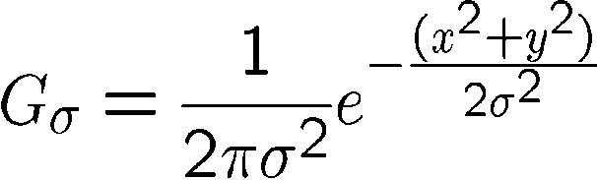
Important filter: Gaussian
Weight contributions of neighboring pixels by nearness
0.003 0.013 0.022 0.013 0.003
0.013 0.059 0.097 0.059 0.013
0.022 0.097 0.159 0.097 0.022
0.013 0.059 0.097 0.059 0.013
0.003 0.013 0.022 0.013 0.003
5 x 5, σ = 1
Slide credit: Christopher Rasmussen

Slide 76

Smoothing with Gaussian filter

Slide 77
Smoothing with box filter

Slide 78
Gaussian filters
Remove “high-frequency” components from the image (low-pass filter)
  Images become more smooth
Convolution with self is another Gaussian
  So can smooth with small-width kernel, repeat, and get same result as larger-width kernel would have
  Convolving two times with Gaussian kernel of width σ is same as convolving once with kernel of width σ√2
Separable kernel
  Factors into product of two 1D Gaussians
Source: K. Grauman
Notes:
Linear vs. quadratic in mask size

Slide 79
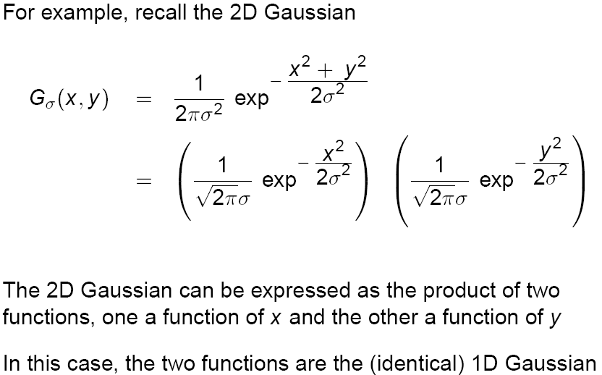
Separability of the Gaussian filter
Source: D. Lowe

Slide 80
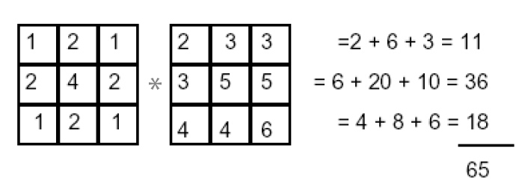
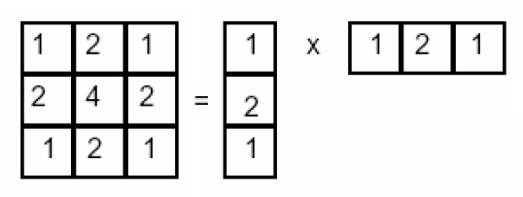
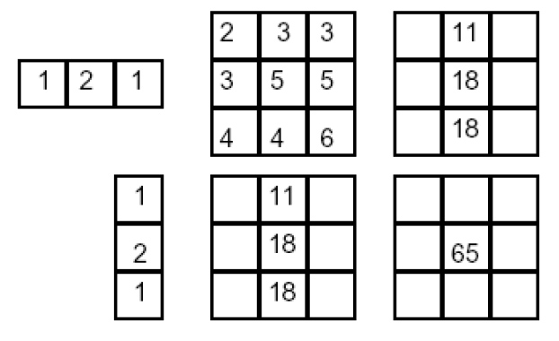
Separability example
2D filtering
(center location only)
The filter factors
into a product of 1D
filters:
Perform filtering
along rows:
*
=
Followed by filtering
along the remaining column:
*
=
Source: K. Grauman

Slide 81
Demo

Slide 82
Separability
Why is separability useful in practice?

Slide 83
Some practical matters

Slide 84
Practical matters
How big should the filter be?
Values at edges should be near zero
Rule of thumb for Gaussian: set filter half-width to about 3 σ

Slide 85
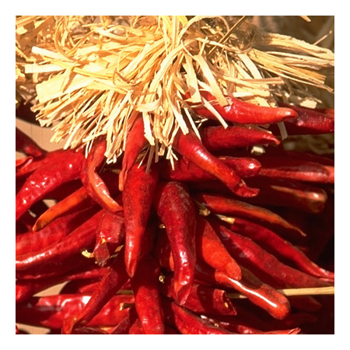
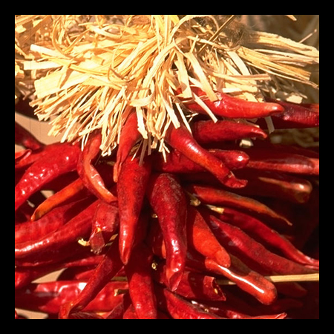











Practical matters
What about near the edge?
  the filter window falls off the edge of the image
  need to extrapolate
  methods:
    clip filter (black)
    wrap around
    copy edge
    reflect across edge
Source: S. Marschner

Slide 86
Practical matters
  methods (MATLAB):
    clip filter (black): imfilter(f, g, 0)
    wrap around: imfilter(f, g, ‘circular’)
    copy edge: imfilter(f, g, ‘replicate’)
    reflect across edge: imfilter(f, g, ‘symmetric’)
Source: S. Marschner

Slide 87
Practical matters
Q?
What is the size of the output?
MATLAB: filter2(g, f, shape)
  shape = ‘full’: output size is sum of sizes of f and g
  shape = ‘same’: output size is same as f
  shape = ‘valid’: output size is difference of sizes of f and g
full
same
valid
g
g
g
g
f
f
f
g
g
g
g
g
g
g
g
Source: S. Lazebnik

Slide 88

Application: Representing Texture
Source: Forsyth

Slide 89




Texture and Material
http://www-cvr.ai.uiuc.edu/ponce_grp/data/texture_database/samples/

Slide 90



Texture and Orientation
http://www-cvr.ai.uiuc.edu/ponce_grp/data/texture_database/samples/

Slide 91


Texture and Scale
http://www-cvr.ai.uiuc.edu/ponce_grp/data/texture_database/samples/

Slide 92
What is texture?
Regular or stochastic patterns caused by bumps, grooves, and/or markings

Slide 93
How can we represent texture?
Compute responses of blobs and edges at various orientations and scales

Slide 94

Overcomplete representation: filter banks
LM Filter Bank
Code for filter banks: www.robots.ox.ac.uk/~vgg/research/texclass/filters.html

Slide 95


Filter banks
Process image with each filter and keep responses (or squared/abs responses)

Slide 96
How can we represent texture?
Measure responses of blobs and edges at various orientations and scales
Record simple statistics (e.g., mean, std.) of absolute filter responses

Slide 97






Can you match the texture to the response?
Filters
A
B
1
2
C
3
Mean abs responses

Slide 98

Representing texture by mean abs response
Filters
Mean abs responses

Slide 99


Take-home messages
Image is a matrix of numbers
Linear filtering is a dot product at each position
  Can smooth, sharpen, translate (among many other uses)
Be aware of details for filter size, extrapolation, cropping
=
0.92 | 0.93 | 0.94 | 0.97 | 0.62 | 0.37 | 0.85 | 0.97 | 0.93 | 0.92 | 0.99
0.95 | 0.89 | 0.82 | 0.89 | 0.56 | 0.31 | 0.75 | 0.92 | 0.81 | 0.95 | 0.91
0.89 | 0.72 | 0.51 | 0.55 | 0.51 | 0.42 | 0.57 | 0.41 | 0.49 | 0.91 | 0.92
0.96 | 0.95 | 0.88 | 0.94 | 0.56 | 0.46 | 0.91 | 0.87 | 0.90 | 0.97 | 0.95
0.71 | 0.81 | 0.81 | 0.87 | 0.57 | 0.37 | 0.80 | 0.88 | 0.89 | 0.79 | 0.85
0.49 | 0.62 | 0.60 | 0.58 | 0.50 | 0.60 | 0.58 | 0.50 | 0.61 | 0.45 | 0.33
0.86 | 0.84 | 0.74 | 0.58 | 0.51 | 0.39 | 0.73 | 0.92 | 0.91 | 0.49 | 0.74
0.96 | 0.67 | 0.54 | 0.85 | 0.48 | 0.37 | 0.88 | 0.90 | 0.94 | 0.82 | 0.93
0.69 | 0.49 | 0.56 | 0.66 | 0.43 | 0.42 | 0.77 | 0.73 | 0.71 | 0.90 | 0.99
0.79 | 0.73 | 0.90 | 0.67 | 0.33 | 0.61 | 0.69 | 0.79 | 0.73 | 0.93 | 0.97
0.91 | 0.94 | 0.89 | 0.49 | 0.41 | 0.78 | 0.78 | 0.77 | 0.89 | 0.99 | 0.93
1
1
1
1
1
1
1
1
1

Slide 100
Take-home questions
8/30/12
Write down a 3x3 filter that returns a positive value if the average value of the 4-adjacent neighbors is less than the center and a negative value otherwise
Write down a filter that will compute the gradient in the x-direction:
gradx(y,x) = im(y,x+1)-im(y,x) for each x, y

Slide 101









Take-home questions
8/30/12
Filtering Operator
a) _ = D * B
b) A = _ * _
c) F = D * _
d) _ = D * D
3. Fill in the blanks:
A
B
E
G
F
C
H
I
D

Slide 102
Possible assignments
In general there will be different versions, for instance with extensions, for the graduate students.

Slide 103


Assignment 1: Image alignment to Colorize the Prokudin-Gorskii photo collection
Notes:
This is our first assignment as we already discussed. And as mentioned the grad students will do some extra alignment in addition (the undergrad can do this for extra credit).

Slide 104

Possible assignment: Poisson Blending

Slide 105



Possible assignment: Poisson Blending
Fun example from a student, Evan Wallace, via James Hays

Slide 106



Possible assignment: Seam carving for image resizing / retargeting
Seam Carving for Content-Aware Image Resizing, by Avidan and Shamir Siggraph 2007

Slide 107

Possible assignment: Texture Synthesis and Transfer

Slide 108


Possible assignment: High dynamic range imaging
Inputs
Output
From Photomatix? http://white.stanford.edu/teach/index.php/File:Example2.png

Slide 109

Possible assignment: Automatic Panorama Construction
Slide from James Hays

Slide 110

Possible assignment: View morphing
View morphing, Seitz and Dyer, Siggraph 1996

Slide 111
For Next Class
Office hours after class on Tuesdays (if no one shows at the beginning I may go get lunch) and by appointment. I am also often available on gchat (alex.c.berg). Please feel free to come talk to me, and to each other about the class. I want you all to learn as much as possible from the class, and think that all of you should be able to get A’s or H’s and make neat things!
Install matlab & hopefully image processing toolbox
Please feel free to “crash” the matlab installation “party” in Marc Niethammer’s Matlab programming class tomorrow (Friday): Genome Sciences (GS G100) 2-2:50
Look over the matlab tutorial (if you haven’t already)
  http://www.cs.unc.edu/~lazebnik/spring11/matlab.intro.html
Start on your assignment.

