Slide 1
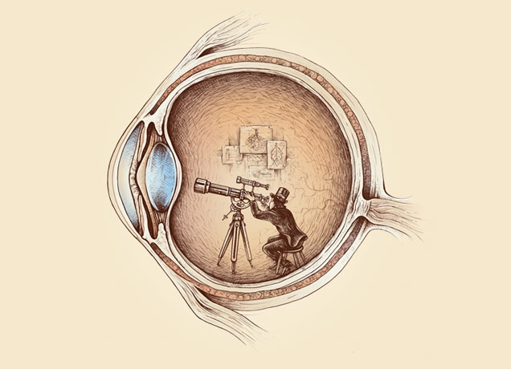
Computational Photography lecture 10 – (pinhole) stereo cameras
CS 590-134 (future 572) Spring 2016
Prof. Alex Berg
(Credits to many other folks on individual slides)

Slide 2
Today
Assignment 2 – part II due Monday Sept 29 at midnight
Today, talking about making (pinhole (stereo)) cameras
Re-read Chapter 2 in the Szeliski book as reference material
Also look at chapter 11 on stereo!
Notes:
(votes and comments are their votes for the best homework 1 write-up, and the best image in any of the write-ups.) Sakai should be open by the time class happens. I am working to try and combine the sakai for 590 and 790, hopefully this will work out ☺

Slide 3
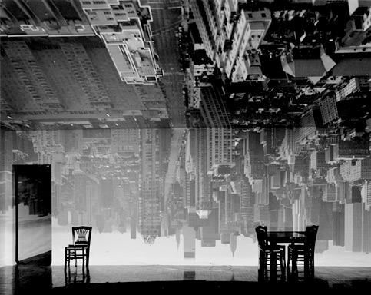
“I made my first picture using camera obscura techniques in my darkened living room in 1991.”
-- Abelardo Morell
I cover all windows with black plastic in order to achieve total darkness.”
-- Abelardo Morell
“In setting up a room to make this kind of photograph,

Slide 4
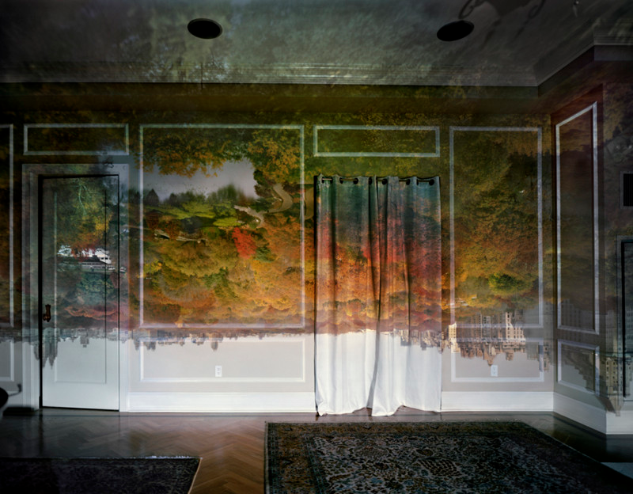
“I made my first picture using camera obscura techniques in my darkened living room in 1991.”
-- Abelardo Morell
I cover all windows with black plastic in order to achieve total darkness.”
-- Abelardo Morell
“In setting up a room to make this kind of photograph,

Slide 5
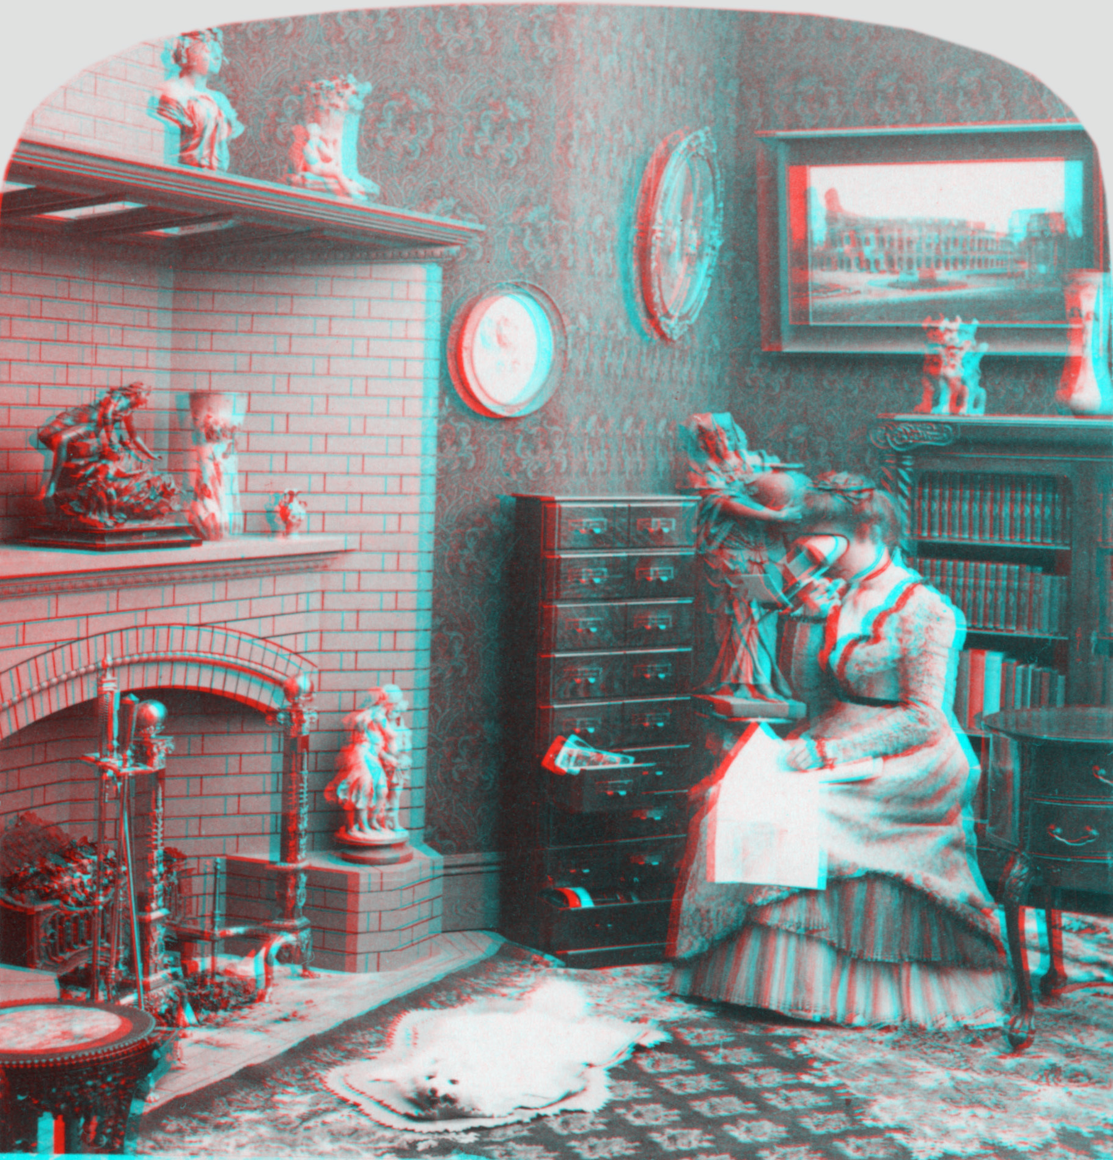
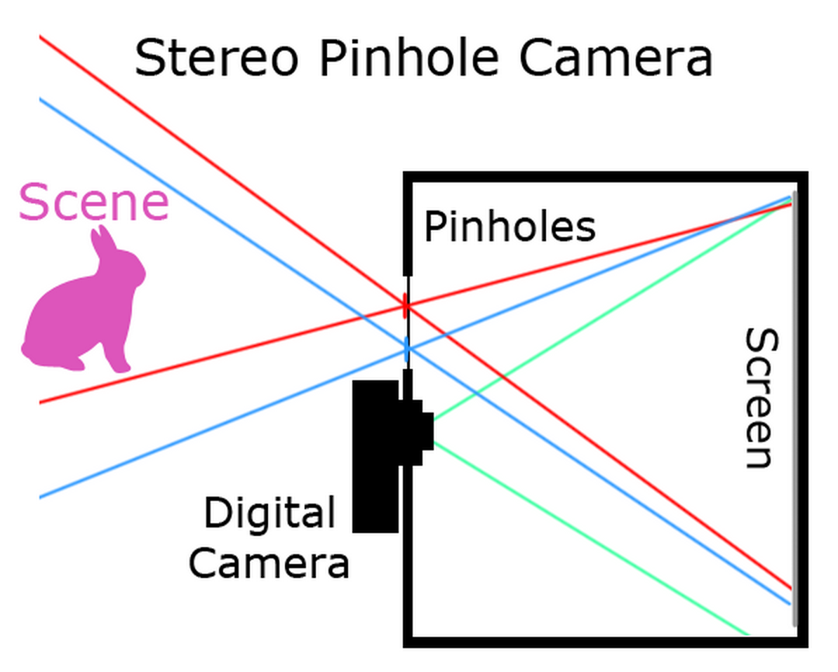
Next assignment: Making pinhole cameras
(and stereo depth estimation)
Groups of 1-2 – find a partner with a good digital camera
http://en.wikipedia.org/wiki/Anaglyph_3D
From James Hays
Based on a class project from Antonio Torralba’s Vision class (MIT).

Slide 6

Stereo and Depth Estimation (Sz 11)
cs129: Computational Photography
James Hays, Brown, Spring 2011
Slides from Steve Seitz and Robert Collins

Slide 7
How is depth estimated?

Slide 8
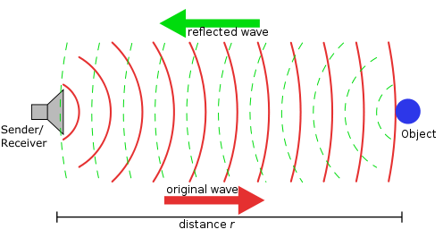
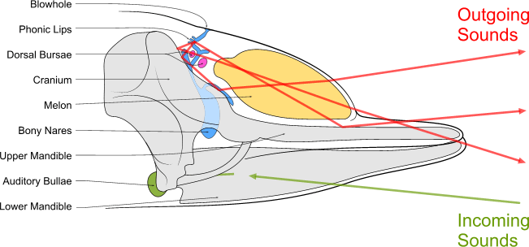
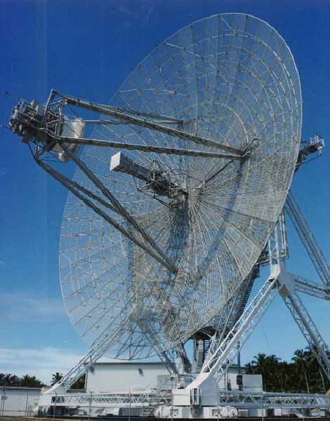
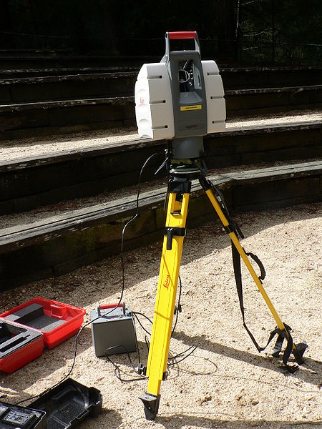
Time of Flight
Humans can learn to echolocate!

Slide 9
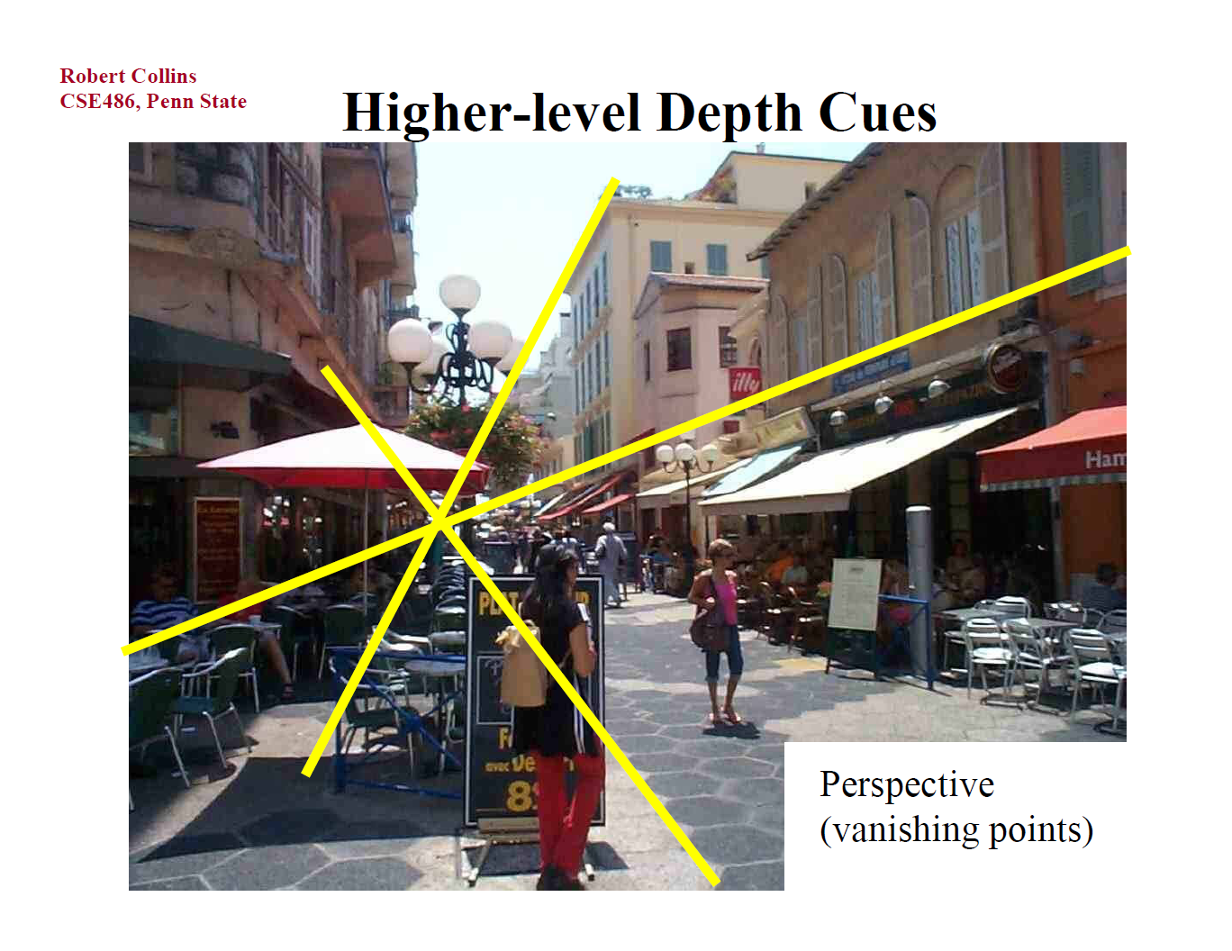

Slide 10
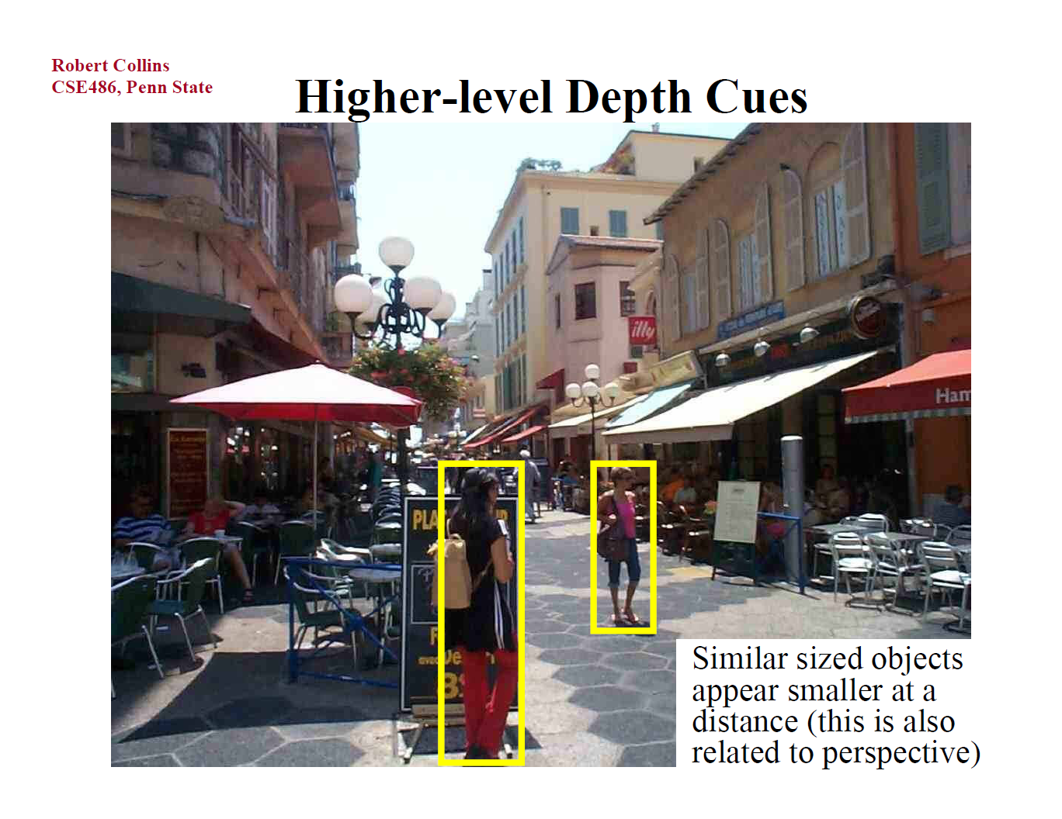

Slide 11
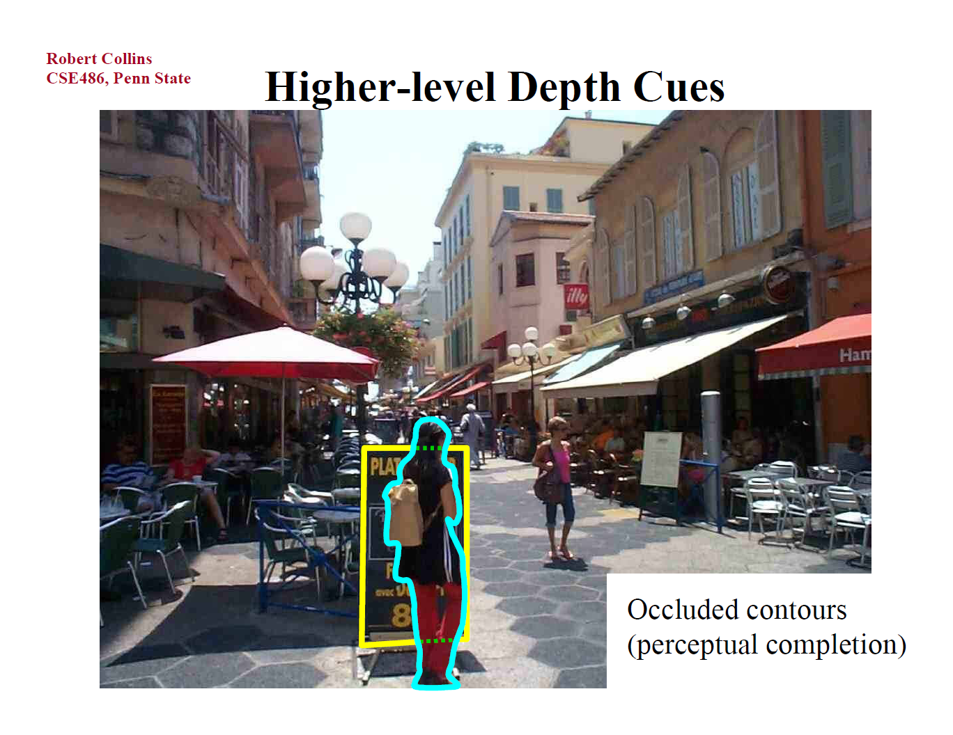

Slide 12
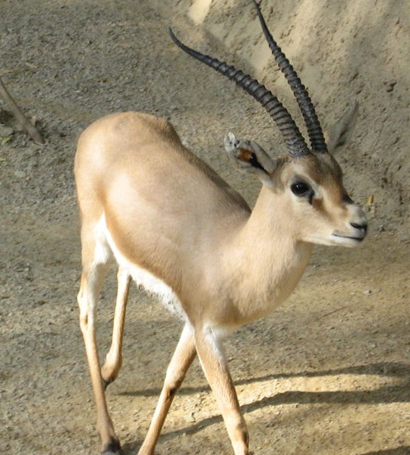
Stereo Vision
Not that important for humans, especially at longer distances. Perhaps 10% of people are stereo blind.
Many animals don’t have much stereo overlap in their fields of view

Slide 13
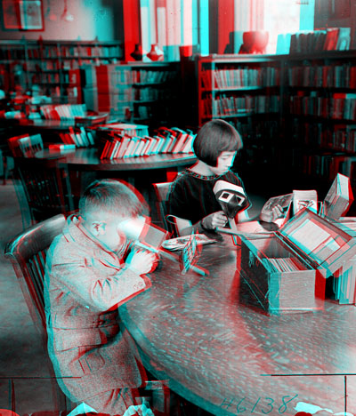

Public Library, Stereoscopic Looking Room, Chicago, by Phillips, 1923

Slide 14
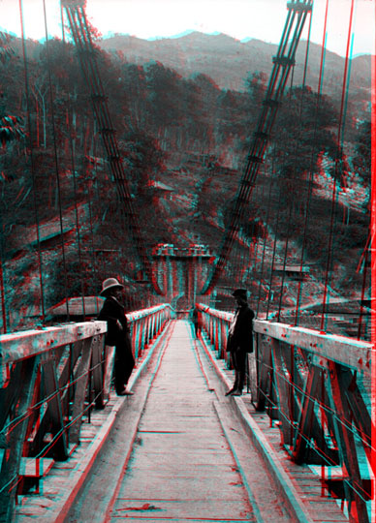
Teesta suspension bridge-Darjeeling, India

Slide 15
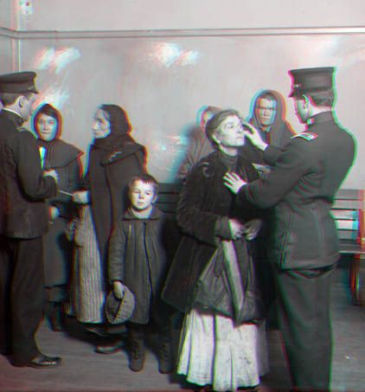
Woman getting eye exam during immigration procedure at Ellis Island, c. 1905 - 1920 , UCR Museum of Phography

Slide 16
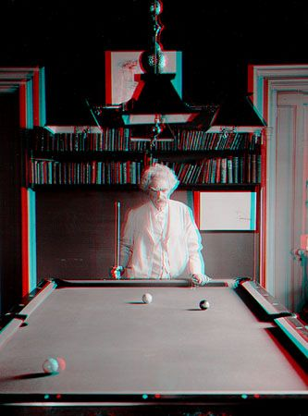
Mark Twain at Pool Table", no date, UCR Museum of Photography

Slide 17
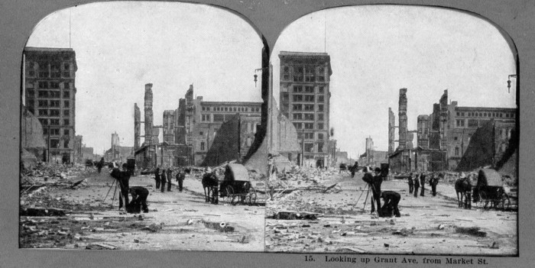
San Francisco Post-Earthquake 1906
http://www.sfog.us/earthquake

Slide 18
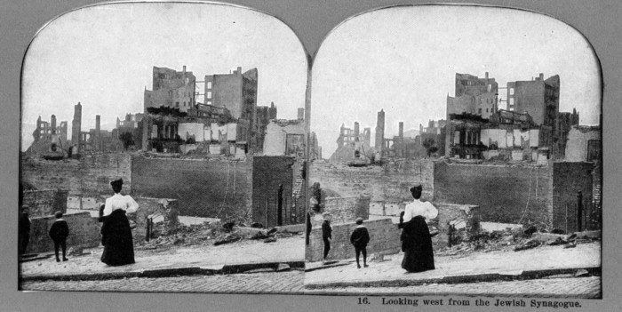
San Francisco Post-Earthquake 1906
http://www.sfog.us/earthquake

Slide 19
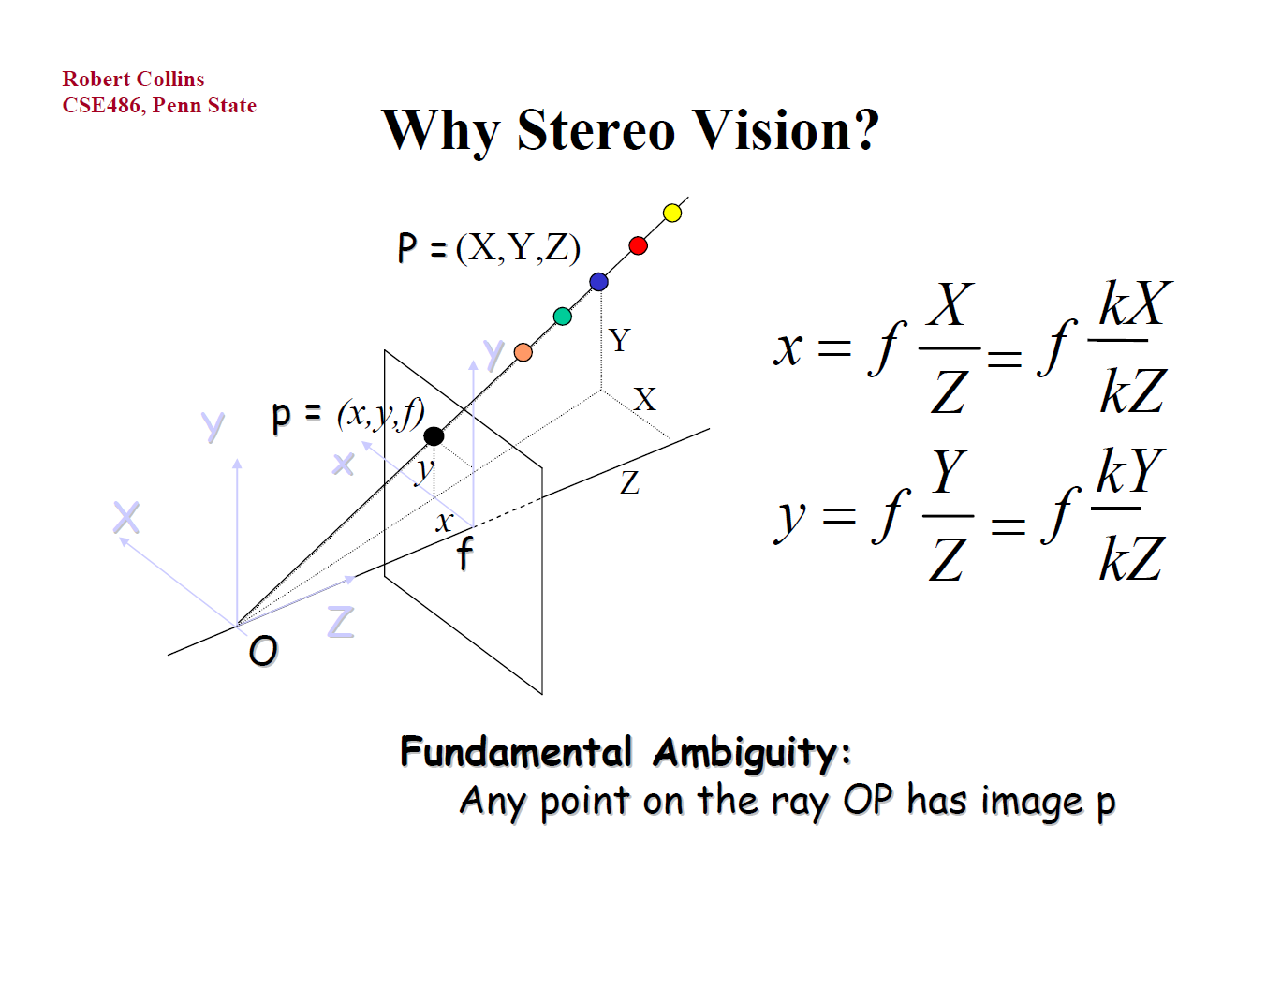

Slide 20
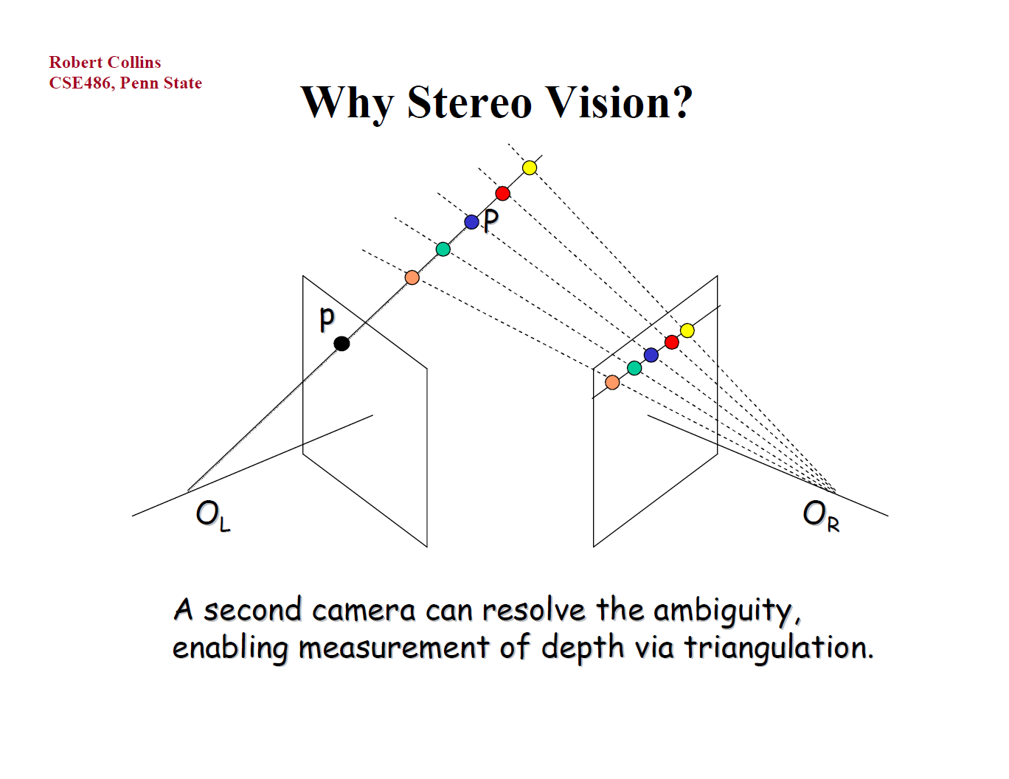

Slide 21
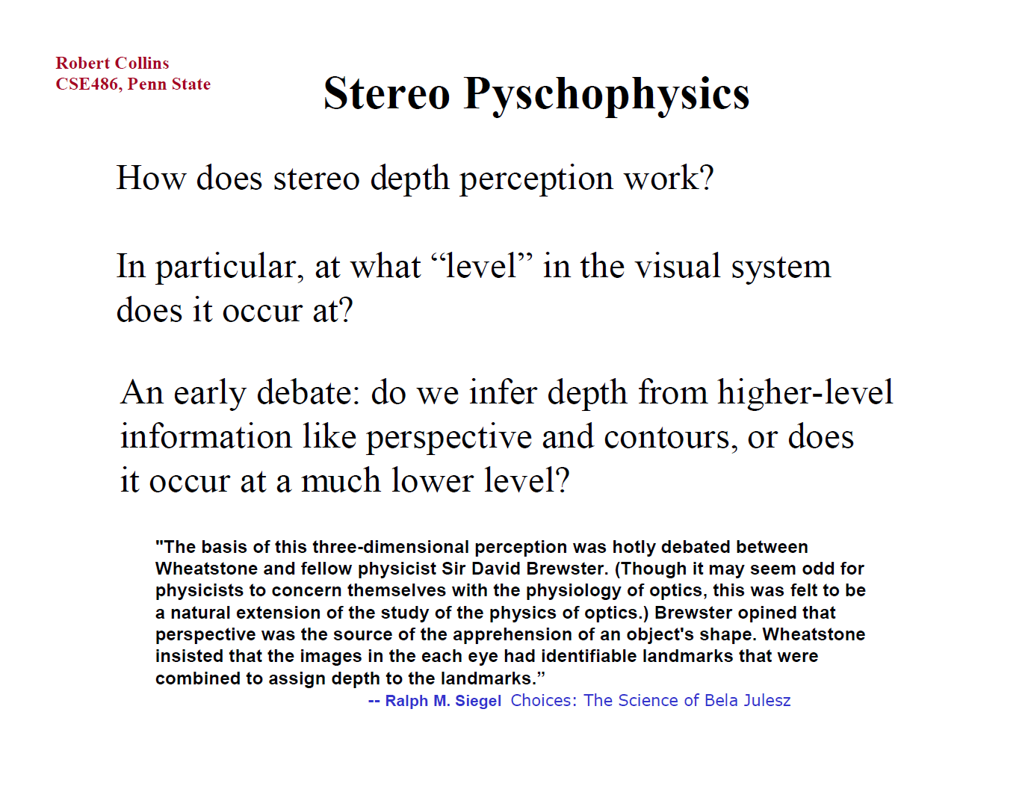

Slide 22
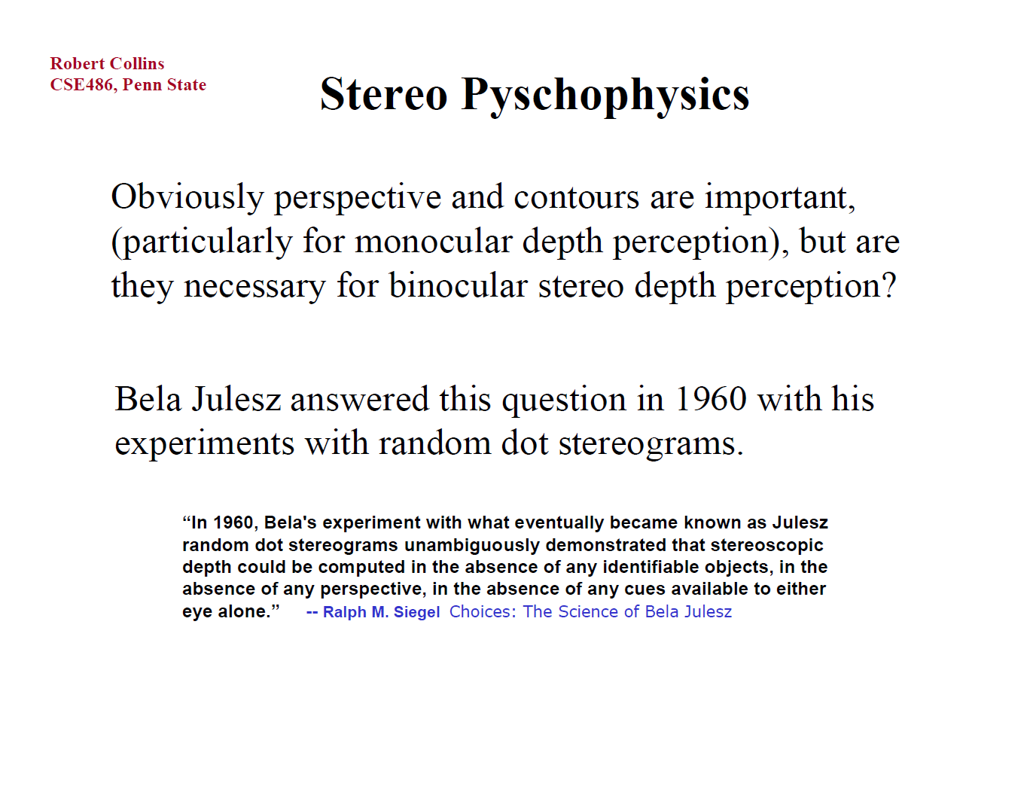

Slide 23
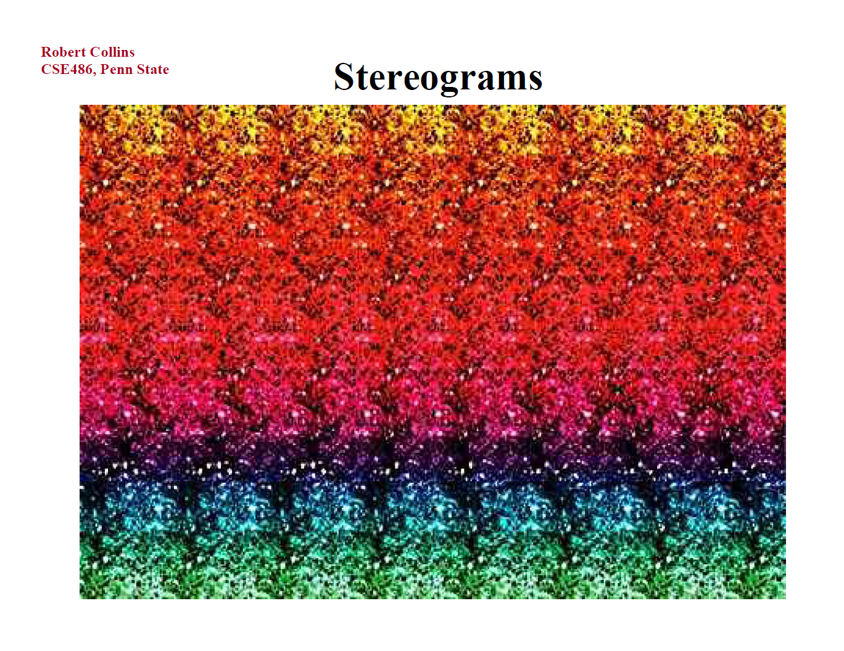

Slide 24
Stereo
scene point
image plane
optical center

Slide 25
Stereo
Basic Principle: Triangulation
  Gives reconstruction as intersection of two rays
  Requires
    camera pose (calibration)
    point correspondence

Slide 26
Stereo correspondence
Determine Pixel Correspondence
  Pairs of points that correspond to same scene point
epipolar line
epipolar line
epipolar plane
Epipolar Constraint
  Reduces correspondence problem to 1D search along conjugate epipolar lines

Slide 27
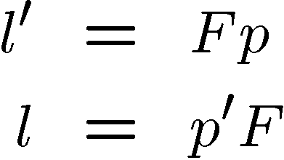


Fundamental matrix
Let p be a point in left image, p’ in right image
Epipolar relation
  p maps to epipolar line l’
  p’ maps to epipolar line l
Epipolar mapping described by a 3x3 matrix F
It follows that
l
l’
p
p’

Slide 28

Fundamental matrix
This matrix F is called
  the “Essential Matrix”
    when image intrinsic parameters are known
  the “Fundamental Matrix”
    more generally (uncalibrated case)
Can solve for F from point correspondences
  Each (p, p’) pair gives one linear equation in entries of F
  8 points give enough to solve for F (8-point algorithm)
  see Marc Pollefey’s notes for a nice tutorial

Slide 29
Stereo image rectification

Slide 30
Stereo image rectification
reproject image planes onto a common
plane parallel to the line between optical centers
pixel motion is horizontal after this transformation
two homographies (3x3 transform), one for each input image reprojection
C. Loop and Z. Zhang. Computing Rectifying Homographies for Stereo Vision. IEEE Conf. Computer Vision and Pattern Recognition, 1999.

Slide 31
Stereo matching algorithms
Match Pixels in Conjugate Epipolar Lines
  Assume brightness constancy
  This is a tough problem
  Numerous approaches
    A good survey and evaluation: http://www.middlebury.edu/stereo/

Slide 32
Your basic stereo algorithm
For each epipolar line
For each pixel in the left image
    compare with every pixel on same epipolar line in right image
    pick pixel with minimum match cost
Improvement: match windows
  This should look familar...

Slide 33


Window size
W = 3
W = 20
Effect of window size
Better results with adaptive window
  T. Kanade and M. Okutomi, A Stereo Matching Algorithm with an Adaptive Window: Theory and Experiment,, Proc. International Conference on Robotics and Automation, 1991.
  D. Scharstein and R. Szeliski. Stereo matching with nonlinear diffusion. International Journal of Computer Vision, 28(2):155-174, July 1998
  Smaller window
  Larger window
Notes:
smaller window: more detail, more noise
bigger window: less noise, more detail

Slide 34


Stereo results
  Data from University of Tsukuba
  Similar results on other images without ground truth
Scene
Ground truth

Slide 35


Results with window search
Window-based matching
(best window size)
Ground truth

Slide 36

Better methods exist...
Better Method
  Boykov et al., Fast Approximate Energy Minimization via Graph Cuts,
  International Conference on Computer Vision, September 1999.
Ground truth
    For the latest and greatest: http://www.middlebury.edu/stereo/

Slide 37
Stereo as energy minimization
What defines a good stereo correspondence?
  Match quality
    Want each pixel to find a good match in the other image
  Smoothness
    If two pixels are adjacent, they should (usually) move about the same amount

Slide 38
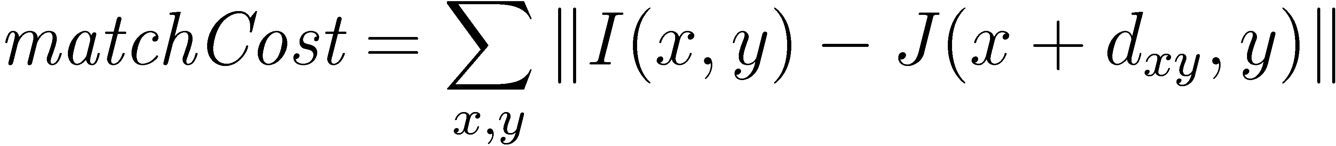
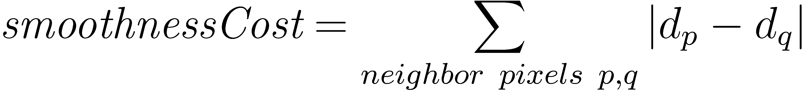
Stereo as energy minimization
Expressing this mathematically
  Match quality
    Want each pixel to find a good match in the other image
  Smoothness
    If two pixels are adjacent, they should (usually) move about the same amount
We want to minimize
  This is a special type of energy function known as an
  MRF (Markov Random Field)
    Effective and fast algorithms have been recently developed:
      Graph cuts, belief propagation….
      for more details (and code): http://vision.middlebury.edu/MRF/
      Great tutorials available online (including video of talks)

Slide 39
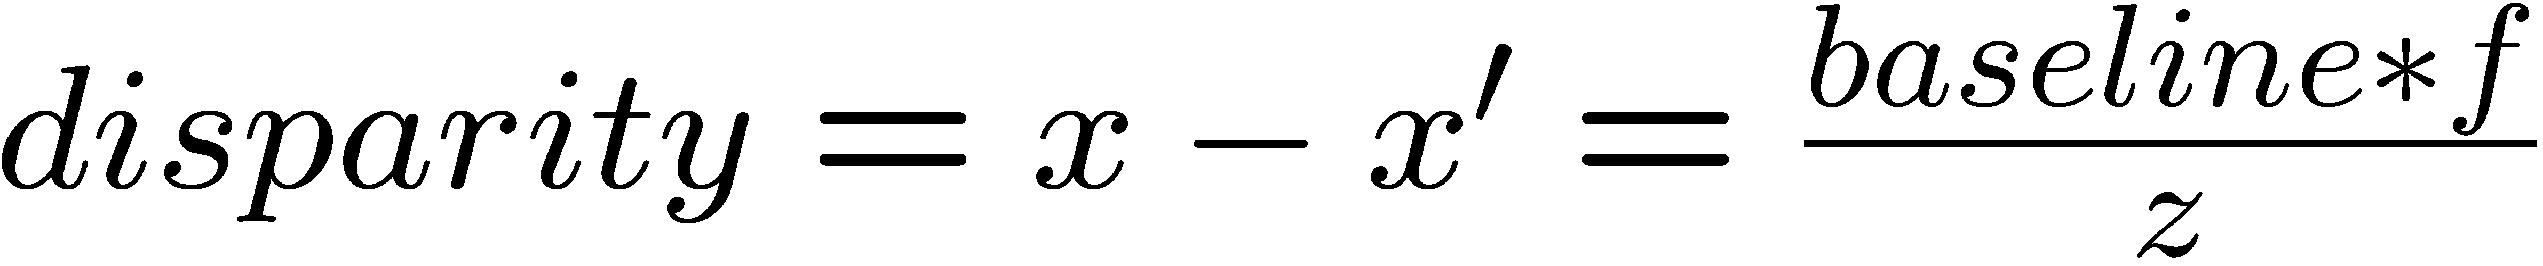
Depth from disparity
X
z
x
x’
f
f
C
baseline
C’

Slide 40
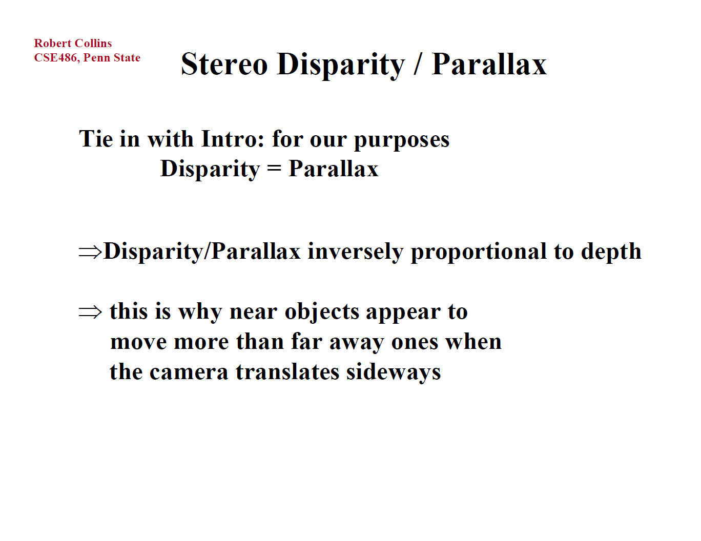

Slide 41
Stereo reconstruction pipeline
Steps
  Calibrate cameras
  Rectify images
  Compute disparity
  Estimate depth
  Camera calibration errors
  Poor image resolution
  Occlusions
  Violations of brightness constancy (specular reflections)
  Large motions
  Low-contrast image regions
What will cause errors?

Slide 42

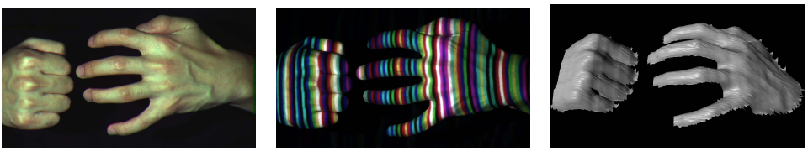
Active stereo with structured light
Li Zhang’s one-shot stereo
camera 1
camera 1
projector
projector
camera 2
Project “structured” light patterns onto the object
  simplifies the correspondence problem

Slide 43
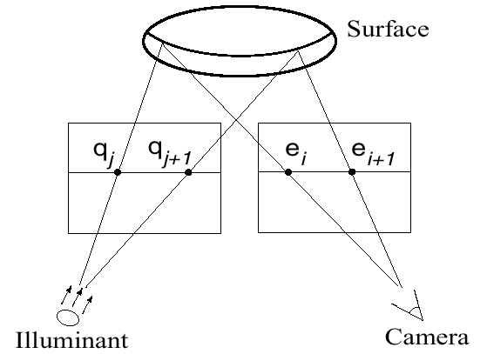
Active stereo with structured light

Slide 44

Laser scanning
Digital Michelangelo Project
http://graphics.stanford.edu/projects/mich/
Optical triangulation
  Project a single stripe of laser light
  Scan it across the surface of the object
  This is a very precise version of structured light scanning

Slide 45
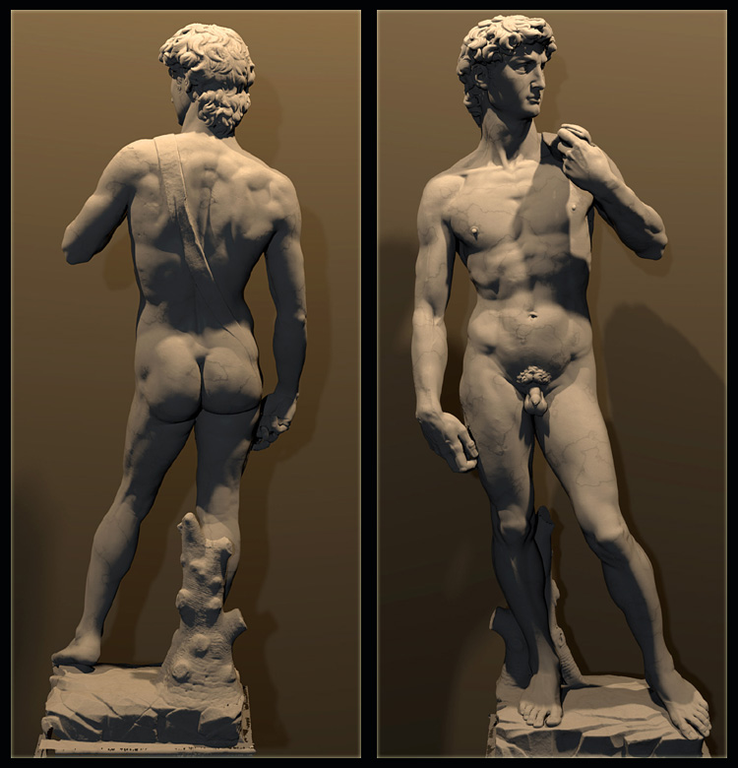
Laser scanned models
  The Digital Michelangelo Project, Levoy et al.

Slide 46
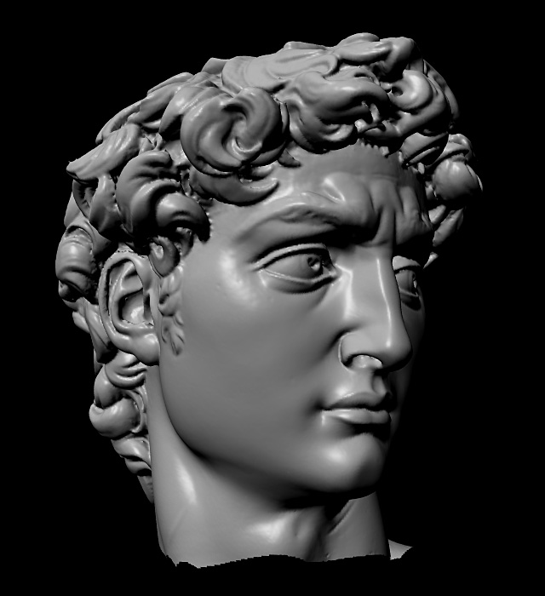
Laser scanned models
  The Digital Michelangelo Project, Levoy et al.

Slide 47
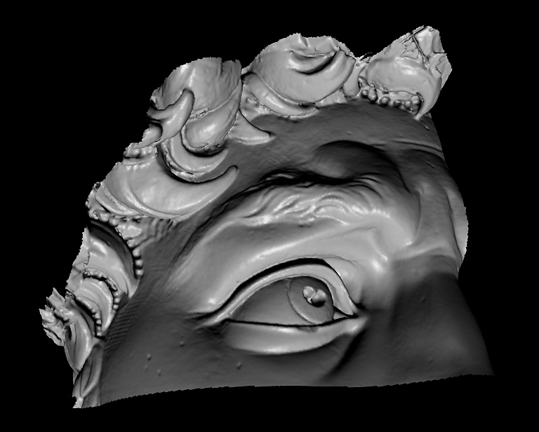
Laser scanned models
  The Digital Michelangelo Project, Levoy et al.

Slide 48
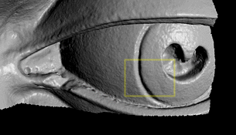
Laser scanned models
  The Digital Michelangelo Project, Levoy et al.

Slide 49
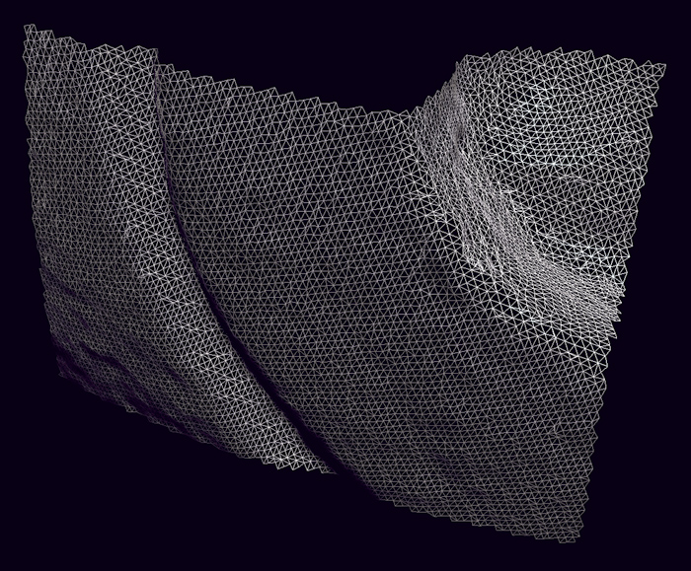
Laser scanned models
  The Digital Michelangelo Project, Levoy et al.

