Slide 1
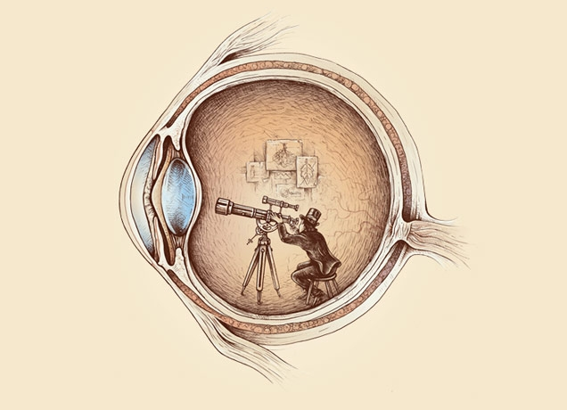
Computational Photography lecture 2– filtering warning, texture synthesis CS 590-134 Spring 2016
Prof. Alex Berg
(Credits to many other folks on individual slides)

Slide 2
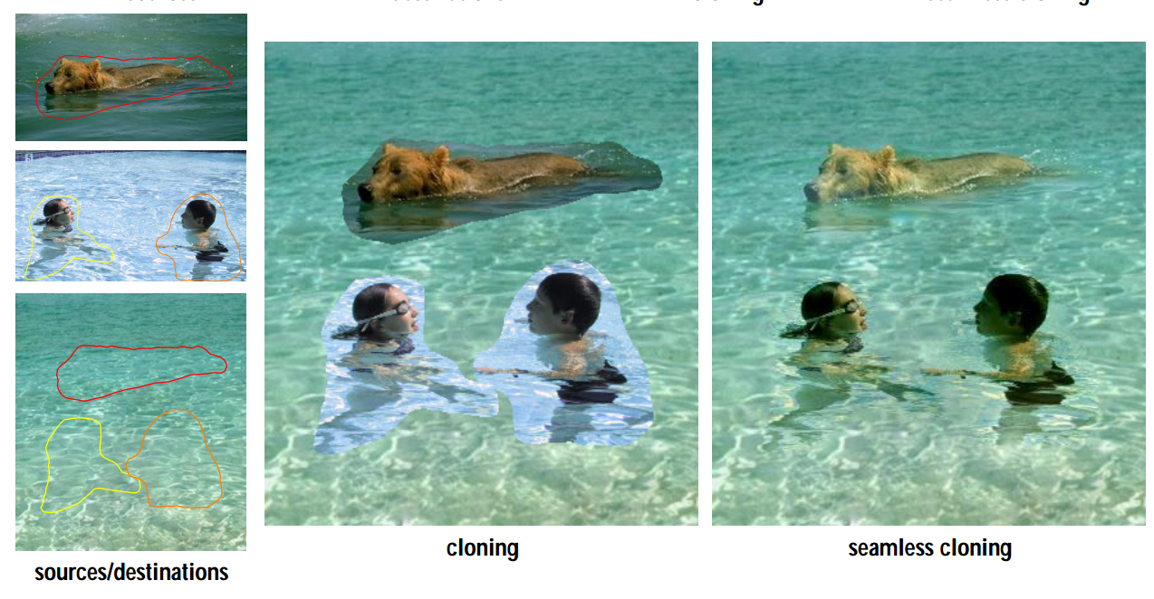
Quick Review
Color and some basic ideas of image formation in a camera, Szeliski Book 2.3
Next texture synthesis and image inpainting
We will look into more detail about image filtering, so please look over chapter 3 in Szeliski and these ppt files from other versions of this class as background for the next lecture. Also, Don’t Panic, using these tools is straightforward.
Alexei Efros Frequency analysis slides
Derek Hoiem Frequency analysis slides
Notes:
Add previous affiliations

Slide 3
Texture Synthesis
Slides from Alexei Efros
(this was his PhD thesis topic)
Also see Szeliski Chapter 10.5

Slide 4
Texture
Texture depicts spatially repeating patterns
Many natural phenomena are textures
radishes
rocks
yogurt

Slide 5
Texture Synthesis
Goal of Texture Synthesis: create new samples of a given texture
Many applications: virtual environments, hole-filling, texturing surfaces

Slide 6
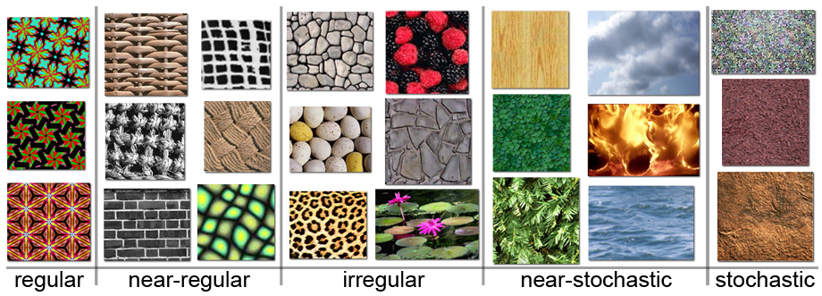
The Challenge
Need to model the whole spectrum: from repeated to stochastic texture

Slide 7
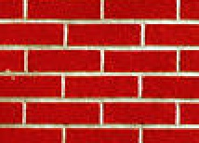
Efros & Leung Algorithm
non-parametric
sampling
p
Input image
Synthesizing a pixel
Assuming Markov property, compute P(p|N(p))
Building explicit probability tables infeasible
Instead, we search the input image for all similar neighborhoods — that’s our pdf for p
To sample from this pdf, just pick one match at random

Slide 8
Some Details
Growing is in “onion skin” order
Within each “layer”, pixels with most neighbors are synthesized first
If no close match can be found, the pixel is not synthesized until the end
Using Gaussian-weighted SSD is very important
to make sure the new pixel agrees with its closest neighbors
Approximates reduction to a smaller neighborhood window if data is too sparse

Slide 9
Neighborhood Window
input

Slide 10
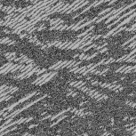
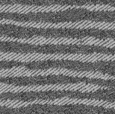
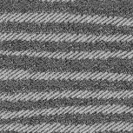
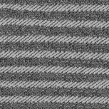
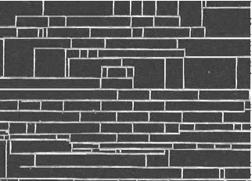
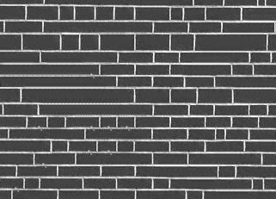
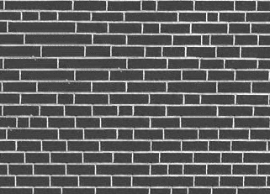
Varying Window Size
Increasing window size

Slide 11
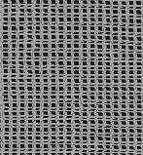
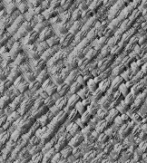
Synthesis Results
french canvas
rafia weave

Slide 12
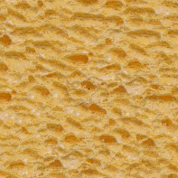
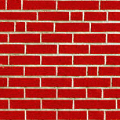
More Results
white bread
brick wall

Slide 13
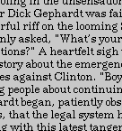
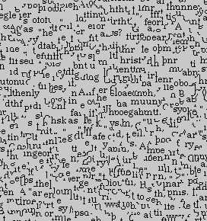
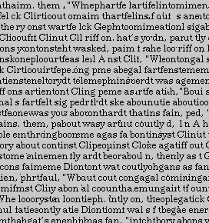
Homage to Shannon

Slide 14
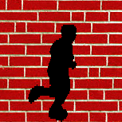
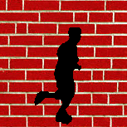
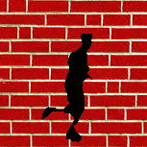
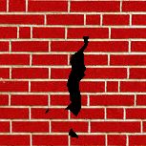
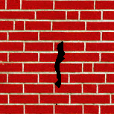
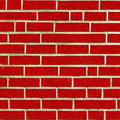
Hole Filling

Slide 15
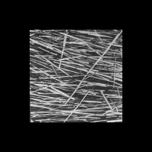
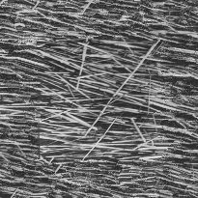
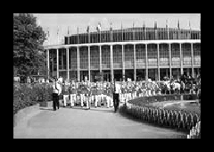
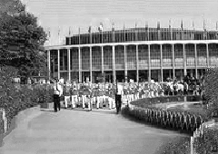
Extrapolation

Slide 16
Summary
The Efros & Leung algorithm
Very simple
Surprisingly good results
…but very slow

Slide 17
Image Quilting [Efros & Freeman]
non-parametric
sampling
p
B
Input image
Synthesizing a block
Observation: neighbor pixels are highly correlated
Idea: unit of synthesis = block
Exactly the same but now we want P(B|N(B))
Much faster: synthesize all pixels in a block at once
Not the same as multi-scale!

Slide 18
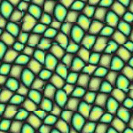
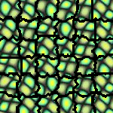
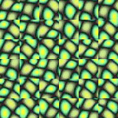
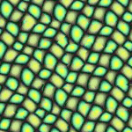
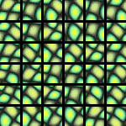
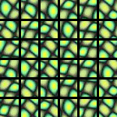
block
Input texture
B1
B2
B1
B2
B1
B2
Random placement
of blocks
Neighboring blocks
constrained by overlap
Minimal error
boundary cut

Slide 19
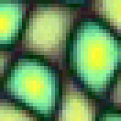
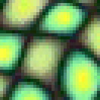
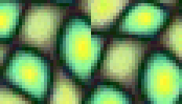
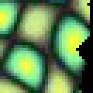
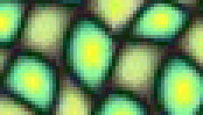
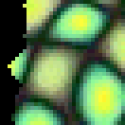
Minimal error boundary
overlapping blocks
vertical boundary
2
_
=
overlap error
min. error boundary

Slide 20
Our Philosophy
The “Corrupt Professor’s Algorithm”:
Plagiarize as much of the source image as you can
Then try to cover up the evidence
Rationale:
Texture blocks are by definition correct samples of texture so problem only connecting them together

Slide 21
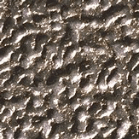
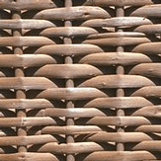
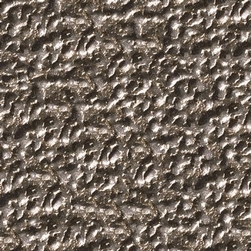
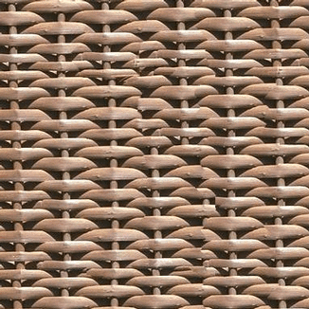

Slide 22
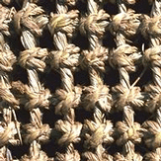
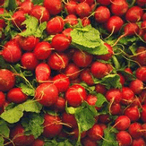
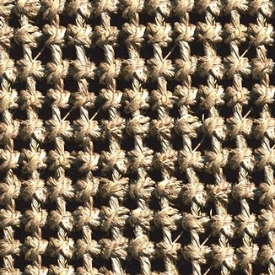
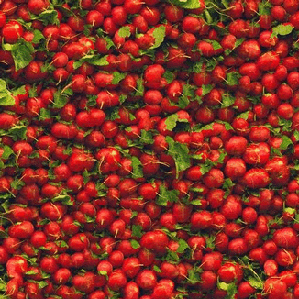

Slide 24
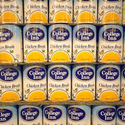
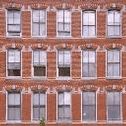

Slide 27
Failures
(Chernobyl
Harvest)

Slide 28
Portilla & Simoncelli
Xu, Guo & Shum
input image
Wei & Levoy
Our algorithm

Slide 29
Portilla & Simoncelli
Xu, Guo & Shum
input image
Wei & Levoy
Our algorithm

Slide 30
Portilla & Simoncelli
Xu, Guo & Shum
input image
Wei & Levoy
Our algorithm

Slide 31
Political Texture Synthesis!

Slide 32
Application: Texture Transfer
Try to explain one object with bits and pieces of another object:
+
=

Slide 33
Texture Transfer
Constraint
Texture sample

Slide 34
Texture Transfer
Take the texture from one image and “paint” it onto another object
Same as texture synthesis, except an additional constraint:
Consistency of texture
Similarity to the image being “explained”

Slide 35
+
=

Slide 37
Next
How do I put an object from one image into another?
Slide from Derek Hoiem @ UIUC

Slide 38
Image Compositing
Some slides from Efros/Seitz

Slide 39
News Composites
http://www.guardian.co.uk/world/2010/sep/16/mubarak-doctored-red-carpet-picture
Original
“Enhanced” Version

Slide 40
News Composites
Original
“Enhanced” Version
Walski, LA Times, 2003

Slide 41
Three methods
Cut and paste
Laplacian pyramid blending
Poisson blending
Slide from Derek Hoiem @ UIUC

Slide 42
Method 1: Cut and Paste
Slide from Derek Hoiem @ UIUC

Slide 43
Method 1: Cut and Paste
Method:
Segment using intelligent scissors
Paste foreground pixels onto target region
Slide from Derek Hoiem @ UIUC

Slide 44
Method 1: Cut and Paste
Problems:
Small segmentation errors noticeable
Pixels are too blocky
Won’t work for semi-transparent materials
Slide from Derek Hoiem @ UIUC

Slide 45
Feathering
Near object boundary pixel values come partly from foreground and partly from background
Slide from Derek Hoiem @ UIUC

Slide 46
Method 1: Cut and Paste (with feathering)
Slide from Derek Hoiem @ UIUC

Slide 47
Alpha compositing
+
Output = foreground*mask + background*(1-mask)
Slide from Derek Hoiem @ UIUC

Slide 48
Alpha compositing with feathering
Output = foreground*mask + background*(1-mask)
Slide from Derek Hoiem @ UIUC

Slide 49
Another example (without feathering)
Mattes
Composite
Composite by
David Dewey
Slide from Derek Hoiem @ UIUC

Slide 50
Proper blending is key
Slide from Derek Hoiem @ UIUC

Slide 51
Alpha Blending / Feathering
+
1
1
0
0
I_{blend} = αI_{left} + (1-α)I_{right}
=
Slide from Derek Hoiem @ UIUC

Slide 52
Affect of Window Size
1
left
1
right
0
0
Slide from Derek Hoiem @ UIUC

Slide 53
Affect of Window Size
1
1
0
0
Slide from Derek Hoiem @ UIUC

Slide 54
Good Window Size
1
0
“Optimal” Window: smooth but not ghosted
Slide from Derek Hoiem @ UIUC

Slide 55
How much should we blend?

Slide 56
Method 2: Pyramid Blending

Slide 57
Method 2: Pyramid Blending
At low frequencies, blend slowly
At high frequencies, blend quickly
1
0
1
0
1
0
Left pyramid
blend
Right pyramid

Slide 58
laplacian
level
4
laplacian
level
2
laplacian
level
0
left pyramid
right pyramid
blended pyramid

Slide 59
Method 2: Pyramid Blending
Burt and Adelson 1983

Slide 60
Laplacian Pyramid Blending
Implementation:
Build Laplacian pyramids for each image
Build a Gaussian pyramid of region mask
Blend each level of pyramid using region mask from the same level
Collapse the pyramid to get the final blended image
Image 1 at level i of Laplacian pyramid
Region mask at level i of Gaussian pyramid
Burt and Adelson 1983

Slide 61
Simplification: Two-band Blending
Brown & Lowe, 2003
Only use two bands: high freq. and low freq.
Blends low freq. smoothly
Blend high freq. with no smoothing: use binary alpha

Slide 62
2-band Blending
Low frequency
High frequency

Slide 63
Linear Blending

Slide 64
2-band Blending

Slide 65
Blending Regions

Slide 66
© Chris Cameron

Slide 67
Related idea: Poisson Blending
A good blend should preserve gradients of source region without changing the background
Perez et al. 2003

Slide 68
Related idea: Poisson Blending
A good blend should preserve gradients of source region without changing the background
Sub-part of assignment
Perez et al. 2003

Slide 69
Method 3: Poisson Blending
A good blend should preserve gradients of source region without changing the background
Treat pixels as variables to be solved
Minimize squared difference between gradients of foreground region and gradients of target region
Keep background pixels constant
Perez et al. 2003
Notes:
Draw on board

Slide 70
Example
Gradient Visualization
Source: Evan Wallace

Slide 71
+
Specify object region
Source: Evan Wallace

Slide 72
Gradient-domain editing
Creation of image = least squares problem in terms of: 1) pixel intensities; 2) differences of pixel intensities
Use Matlab least-squares solvers for numerically stable solution with sparse A
Least Squares Line Fit in 2 Dimensions

Slide 73
Examples
Line-fitting: y=mx+b

Slide 74
Examples
2. Gradient domain processing
source image
background image
target image
1
5
9
13
1
5
9
13
1
5
9
13
20 | 20 | 20 | 20
20 | 80 | 20 | 20
20 | 20 | 80 | 20
20 | 20 | 20 | 20
10 | 10 | 10 | 10
10 | 10 | 10 | 10
10 | 10 | 10 | 10
10 | 10 | 10 | 10
10 | 10 | 10 | 10
10 | v₁ | v₃ | 10
10 | v₂ | v₄ | 10
10 | 10 | 10 | 10
2
6
10
14
2
6
10
14
2
6
10
14
3
7
11
15
3
7
11
15
3
7
11
15
4
8
12
16
4
8
12
16
4
8
12
16

Slide 75
Other results
Perez et al. 2003

Slide 76
Putting these ideas together, scene completion!
…
Input image
Scene Descriptor
Image Collection
…
Context matching
+ blending
20 completions
200 matches
Hays and Efros, SIGGRAPH 2007
Notes:
Background pixels completely replaced, color of foreground changed

Slide 77
For next class
We will look into more detail about image filtering, so please look over chapter 3 in Szeliski and these ppt files from other versions of this class as background for the next lecture. Also, Don’t Panic, using these tools is straightforward.
Alexei Efros Frequency analysis slides
Derek Hoiem Frequency analysis slides
Notes:
Add previous affiliations

