Slide 1
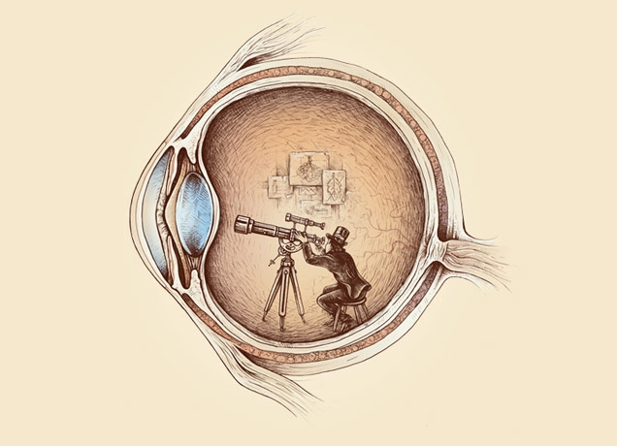
Computational Photography lecture 7 – (pinhole) cameras
CS 590-134 (Future 572) Spring 2016
Prof. Alex Berg
(Credits to many other folks on individual slides)

Slide 2
Today
Tell me about why and how to find corresponding points…
Will hand back (electronically) your assignments next lecture.
We will talk about using correspondence for next part of assignment,
but first we need to talk about camera geometry and transformations a bit.
Notes:
(votes and comments are their votes for the best homework 1 write-up, and the best image in any of the write-ups.) Sakai should be open by the time class happens. I am working to try and combine the sakai for 590 and 790, hopefully this will work out ☺

Slide 3
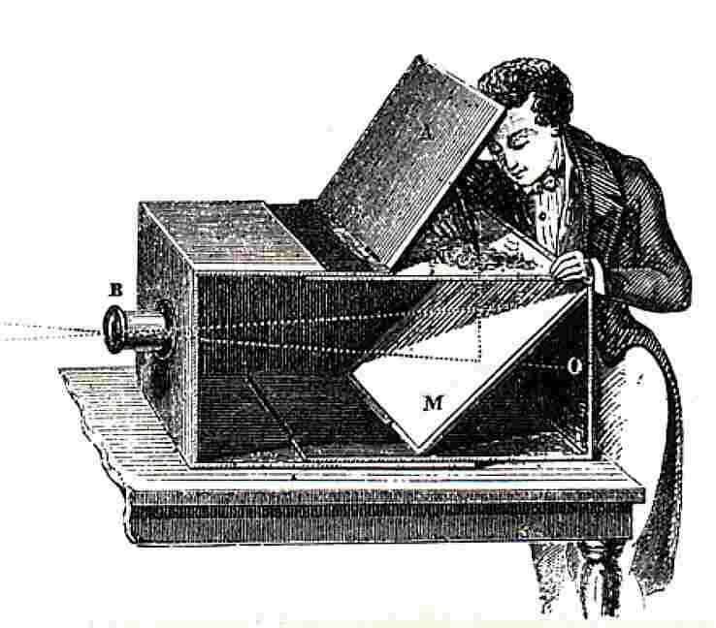
Pinhole Camera Model
Sildes from Derek Hoiem, University of Illinois

Slide 4
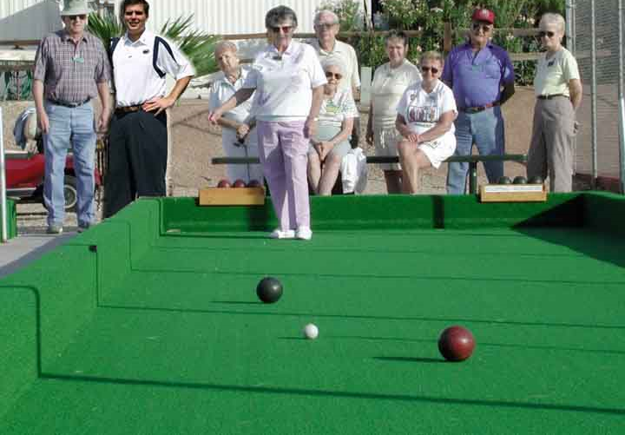
Single-view Geometry
How tall is this woman?
How high is the camera?
What is the camera rotation?
What is the focal length of the camera?
Which ball is closer?

Slide 5
Some camera concepts
Mapping between image and world coordinates
  Pinhole camera model
  Projective geometry
    Vanishing points and lines
  Projection matrix

Slide 6
Image formation
Let’s design a camera
  Idea 1: put a piece of film in front of an object
  Do we get a reasonable image?
Slide source: Seitz

Slide 7
Pinhole camera
Idea 2: add a barrier to block off most of the rays
  This reduces blurring
  The opening known as the aperture
Slide source: Seitz
Notes:
Q: How does this transform the image? A: It gets inverted

Slide 8

Pinhole camera
f
c
f = focal length
c = center of the camera
Figure from Forsyth

Slide 9
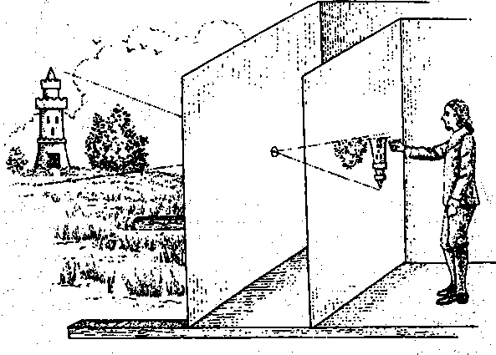
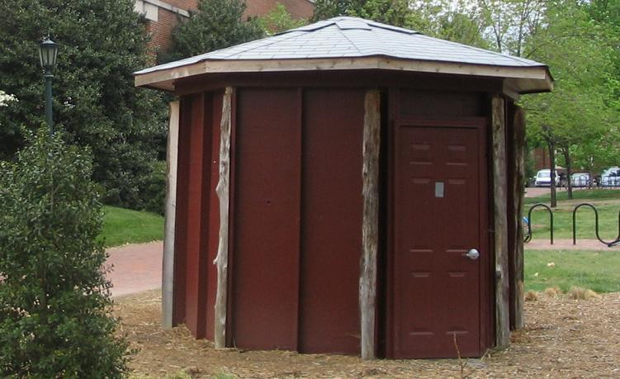
Camera obscura: the pre-camera
First idea: Mo-Ti, China (470BC to 390BC)
First built: Alhacen, Iraq/Egypt (965 to 1039AD)
Illustration of Camera Obscura
Freestanding camera obscura at UNC Chapel Hill
Photo by Seth Ilys

Slide 10
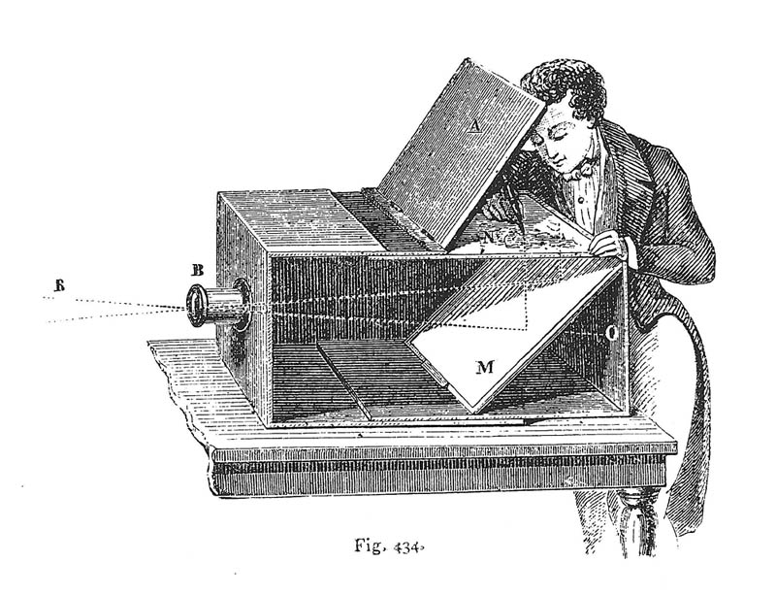
Camera Obscura used for Tracing
Lens Based Camera Obscura, 1568

Slide 11
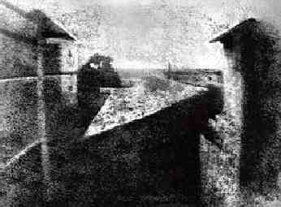
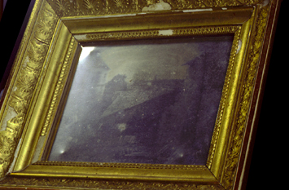
First Photograph
Oldest surviving photograph
  Took 8 hours on pewter plate
Photograph of the first photograph
Joseph Niepce, 1826
Stored at UT Austin
Niepce later teamed up with Daguerre, who eventually created Daguerrotypes

Slide 12
Pinhole camera
“circle of
confusion”
A lens focuses light onto the film
Slide source: Seitz

Slide 13
Dimensionality Reduction Machine (3D to 2D)
3D world
2D image
Figures © Stephen E. Palmer, 2002

Slide 14
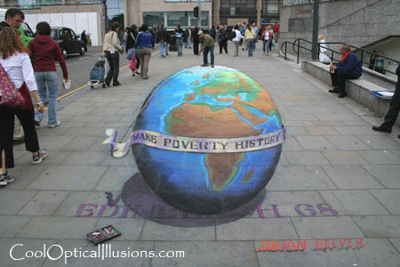
Projection can be tricky…
Slide source: Seitz

Slide 15
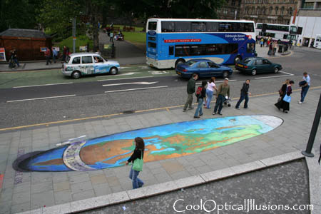
Projection can be tricky…
Slide source: Seitz

Slide 16
Projective Geometry
What is lost?
Length
Who is taller?
Which is closer?

Slide 17
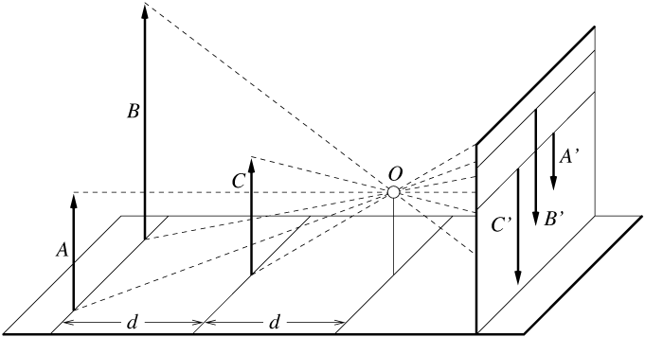
Length is not preserved
A’
C’
B’
Figure by David Forsyth

Slide 18
Projective Geometry
What is lost?
Length
Angles
Parallel?
Perpendicular?

Slide 19
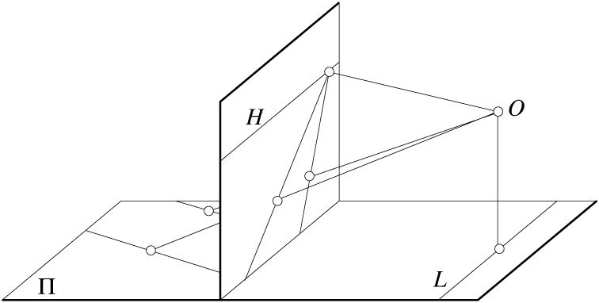
Parallel lines are not parallel in the image
Figure by David Forsyth

Slide 20
Projective Geometry
What is preserved?
Straight lines are still straight

Slide 21
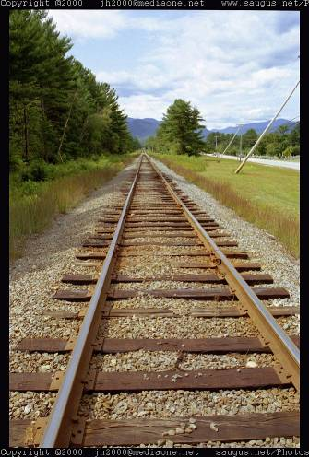
Vanishing points and lines
Parallel lines in the world intersect in the image at a “vanishing point”
Notes:
Go to board, sketch out various properties of vanishing points/lines

Slide 22
Vanishing points and lines
Vanishing Point
Vanishing Point
o
o
Vanishing Line
Notes:
Go to board, sketch out various properties of vanishing points/lines
Parallel lines intersect at a point
The intersection of red lines and blue lines form a parallelogram
Sets of parallel lines on the same plane form a vanishing line
Sets of parallel planes form a vanishing line
Not all lines that intersect are parallel

Slide 23

Vanishing points and lines
Vertical vanishing
point
(at infinity)
Vanishing
line
Vanishing
point
Vanishing
point
Credit: Criminisi

Slide 24
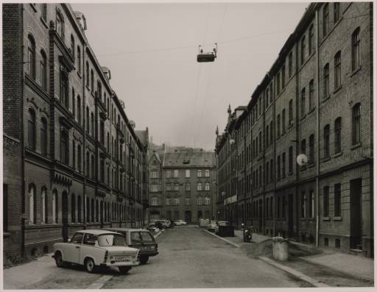
Vanishing points and lines
Photo from online Tate collection
Notes:
Where are the vanishing points? Do buildings on left and buildings on right have the same vanishing line? Which way is the camera tilted?

Slide 25
Note on estimating vanishing points
Use multiple lines for better accuracy
… but lines will not intersect at exactly the same point in practice
One solution: take mean of intersecting pairs
… bad idea!
Instead, minimize angular differences
Notes:
Go to board, sketch out various properties of vanishing points/lines

Slide 26
(more vanishing points on board)

Slide 27

Vanishing objects

Slide 28
Camera matrix
http://www.youtube.com/watch?v=6KlJzfsAzoY
Notes:
P = K [R t]

Slide 29
Projection: world coordinates→image coordinates
.
Optical Center (u₀, v₀)
.
.
f
Z
Y
.
v
Camera Center (t_{x}, t_{y}, t_{z})
u

Slide 30




Homogeneous coordinates
Conversion
Converting to homogeneous coordinates
homogeneous image
coordinates
homogeneous scene
coordinates
Converting from homogeneous coordinates
Notes:
Append coordinate with value 1; proportional coordinate system

Slide 31
Homogeneous coordinates
Invariant to scaling
Point in Cartesian is ray in Homogeneous
Homogeneous Coordinates
Cartesian Coordinates
Notes:
Q: Suppose we have a point in Cartesian coordinates. What is that in homogeneous coordinates? A: a ray

Slide 32
Basic geometry in homogeneous coordinates
Line equation: ax + by + c = 0
Append 1 to pixel coordinate to get homogeneous coordinate
Line given by cross product of two points
Intersection of two lines given by cross product of the lines

Slide 33
Work out at home
Write the equation for a line in 2d and 3d using homogeneous coordinates
Why is this the cross product?
Write the equation for a plane in 3D using homogeneous coordinates

Slide 34
Another problem solved by homogeneous coordinates
Intersection of parallel lines
  Cartesian: (Inf, Inf)
  Homogeneous: (1, 1, 0)
  Cartesian: (Inf, Inf)
Homogeneous: (1, 2, 0)
Notes:
Parallel lines intersect at different infinities

Slide 35

Projection matrix
Slide Credit: Saverese
R,T
j_{w}
k_{w}
O_{w}
i_{w}
x: Image Coordinates: w(u,v,1)
K: Intrinsic Matrix (3x3)
R: Rotation (3x3)
t: Translation (3x1)
X: World Coordinates: (X,Y,Z,1)

Slide 36
Projection matrix
Intrinsic Assumptions
Unit aspect ratio
Principal point at (0,0)
No skew
Extrinsic Assumptions
No rotation
Camera at (0,0,0)
K
Slide Credit: Saverese
Notes:
Work through equations for u and v on board

Slide 37
Remove assumption: known optical center
Intrinsic Assumptions
Unit aspect ratio
No skew
Extrinsic Assumptions
No rotation
Camera at (0,0,0)

Slide 38
Remove assumption: square pixels
Intrinsic Assumptions
No skew
Extrinsic Assumptions
No rotation
Camera at (0,0,0)

Slide 39
Remove assumption: non-skewed pixels
Intrinsic Assumptions
Extrinsic Assumptions
No rotation
Camera at (0,0,0)
Note: different books use different notation for parameters

Slide 40
Oriented and Translated Camera
R
j_{w}
t
k_{w}
O_{w}
i_{w}

Slide 41
Allow camera translation
Intrinsic Assumptions
Extrinsic Assumptions
No rotation

Slide 42
3D Rotation of Points
Slide Credit: Saverese
Rotation around the coordinate axes, counter-clockwise:
p’
γ
y
p
z

Slide 43
Allow camera rotation

Slide 44
Degrees of freedom
5
6
Notes:
How many known points are needed to estimate this?

Slide 45
Vanishing Point = Projection from Infinity

Slide 46
Orthographic Projection
Special case of perspective projection
  Distance from the COP to the image plane is infinite
  Also called “parallel projection”
  What’s the projection matrix?
Image
World
Slide by Steve Seitz

Slide 47
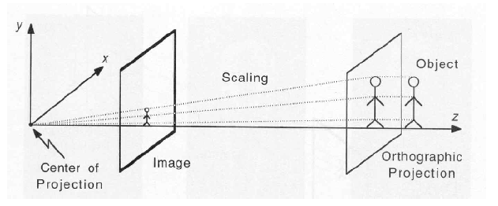
Scaled Orthographic Projection
Special case of perspective projection
  Object dimensions are small compared to distance to camera
  Also called “weak perspective”
  What’s the projection matrix?
Illustration from George Bebis
Slide by Steve Seitz

Slide 48
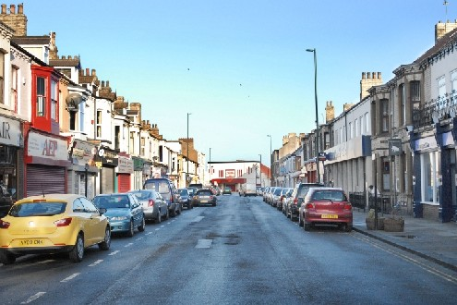
Take-home question
Suppose we have two 3D cubes on the ground facing the viewer, one near, one far.
What would they look like in perspective?
What would they look like in weak perspective?
Photo credit: GazetteLive.co.uk

Slide 49
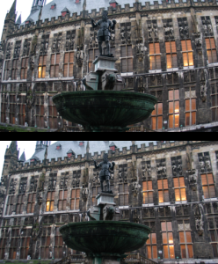
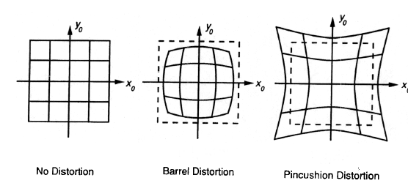
Beyond Pinholes: Radial Distortion
Corrected Barrel Distortion
Image from Martin Habbecke

Slide 50
Things to remember
Vertical vanishing
point
(at infinity)
Vanishing points and vanishing lines
Pinhole camera model and camera projection matrix
Vanishing
line
Vanishing
point
Vanishing
point

Slide 51

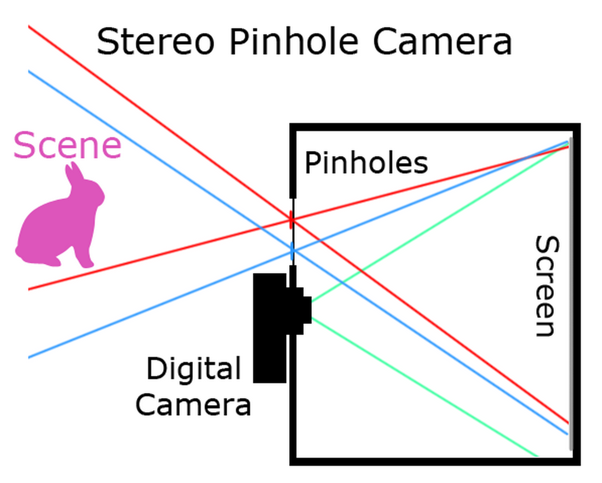
Making pinhole cameras
Groups of 1-2 – find a partner with a good digital camera
http://en.wikipedia.org/wiki/Anaglyph_3D
From James Hays

