Slide 1
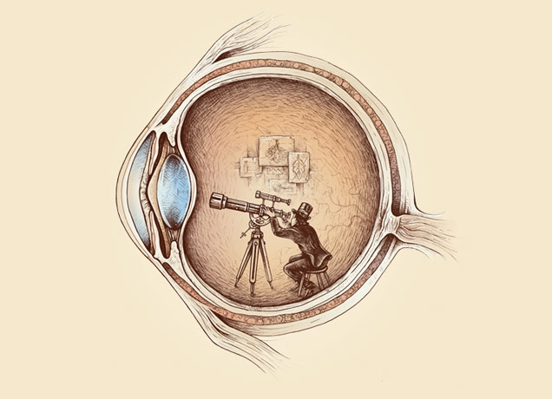
Computational Photography lecture 9 – HDR
CS 590-134 (Future 572) Spring 2016
Prof. Alex Berg
(Credits to many other folks on individual slides)

Slide 2
Today
Sign up for one-on-one midterm time.
Light probes and high dynamic range.
Notes:
(votes and comments are their votes for the best homework 1 write-up, and the best image in any of the write-ups.) Sakai should be open by the time class happens. I am working to try and combine the sakai for 590 and 790, hopefully this will work out ☺

Slide 3
Slides from Derek Hoiem and other

Slide 4
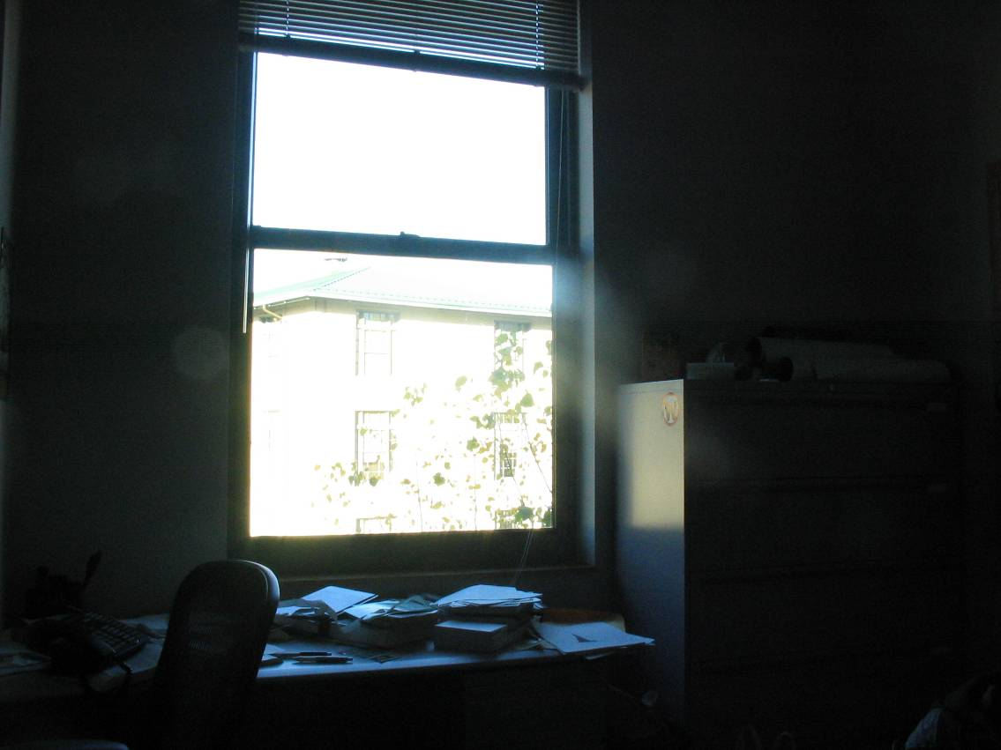
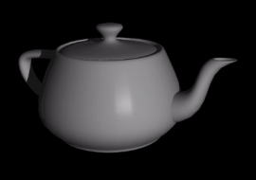
How to render an object inserted into an image?
Notes:
Lighting, no shadows, blending, etc.

Slide 5
How to render an object inserted into an image?
Traditional graphics way
Manually model BRDFs of all room surfaces
Manually model radiance of lights
Do ray tracing to relight object, shadows, etc.
Notes:
Lighting, no shadows, blending, etc.

Slide 6
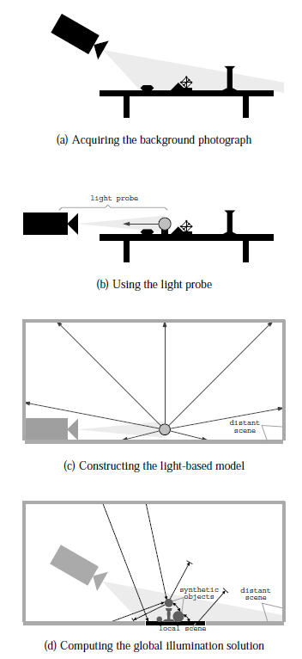
How to render an object inserted into an image?
Image-based lighting
Capture incoming light with a “light probe”
Model local scene
Ray trace, but replace distant scene with info from light probe
Debevec SIGGRAPH 1998

Slide 7


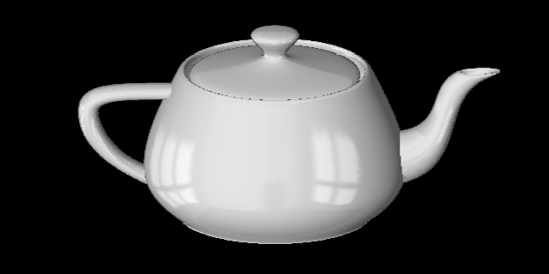
Key ideas for Image-based Lighting
Environment maps: tell what light is entering at each angle within some shell
+

Slide 8
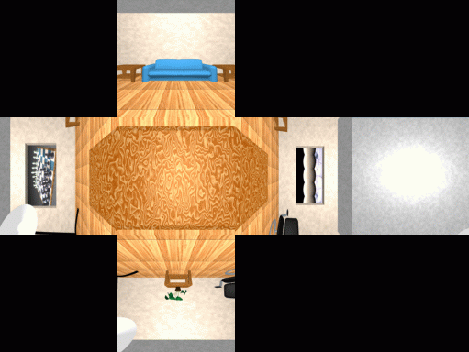
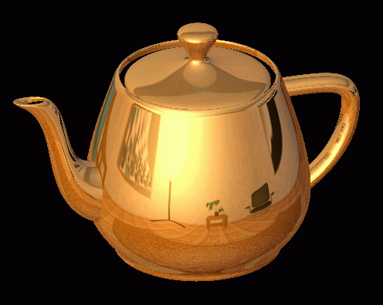
Cubic Map Example

Slide 9
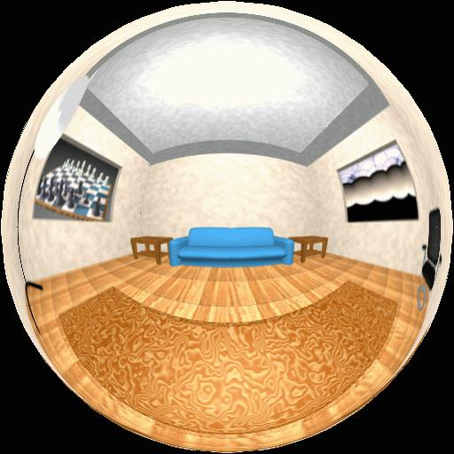
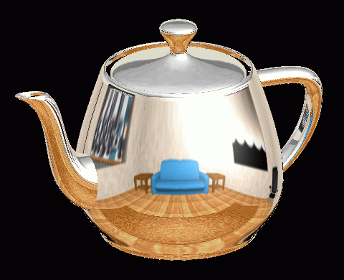
Spherical Map Example

Slide 10
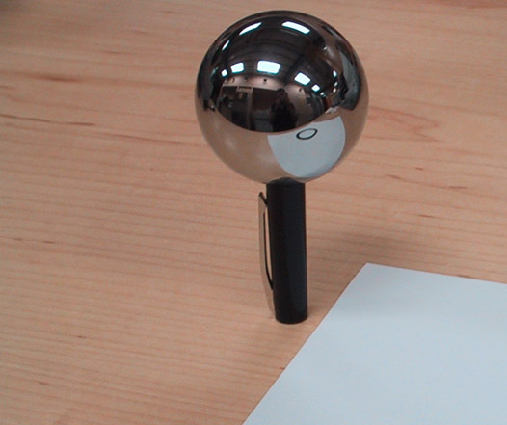
Key ideas for Image-based Lighting
Light probes: a way of capturing environment maps in real scenes

Slide 11
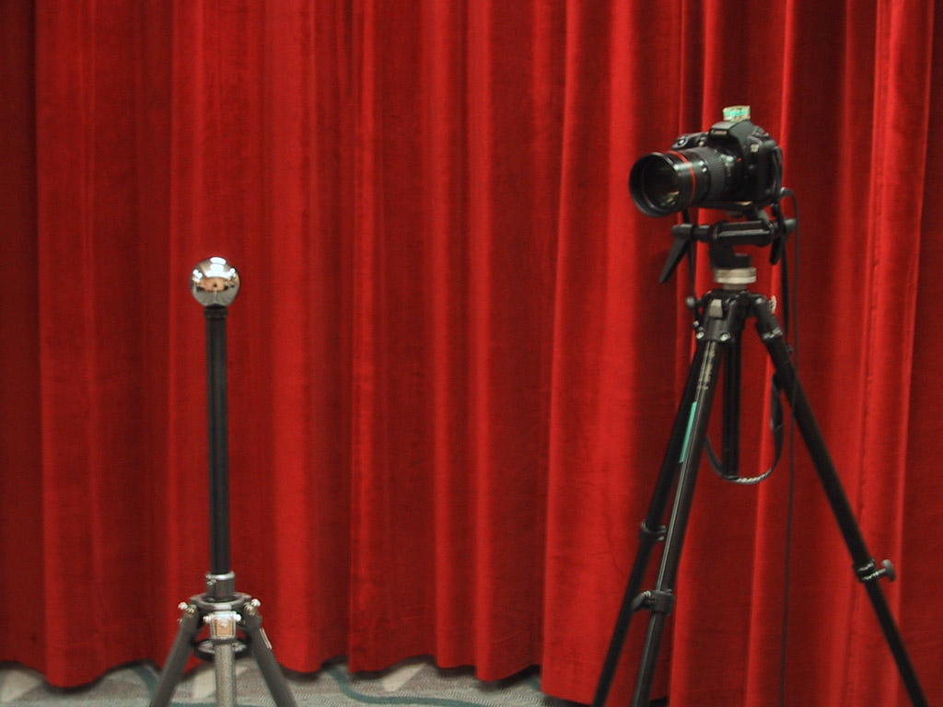
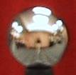
Mirrored Sphere

Slide 12
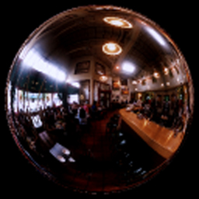
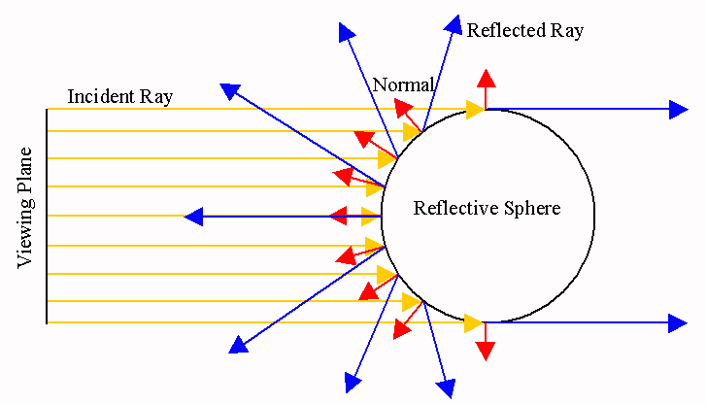

Slide 13
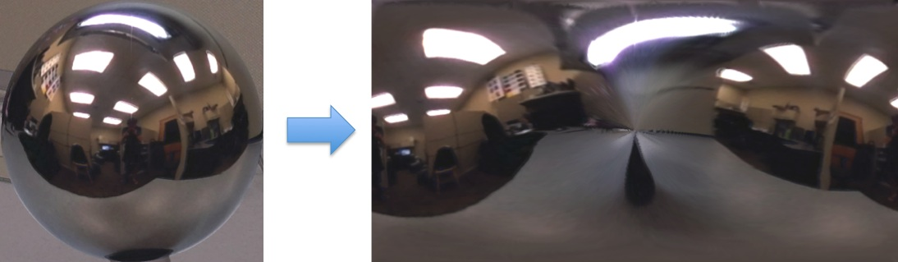
Mirror ball -> equirectangular

Slide 14
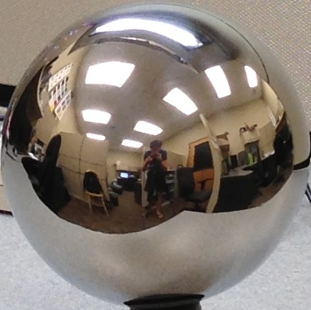



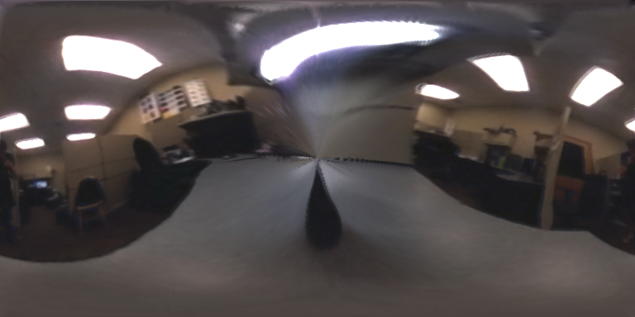

Mirror ball -> equirectangular
Mirror ball
Normals
Reflection
vectors
Phi/theta of reflection vecs
Equirectangular
Phi/theta equirectangular domain

Slide 15
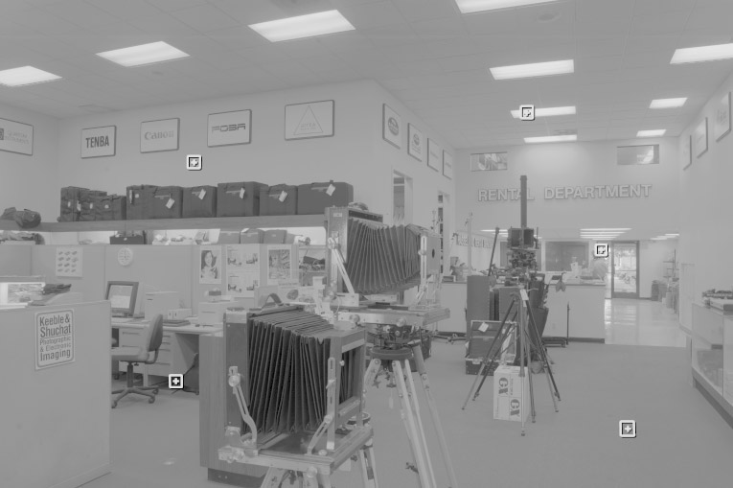
One small snag
How do we deal with light sources? Sun, lights, etc?
  They are much, much brighter than the rest of the environment
Use High Dynamic Range photography!
Relative Brightness
1907
.
46
.
.
15116
1
.
.
18

Slide 16
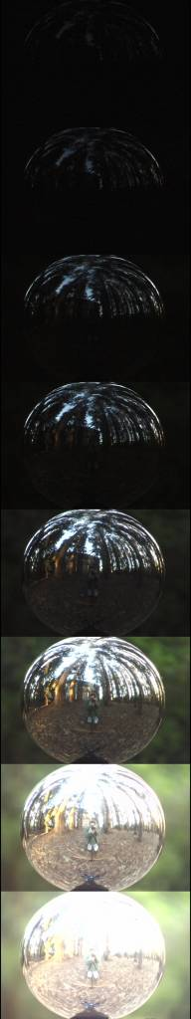
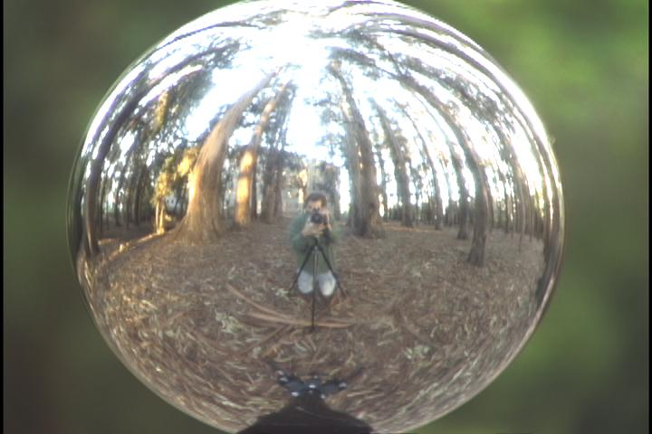
Key ideas for Image-based Lighting
Capturing HDR images: needed so that light probes capture full range of radiance

Slide 17
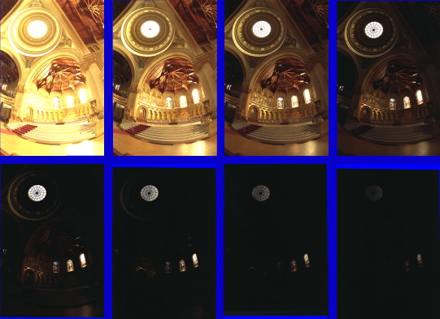
Problem: Dynamic Range

Slide 18
Long Exposure
10⁻⁶
High dynamic range
10⁶
Real world
10⁻⁶
10⁶
Picture
^{0 to 255}

Slide 19
Short Exposure
10⁻⁶
High dynamic range
10⁶
Real world
10⁻⁶
10⁶
Picture
^{0 to 255}

Slide 20
LDR->HDR by merging exposures
^{0 to 255}
Exposure 1
Exposure 2
…
Exposure n
10⁻⁶
10⁶
Real world
High dynamic range

Slide 21
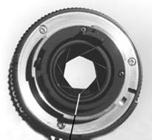
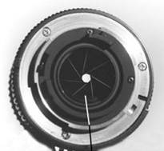
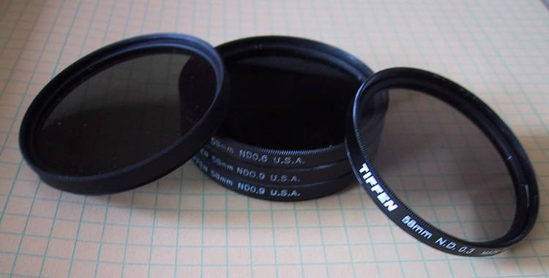
Ways to vary exposure
Shutter Speed (*)
F/stop (aperture, iris)
Neutral Density (ND) Filters

Slide 22
Shutter Speed
Ranges: Canon EOS-1D X: 30 to 1/8,000 sec.
ProCamera for iOS: ~1/10 to 1/2,000 sec.
Pros:
Directly varies the exposure
Usually accurate and repeatable
Issues:
Noise in long exposures

Slide 23
Recovering High Dynamic Range
Radiance Maps from Photographs
Paul Debevec
Jitendra Malik
Computer Science Division
University of California at Berkeley
August 1997
Notes:
1

Slide 24
The Approach
Get pixel values Z_{ij} for image with shutter time Δt_{j} (i^{th} pixel location, j^{th} image)
Exposure is radiance integrated over time:
Pixel values are non-linearly mapped E_{ij}’s:
Rewrite to form a (not so obvious) linear system:

Slide 25
The objective
Solve for radiance R and mapping g for each of 256 pixel values to minimize:
give pixels near 0 or 255 less weight
known shutter time for image j
exposure should smoothly increase as pixel intensity increases
radiance at particular pixel site is the same for each image
exposure, as a function of pixel value

Slide 26
The Math
Let g(z) be the discrete inverse response function
For each pixel site i in each image j, want:
Solve the overdetermined linear system:
fitting term
smoothness term
Notes:
g(z) maps the pixel intensity to an exposure

Slide 27
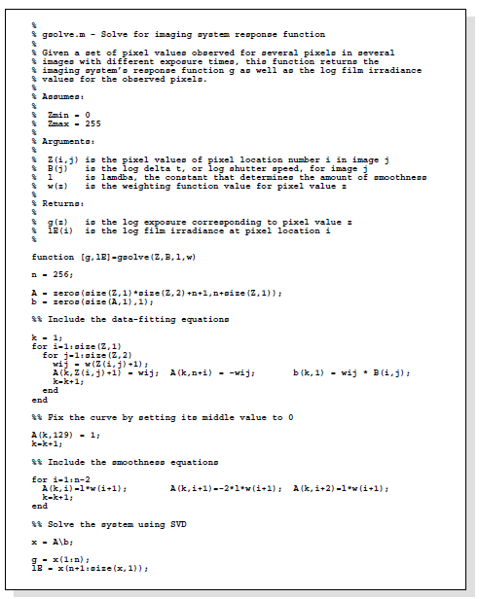
Matlab Code

Slide 28
Matlab Code
function [g,lE]=gsolve(Z,B,l,w)
n = 256;
A = zeros(size(Z,1)*size(Z,2)+n+1,n+size(Z,1));
b = zeros(size(A,1),1);
k = 1; %% Include the data-fitting equations
for i=1:size(Z,1)
for j=1:size(Z,2)
wij = w(Z(i,j)+1);
A(k,Z(i,j)+1) = wij; A(k,n+i) = -wij; b(k,1) = wij * B(i,j);
k=k+1;
end
end
A(k,129) = 1; %% Fix the curve by setting its middle value to 0
k=k+1;
for i=1:n-2 %% Include the smoothness equations
A(k,i)=l*w(i+1); A(k,i+1)=-2*l*w(i+1); A(k,i+2)=l*w(i+1);
k=k+1;
end
x = A\b; %% Solve the system using pseudoinverse
g = x(1:n);
lE = x(n+1:size(x,1));

Slide 29
Illustration
Image series
• 1
• 1
• 1
• 1
• 1
• 2
• 2
• 2
• 2
• 2
• 3
• 3
• 3
• 3
• 3
Δt =
1/64 sec
Δt =
1/16 sec
Δt =
1/4 sec
Δt =
1 sec
Δt =
4 sec
Pixel Value Z = f(Exposure)
Exposure = Radiance × Δt
log Exposure = log Radiance + log Δt
Notes:
10

Slide 30
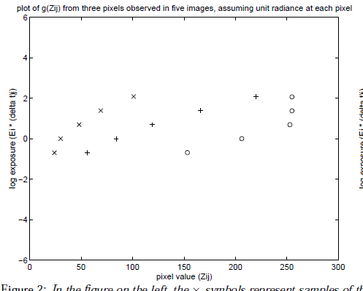
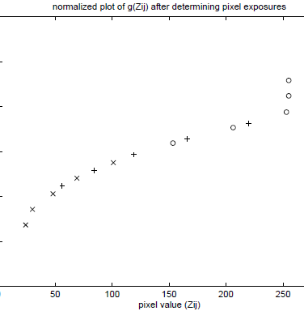
Illustration: Response Curve
ln(exposure)

Slide 31
Response Curve
Assuming unit radiance
for each pixel
After adjusting radiances to obtain a smooth response curve
3
2
Pixel value
Pixel value
1
ln Exposure
ln Exposure

Slide 32
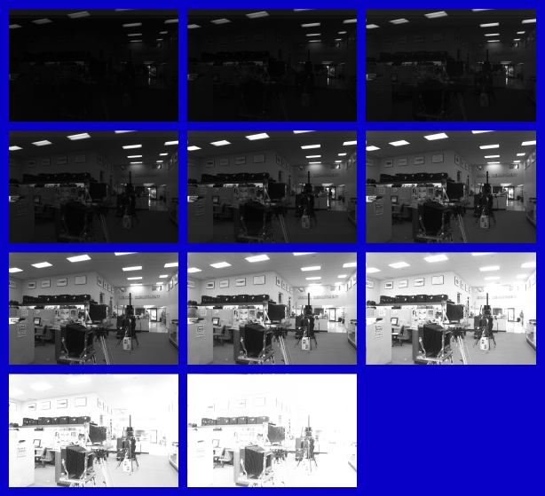
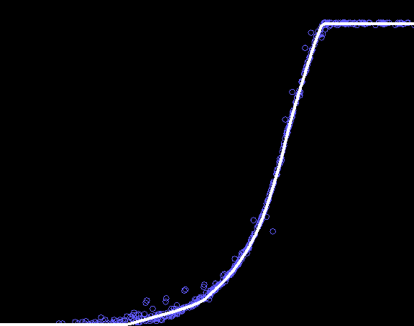
Results: Digital Camera
Kodak DCS460
1/30 to 30 sec
Recovered response curve
Pixel value
log Exposure
Notes:
13

Slide 33
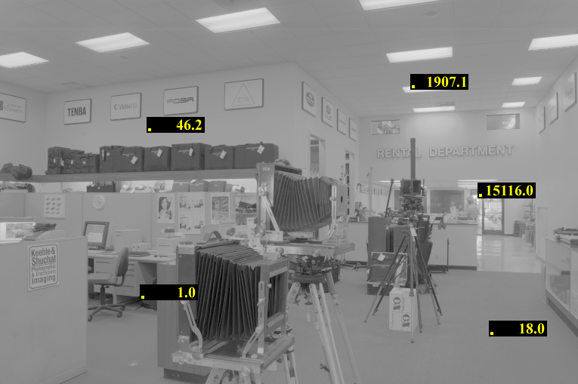
Reconstructed radiance map

Slide 34
Results: Color Film
Kodak Gold ASA 100, PhotoCD
Notes:
14

Slide 35
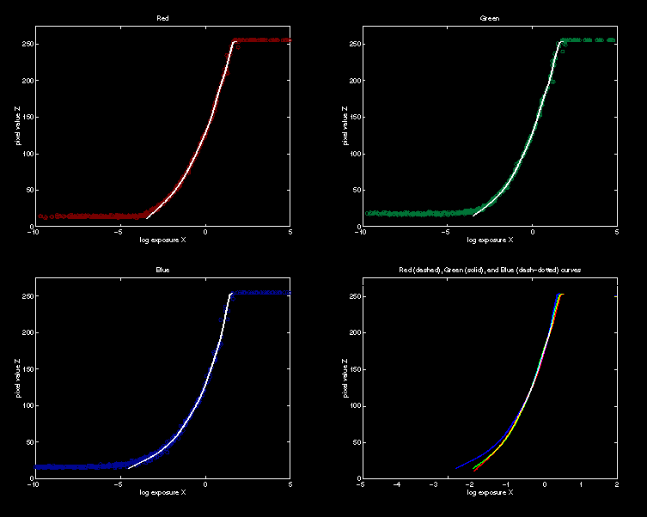
Recovered Response Curves
Red
Green
Blue
RGB
Notes:
15

Slide 36
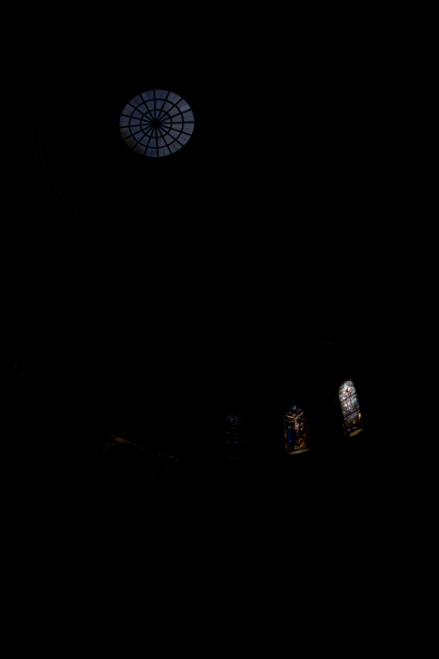
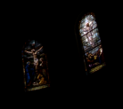
How to display HDR?
Linearly scaled to
display device

Slide 37
Simple Global Operator
Compression curve needs to
  Bring everything within range
  Leave dark areas alone
In other words
  Asymptote at 255
  Derivative of 1 at 0

Slide 38
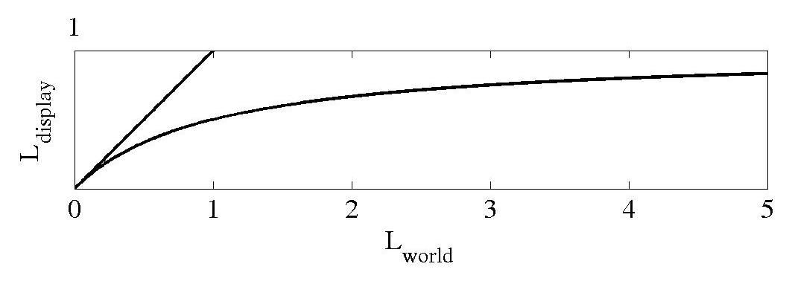
Global Operator (Reinhart et al)

Slide 39
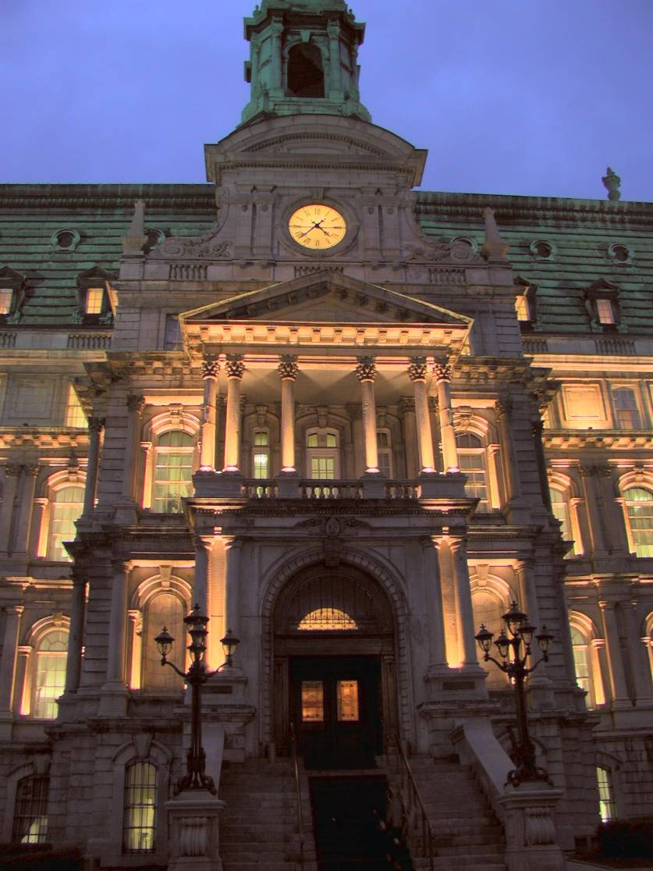
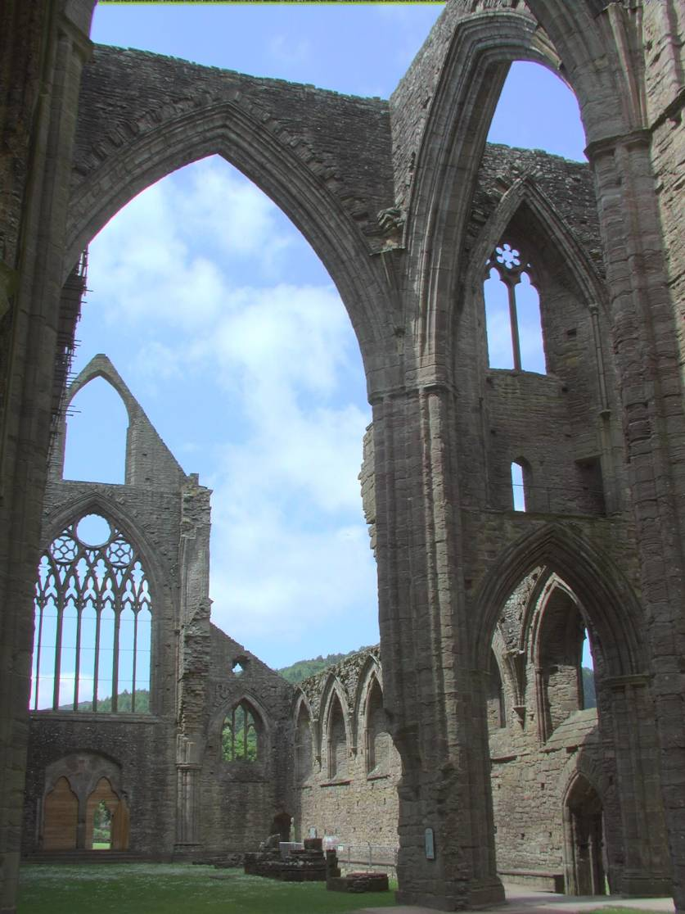
Global Operator Results

Slide 40
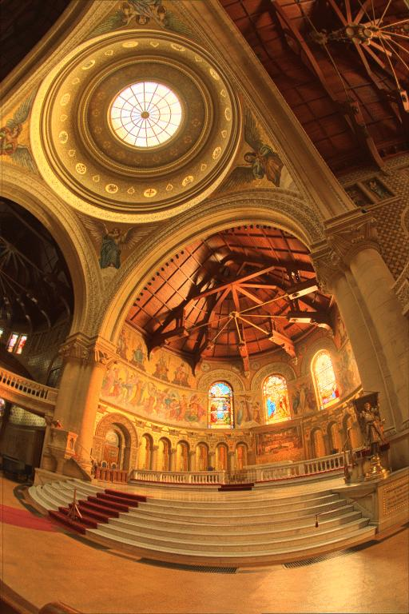
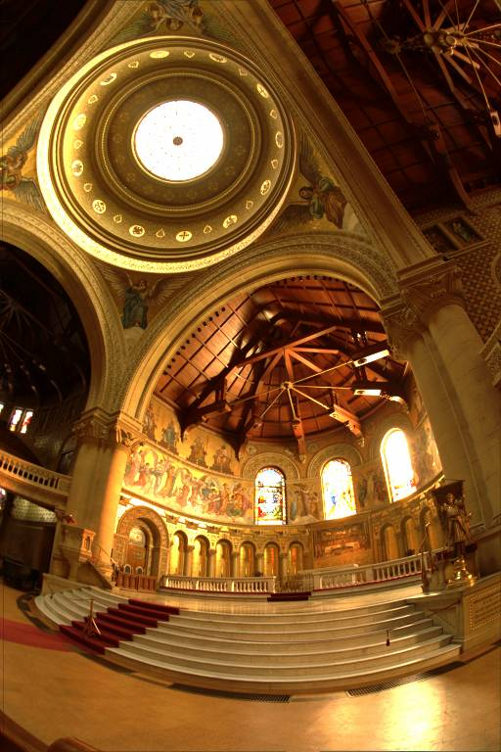
Reinhart Operator
Darkest 0.1% scaled
to display device

Slide 41
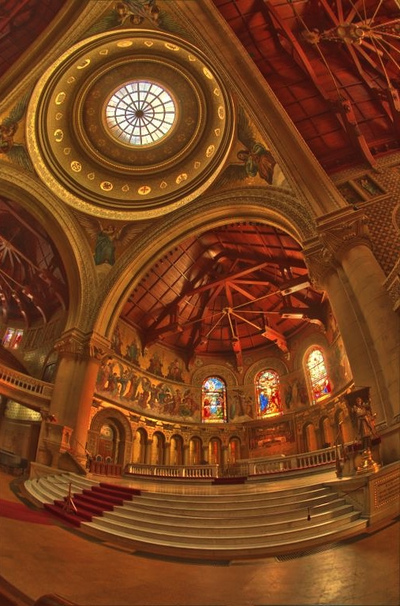
Local operator

Slide 42
What do we see?
Vs.

Slide 43
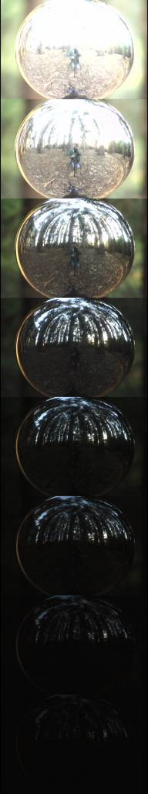
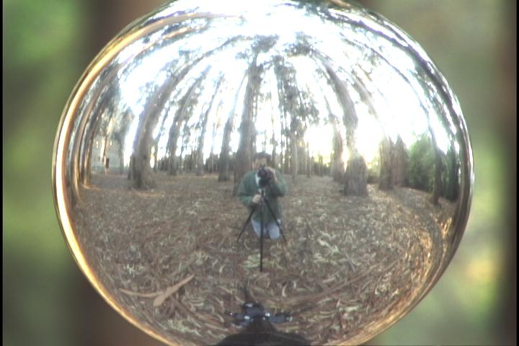
Acquiring the Light Probe

Slide 44
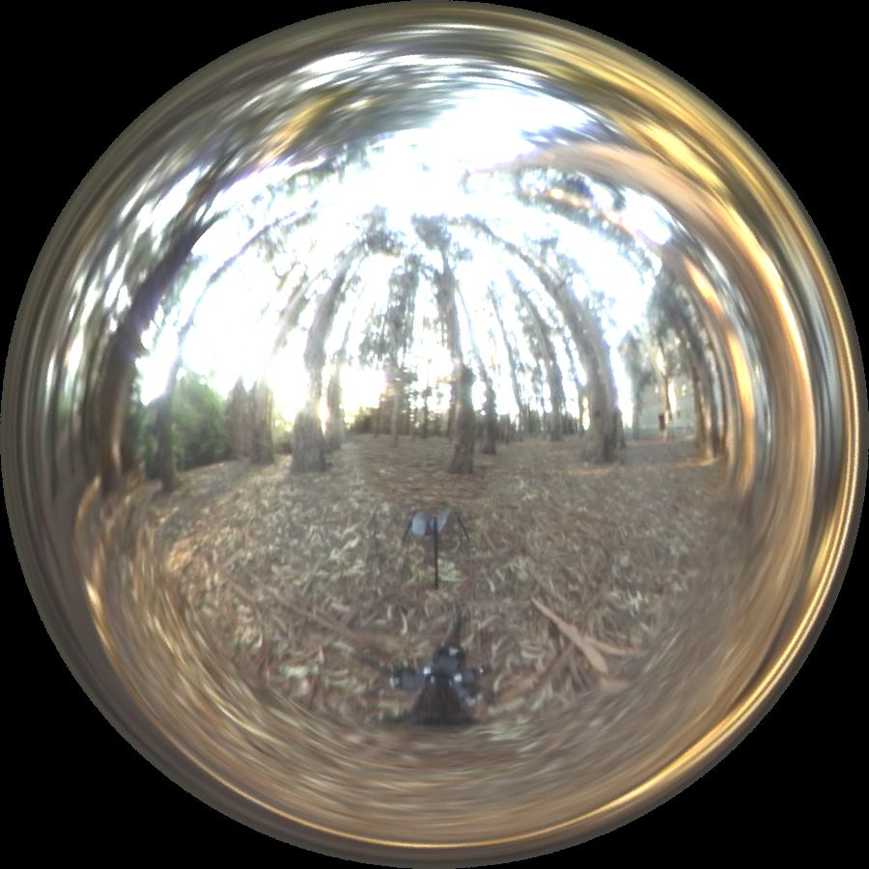
Assembling the Light Probe

Slide 45
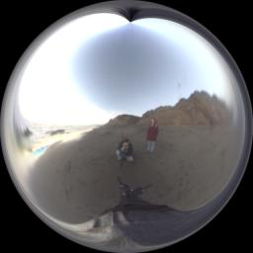
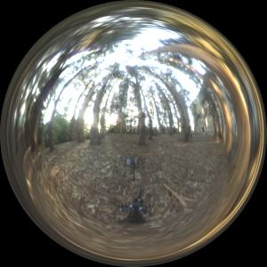
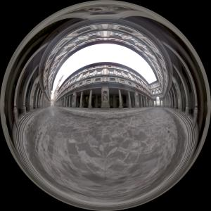
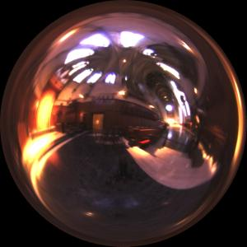
Real-World HDR Lighting Environments
Funston
Beach
Eucalyptus
Grove
Uffizi
Gallery
Grace
Cathedral
Lighting Environments from the Light Probe Image Gallery:
http://www.debevec.org/Probes/

Slide 46
Not just shiny…
We have captured a true radiance map
We can treat it as an extended (e.g spherical) light source
Can use Global Illumination to simulate light transport in the scene
  So, all objects (not just shiny) can be lighted
  What’s the limitation?

Slide 47
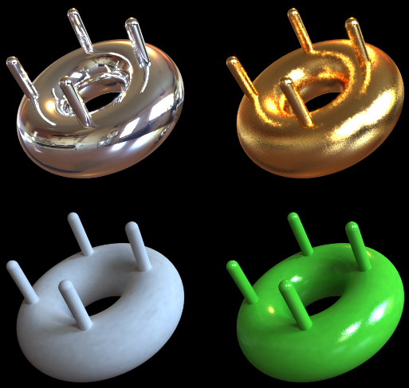
Illumination Results
Rendered with Greg Larson’s RADIANCE
synthetic imaging system
Notes:
HDR is revealed with rough specularities.

Slide 48
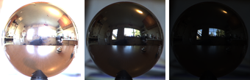
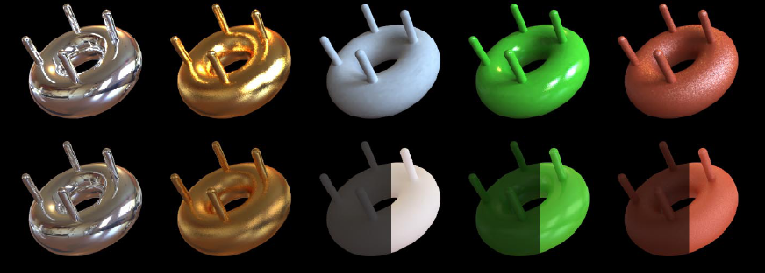
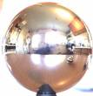
Comparison: Radiance map versus single image
HDR
LDR

Slide 49
Synthetic Objects
+
Real light!

Slide 50

CG Objects Illuminated by a Traditional CG Light Source

Slide 51
Illuminating Objects using Measurements of Real Light
Light
Environment assigned “glow” material property in
Greg Ward’s RADIANCE system.
Object
http://radsite.lbl.gov/radiance/

Slide 52




Paul Debevec. A Tutorial on Image-Based Lighting. IEEE Computer Graphics and Applications, Jan/Feb 2002.

Slide 53

Rendering with Natural Light
SIGGRAPH 98 Electronic Theater

Slide 54
Movie
http://www.youtube.com/watch?v=EHBgkeXH9lU

Slide 55

Illuminating a Small Scene

Slide 56


Slide 57
  We can now illuminate
  synthetic objects with real light.
  - Environment map
  - Light probe
  - HDR
  - Ray tracing
How do we add synthetic objects to a
real scene?

Slide 58

Real Scene Example
Goal: place synthetic objects on table

Slide 59
Modeling the Scene
light-based model
real scene

Slide 60
Light Probe / Calibration Grid

Slide 61

The Light-Based Room Model

Slide 62
Modeling the Scene
light-based model
local scene
synthetic objects
real scene

Slide 63

Differential Rendering
Local scene w/o objects, illuminated by model

Slide 64
The Lighting Computation
distant scene (light-based, unknown BRDF)
synthetic objects
(known BRDF)
local scene
(estimated BRDF)

Slide 65
Rendering into the Scene
Background Plate

Slide 66

Rendering into the Scene
Objects and Local Scene matched to Scene

Slide 67

Differential Rendering
Difference in local scene
-
=

Slide 68

Differential Rendering
Final Result

Slide 69
How to render an object inserted into an image?
Image-based lighting
Capture incoming light with a “light probe”
Model local scene
Ray trace, but replace distant scene with info from light probe
Debevec SIGGRAPH 1998

Slide 70

IMAGE-BASED LIGHTING IN FIAT LUX
Paul Debevec, Tim Hawkins, Westley Sarokin, H. P. Duiker, Christine Cheng, Tal Garfinkel, Jenny Huang
SIGGRAPH 99 Electronic Theater

Slide 71
Fiat Lux
http://ict.debevec.org/~debevec/FiatLux/movie/
http://ict.debevec.org/~debevec/FiatLux/technology/

Slide 72


Slide 73






HDR Image Series
2 sec
1/4 sec
1/30 sec
1/250 sec
1/2000 sec
1/8000 sec

Slide 74










Stp1 Panorama

Slide 75

Assembled Panorama

Slide 76



Light Probe Images

Slide 77














Capturing a Spatially-Varying Lighting Environment

Slide 78



What if we don’t have a light probe?
Zoom in on eye
Insert Relit Face
Environment map from eye
http://www1.cs.columbia.edu/CAVE/projects/world_eye/ -- Nishino Nayar 2004

Slide 79


Slide 80

Environment Map from an Eye

Slide 81




Can Tell What You are Looking At
Eye Image:
Computed Retinal Image:

Slide 82





Slide 83

Summary
Real scenes have complex geometries and materials that are difficult to model
We can use an environment map, captured with a light probe, as a replacement for distance lighting
We can get an HDR image by combining bracketed shots
We can relight objects at that position using the environment map

Slide 84
Take away
Read the paper for next class (Wed), we will go over the math again
http://www.pauldebevec.com/Research/HDR/debevec-siggraph97.pdf
Make progress on your assignments

