Slide 1
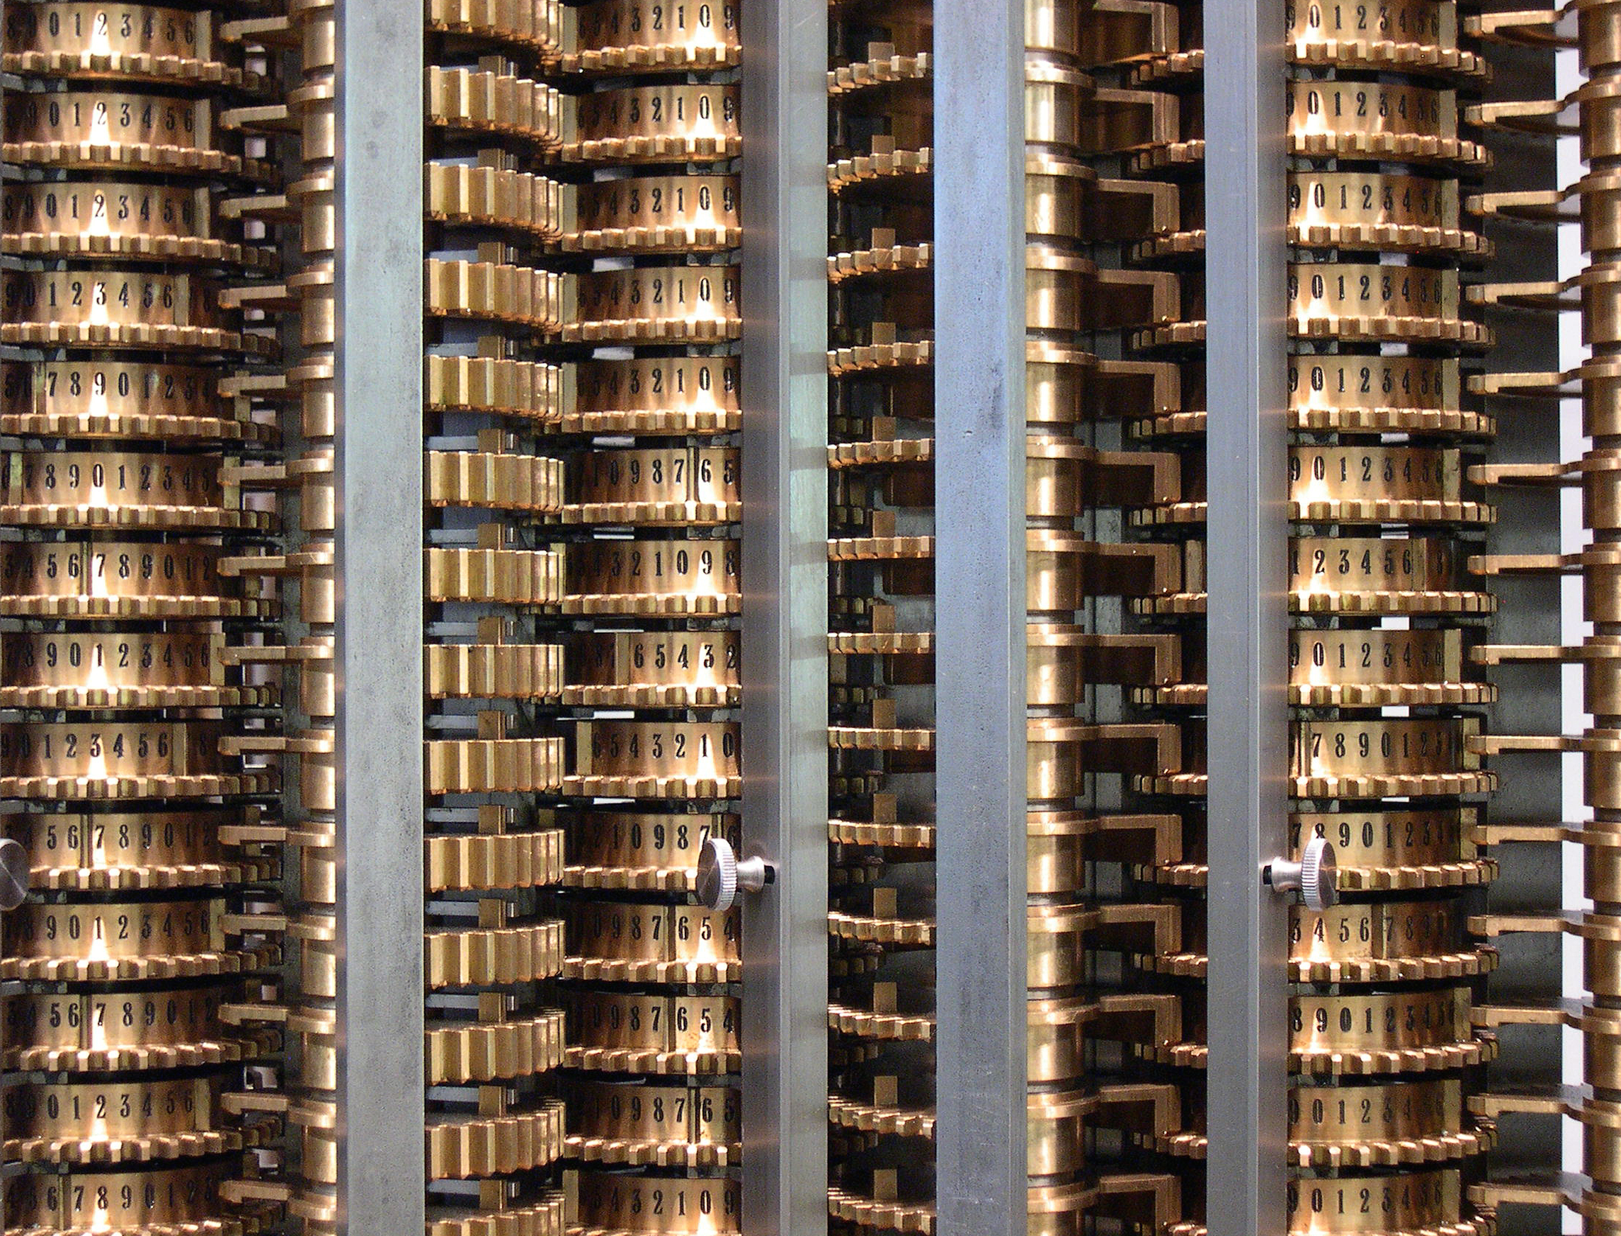
Machine Learning with Discriminative Methods Lecture 05 – Doing it 1 CS 790-134 Spring 2015
Alex Berg

Slide 2
Today’s class
Go over write-ups
Train, test, and validation error
Overfitting
Linear regression

Slide 3
Figures from Hastie et al Text…

Slide 4
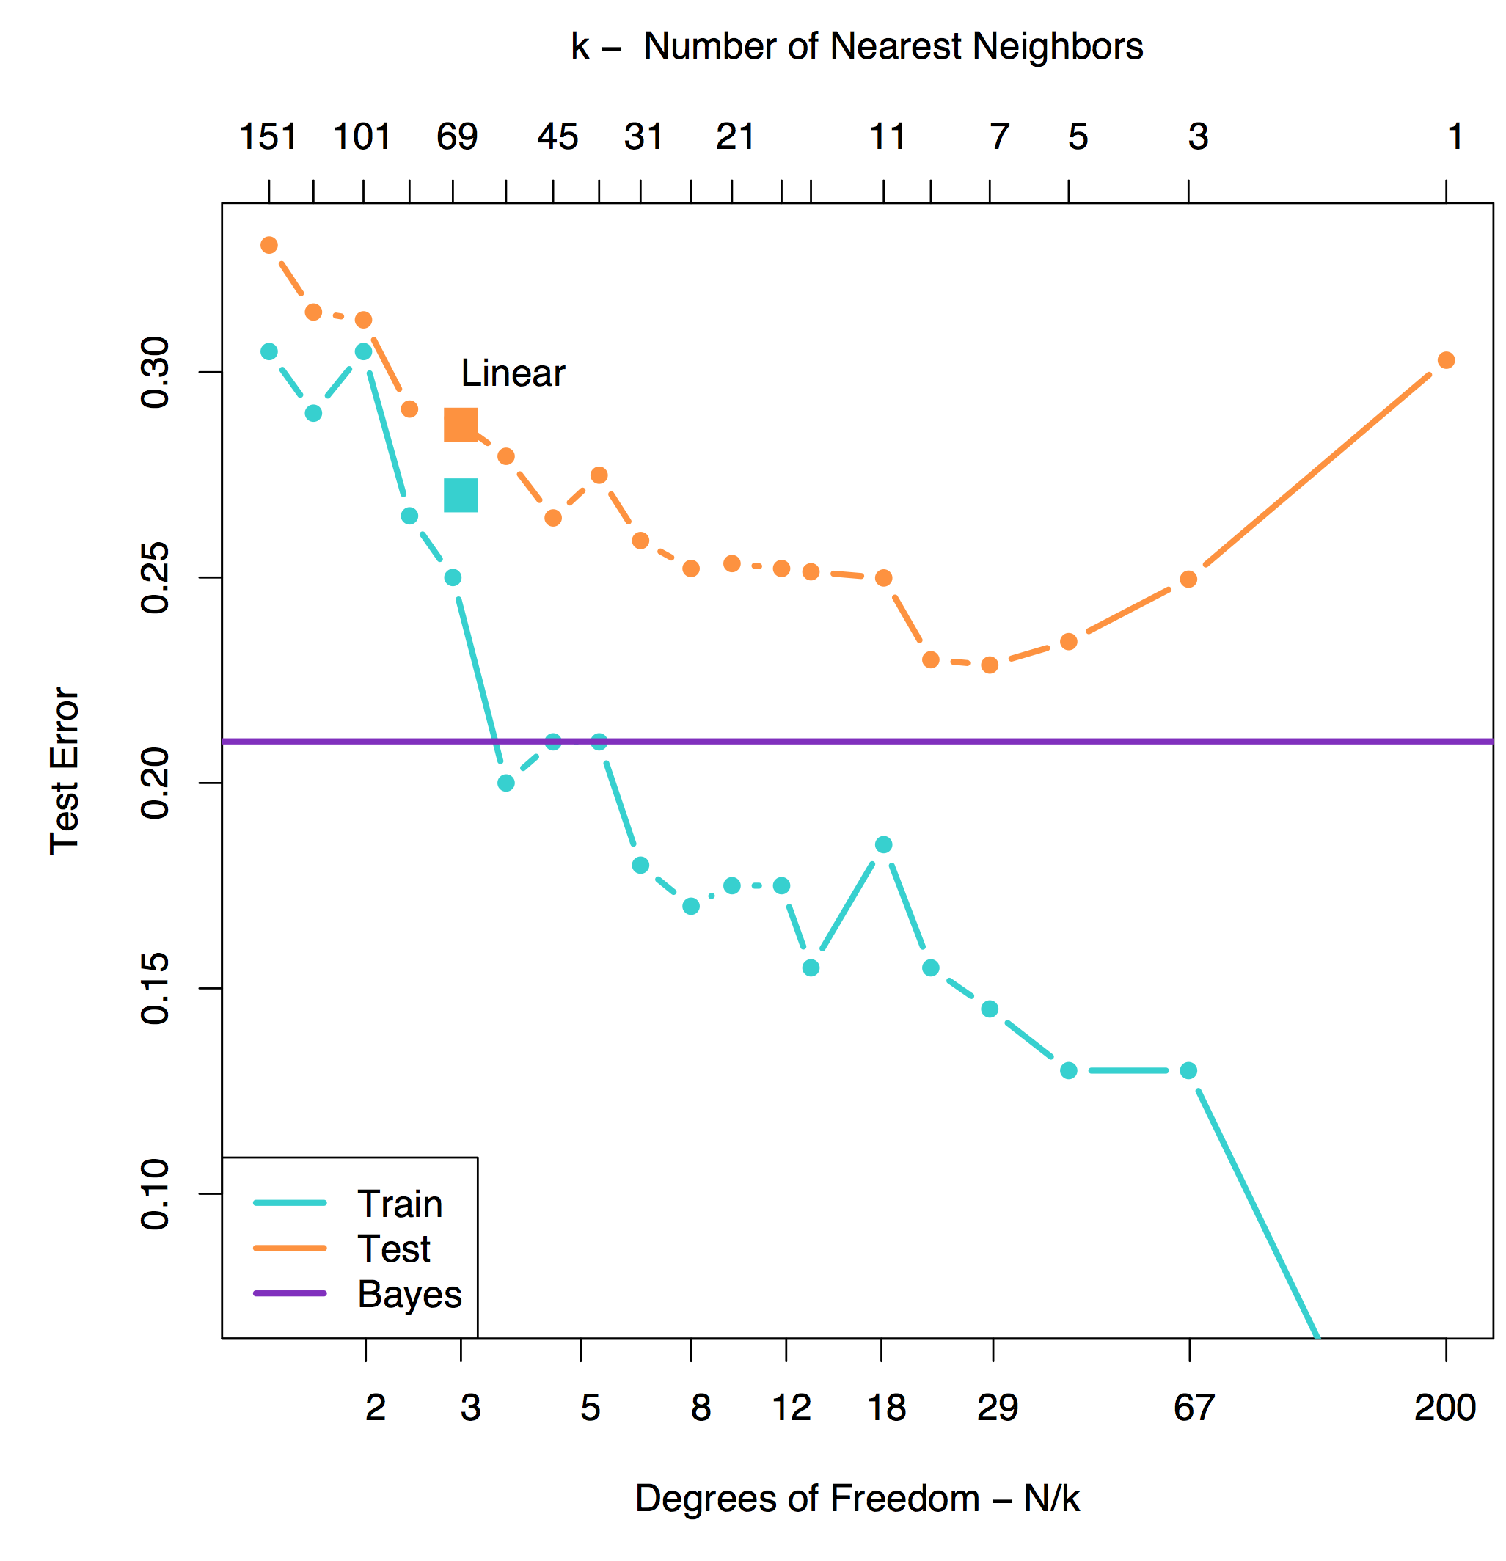
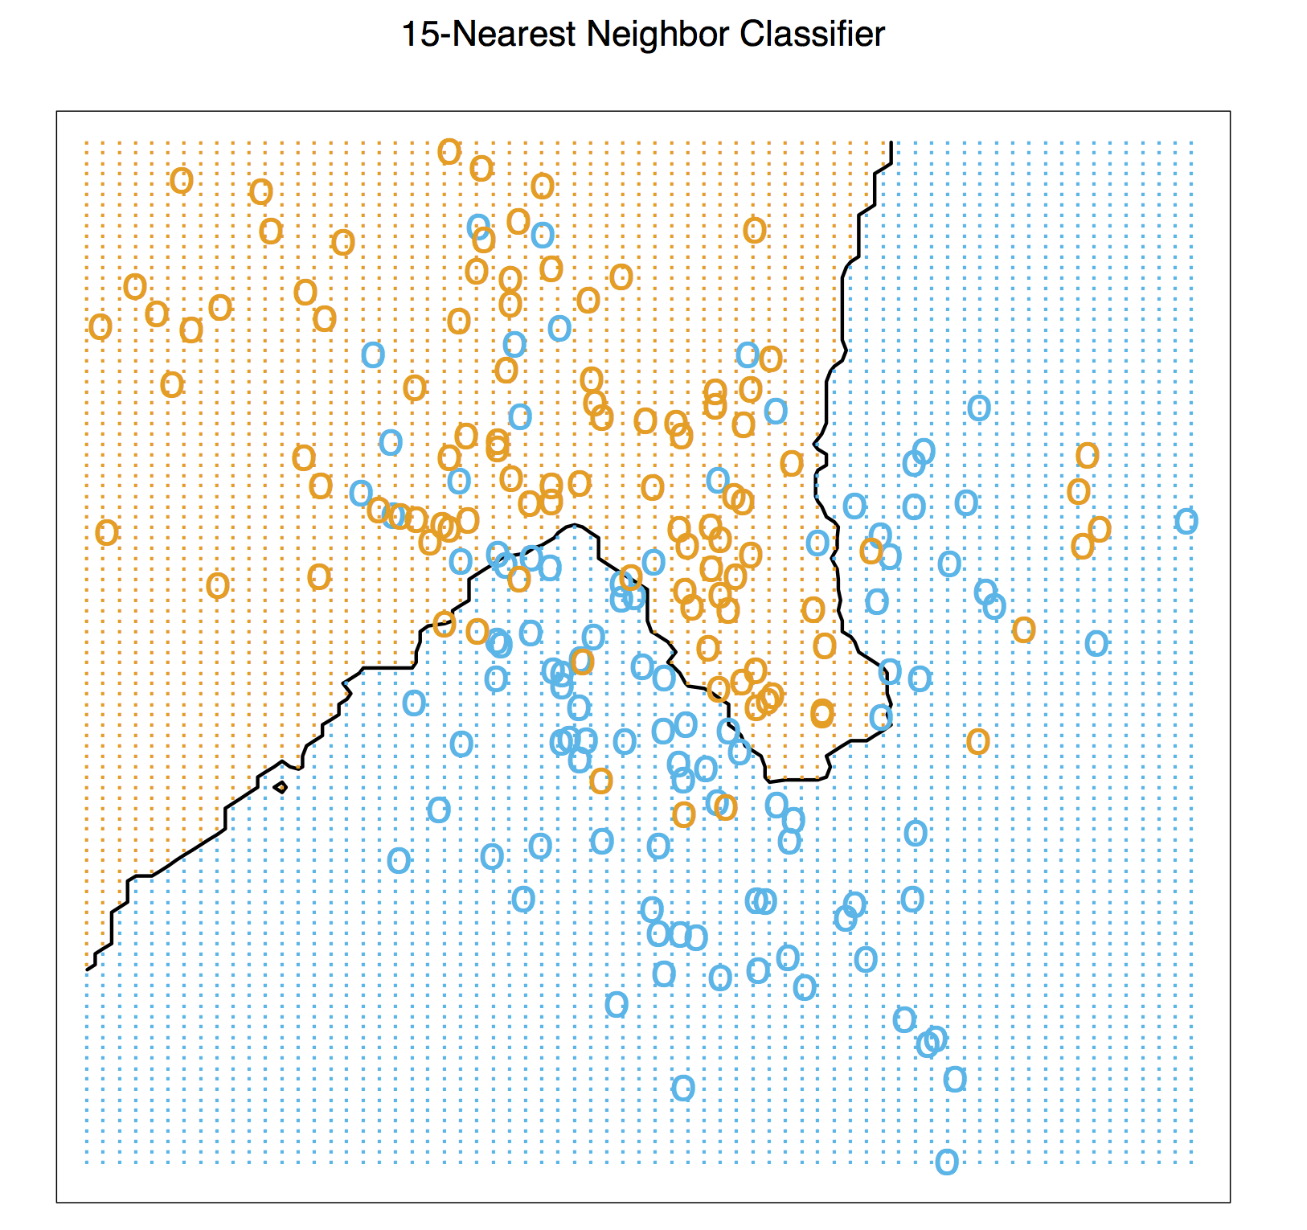
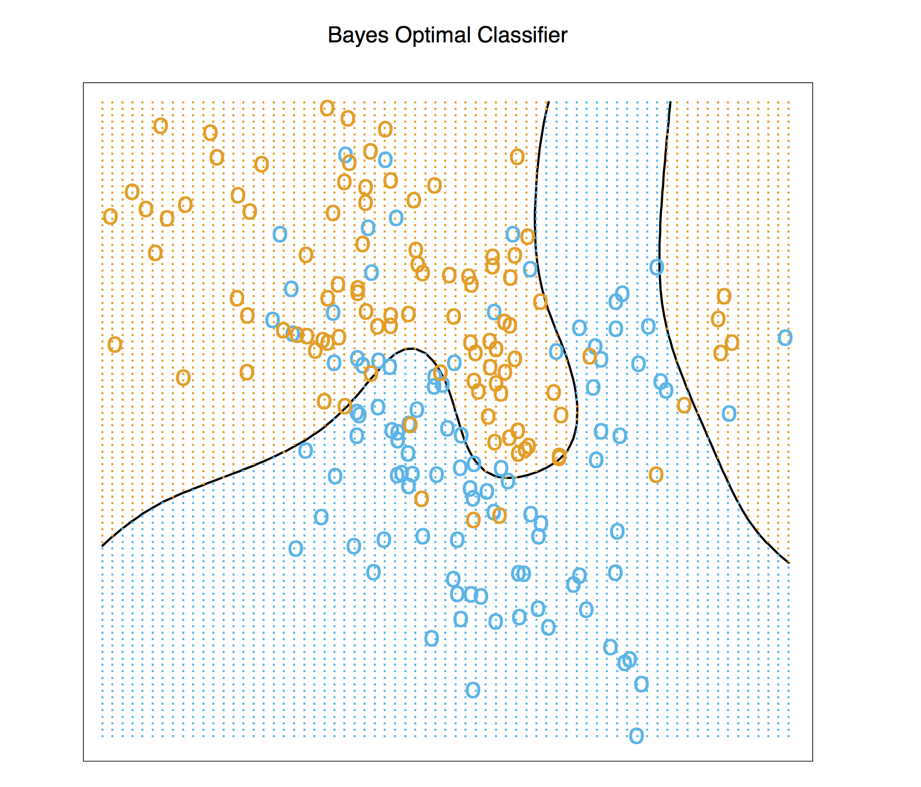
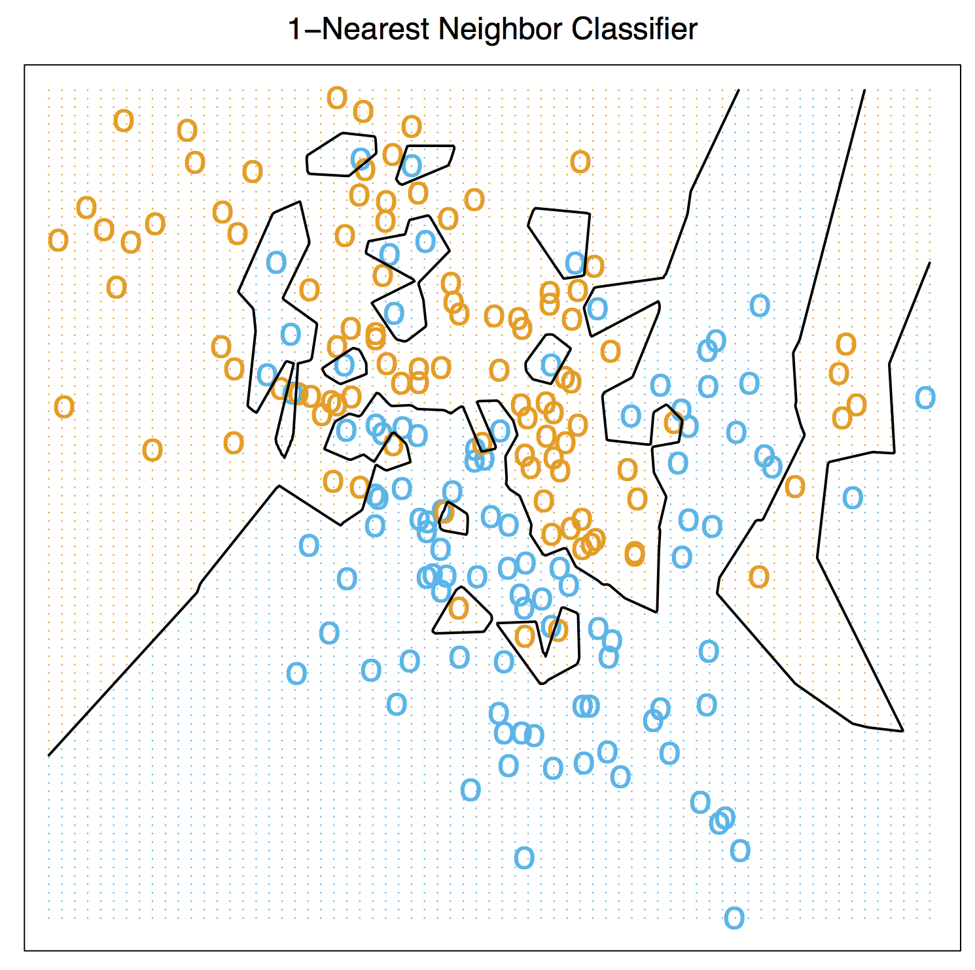
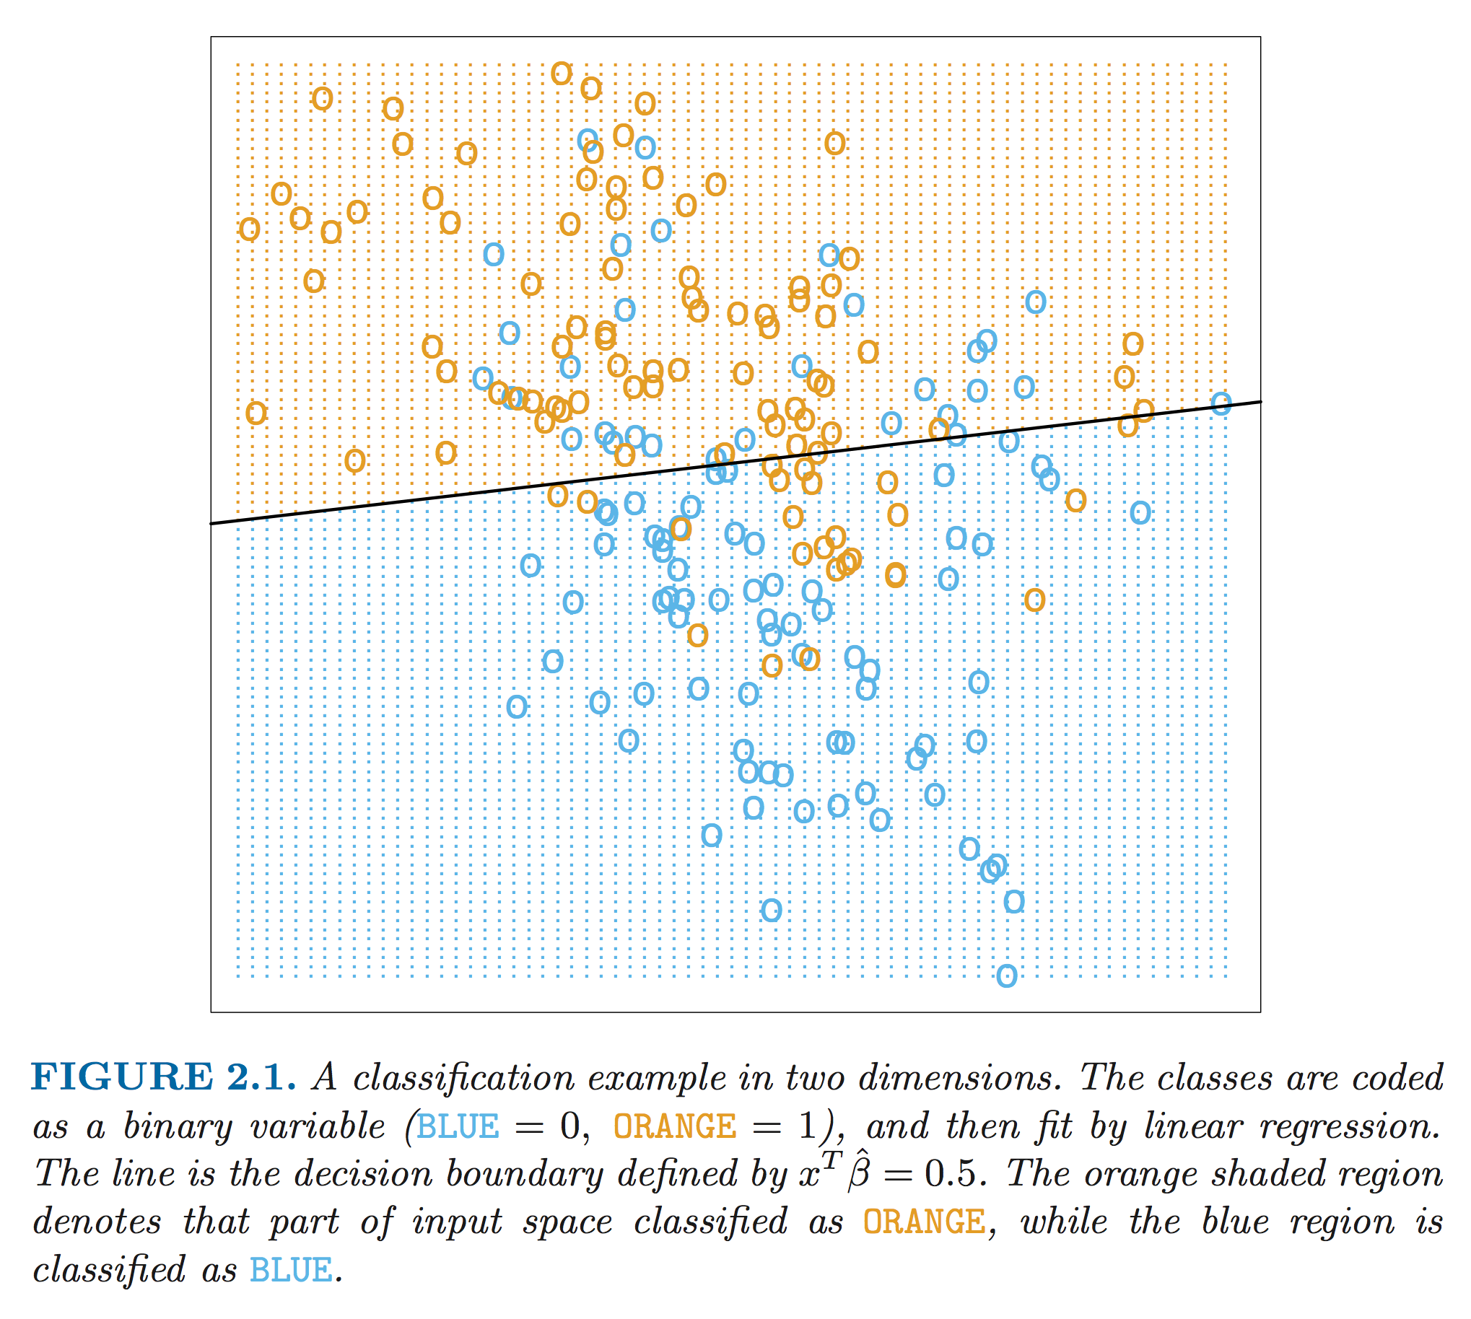

Slide 5
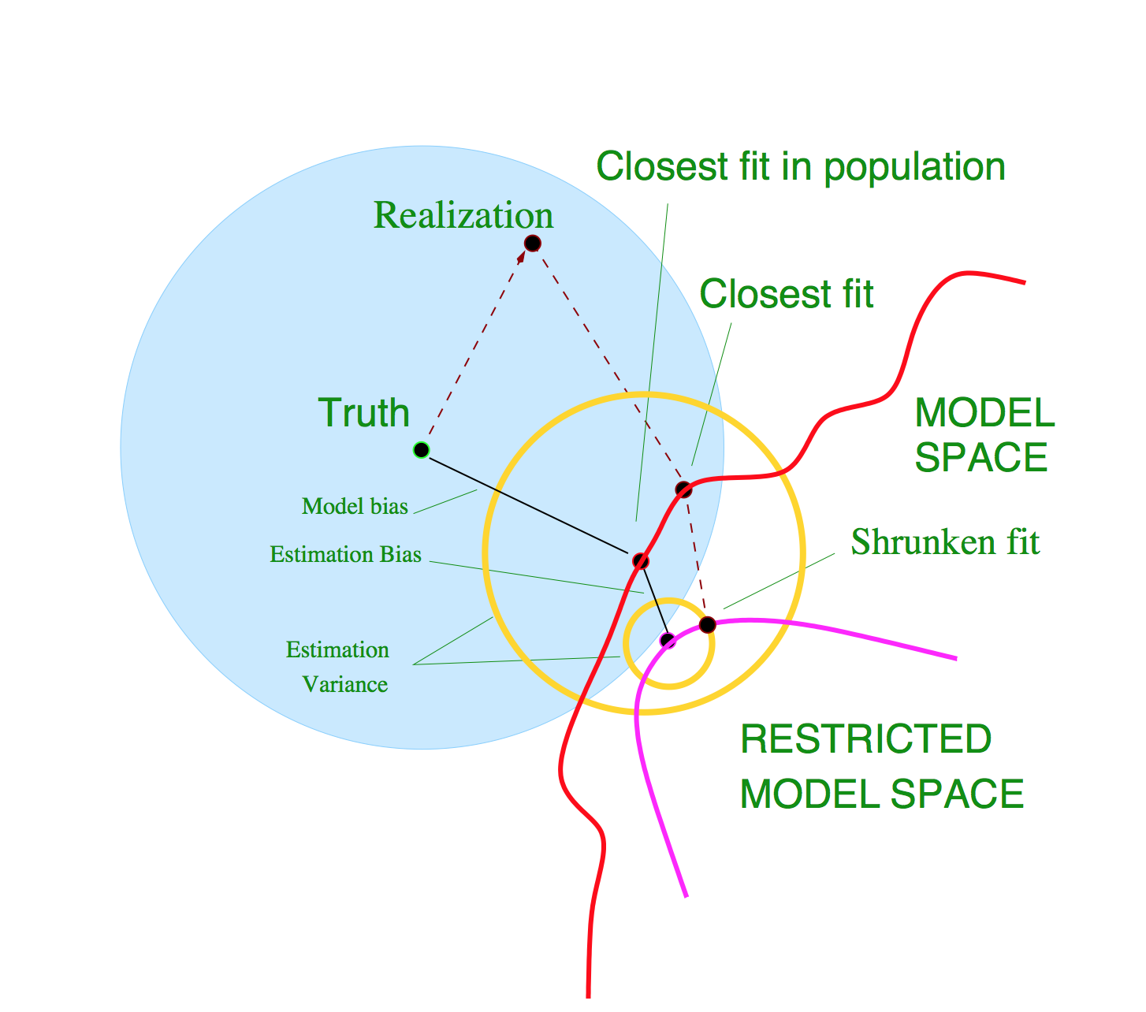

Slide 6
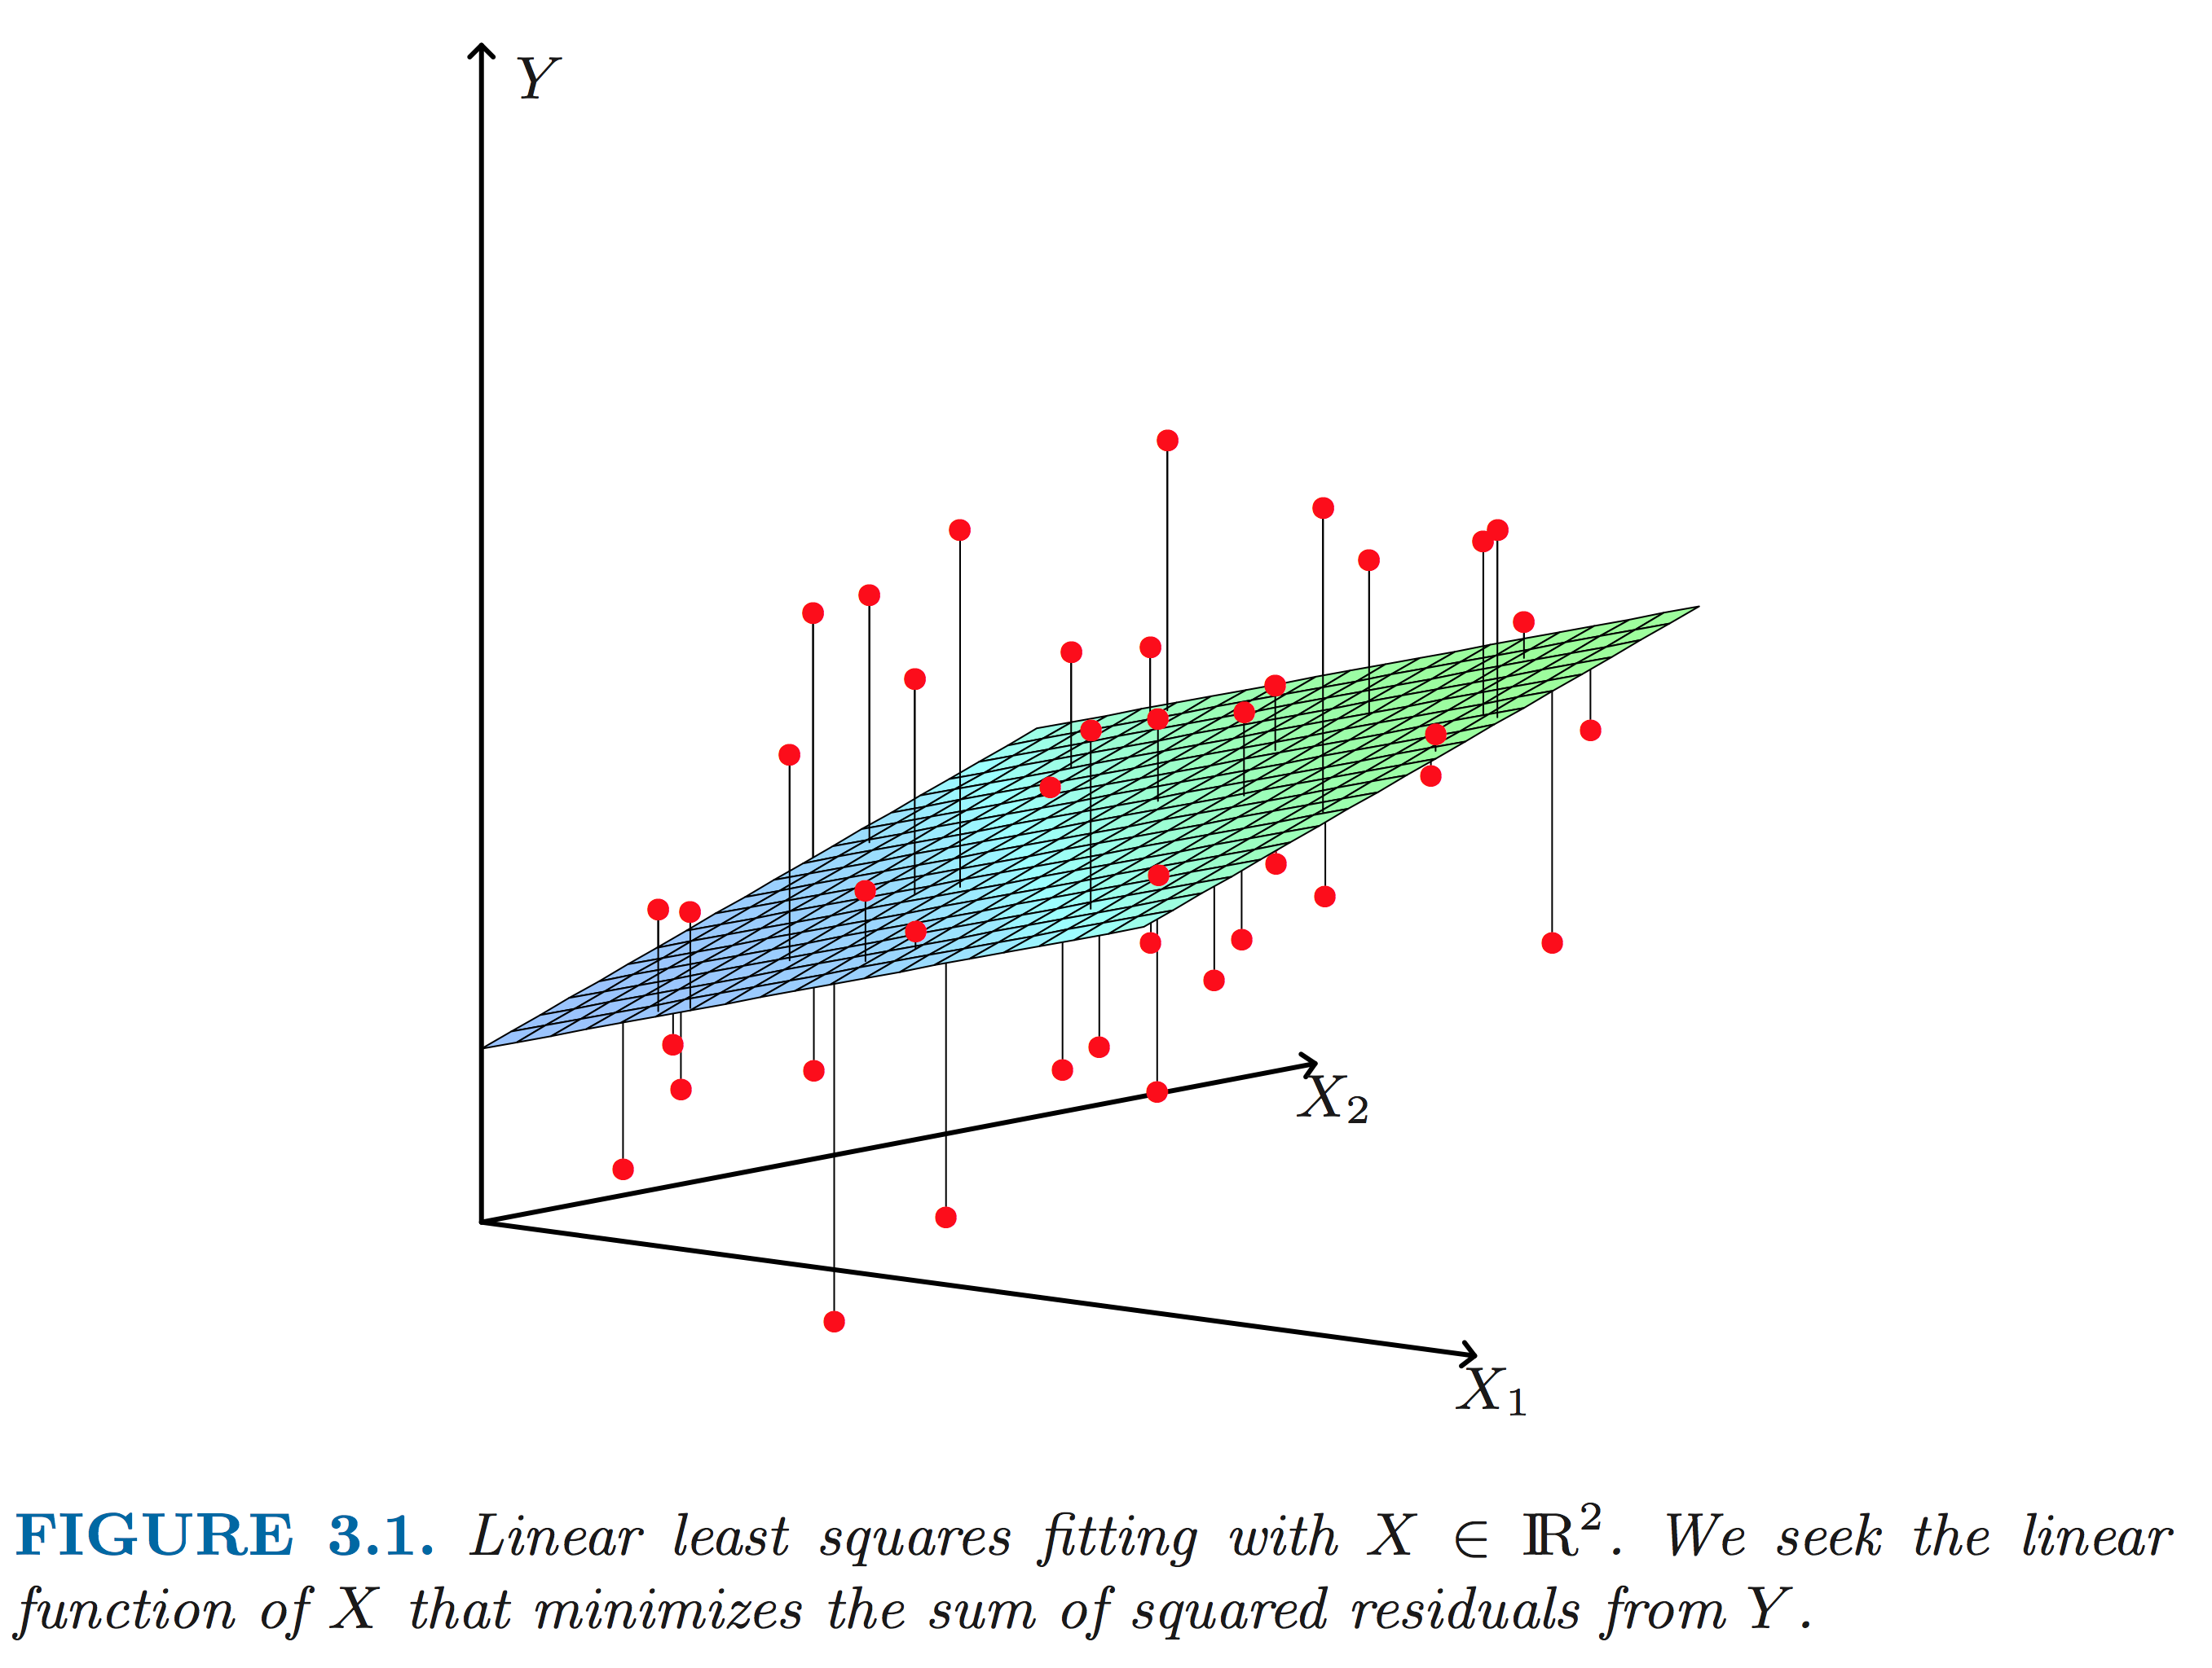

Slide 7
For next class
Homework:
Finish your ERM write-ups.
Take some data
plot training/validation/test error as a function of training set size
Use NN with n=1-10 and linear (or logistic) regression,
Describe the results and include with your ERM writeup. Due Tues. Feb. 3 before class.

