Slide 1
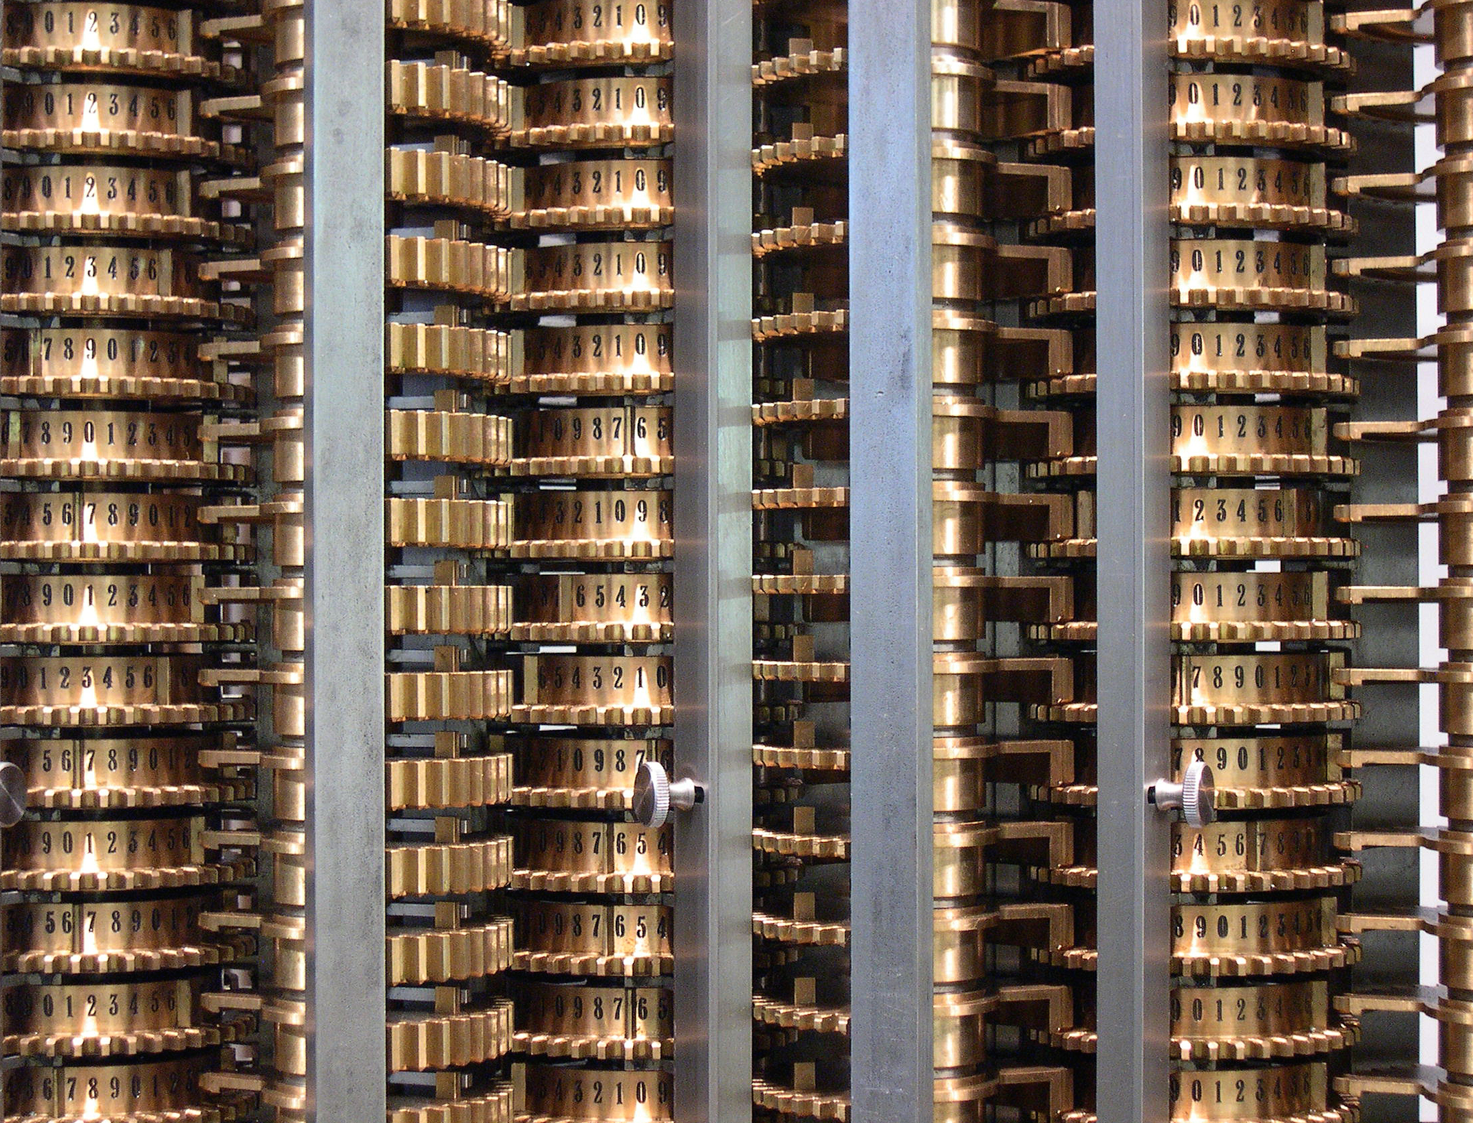
Machine Learning with Discriminative Methods
Lecture 19 – Deep learning 1
CS 790-134 Spring 2015
Alex Berg

Slide 2
Today’s class
Recent history
Intuition about deep learning structures
SSGD for deep learning

Slide 3
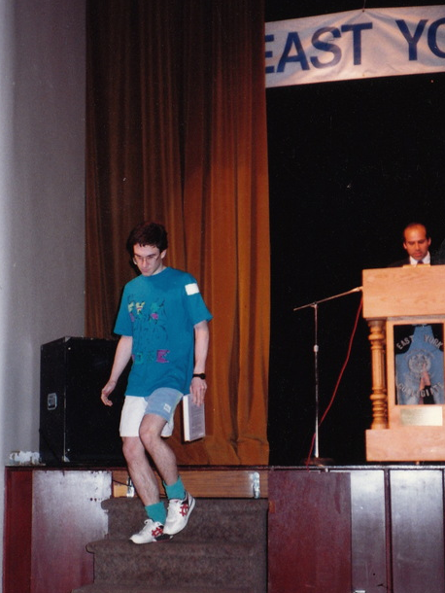
“Recent” History***
1970’s 1980’s 1990’s 2000’s 2010’s 2015…
Supervised
1984
PAC Learning
Leslie Valiant
2010
Leslie Valiant
Turing Award
1957
Perceptron
Rosenblatt
1970s -
Support Vector Machines
Vapnik et al
1975s - 1990s-
Efficient 1st order methods
Nemirovski & Nesterov
2008/2011
Dual Coordinate Descent
Pegasos
1960s
Adaline
Madaline
1975
Multi-layer
Back
Propagation
Werbos
1979
Convolutional
NNs
Fukushima
1989
ConvNets for Digits
LeCun
2012*
Krizhevsky,
Sutskever,
& Hinton
I played with Kohonen Feature Maps on a
2xIBM 3090-600S
6+6 processors
~1.6 GFlops
~$25M
2xNVidia GTX580
~2x1581 GFlops
~$1000
Titan X
~7000 GFlops
~$1000
1969
No XOR,
no benefit from naïve multi-layer
Minsky & Papert
1949
Hebb
1982
Self Organizing Maps
Kohonen
2006
Deep Learning
(Hinton)
Unsupervised
*** Many others too, this is just a sketch!

Slide 4
When did things change?
(computer-vision-centric!)
(ILSVRC-centric!)
Pascal VOC, etc.
ImageNet Large Scale Visual Recognition Challenge (ILSVRC)
???
Image Classification
Object Detection
???
before
ILSVRC 2012
Krizhevsky, Sutskever, & Hinton
Network for
Image Classification
Keys to success of their deep network:
1) Large Labeled Data to train and evaluate
2) GPUs for faster iteration and improvement of design
after
Labeled datasets were too small or artificial.
Computation limited iterating designs.
Confusion about most useful strategy for deep learning.
That one network provided features for improvement across many recognition tasks outside of ILSVRC
Hundreds of newspaper articles, many millions of dollars for startups, new market for GPUs!
New research labs including Face Book’s FAIR, etc.
Proving progress with evaluation is critical to impact.

Slide 5
Funny joke… from Olga Russakovsky
(grad student collabroator at Stanford)
The union of large-scale visual recognition and deep learning
Data Diversity
Algorithm complexity
Data Annotation
Algorithm Speed

Slide 6
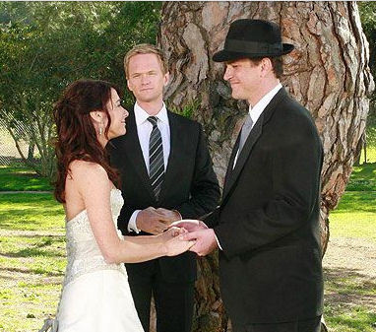
The time was right
A. Krizhevsky et al. ImageNet Classification with Deep Convolutional Neural Networks. NIPS 2012

Slide 7
The time was right
Diverse large-scale annotated data: ILSVRC
A. Krizhevsky et al. ImageNet Classification with Deep Convolutional Neural Networks. NIPS 2012

Slide 8
The time was right
Powerful algorithm:
Convolutional neural network
Diverse large-scale annotated data: ILSVRC
A. Krizhevsky et al. ImageNet Classification with Deep Convolutional Neural Networks. NIPS 2012

Slide 9
The time was right
Fast computational resource: GPUs
Powerful algorithm:
Convolutional neural network
Diverse large-scale annotated data: ILSVRC
A. Krizhevsky et al. ImageNet Classification with Deep Convolutional Neural Networks. NIPS 2012

Slide 10
The time was right
Fast computational resource: GPUs
Powerful algorithm:
Convolutional neural network
Diverse large-scale annotated data: ILSVRC
The ILSVRC data provided
A large-scale and diverse training set
(2) A testing platform to showcase results
A. Krizhevsky et al. ImageNet Classification with Deep Convolutional Neural Networks. NIPS 2012

Slide 11
The time was right
Fast computational resource: GPUs
Powerful algorithm:
Convolutional neural network
Diverse large-scale annotated data: ILSVRC
The ILSVRC data provided
A large-scale and diverse training set
(2) A testing platform to showcase results
Also (3) Trained models useful for other tasks
A. Krizhevsky et al. ImageNet Classification with Deep Convolutional Neural Networks. NIPS 2012

Slide 12
What are neural networks?
A bunch of bits that look like linear models, composed in layers.
  Early mistakes involved falling in love with multiple layers without realizing that a bit of separation is required between them!
  Remember! Many layers aren’t “necessary”, but they do seem to help.
Structured prediction models!

Slide 13
“Recent” History***
1970’s 1980’s 1990’s 2000’s 2010’s 2015…
Supervised
1984
PAC Learning
Leslie Valiant
2010
Leslie Valiant
Turing Award
1957
Perceptron
Rosenblatt
1970s -
Support Vector
Machines
Vapnik et al
1975s - 1990s-
Efficient 1st order methods
Nemirovski & Nesterov
2008/2011
Dual Coordinate Descent
Pegasos
1960s
Adaline
Madaline
1975
Multi-layer
Back
Propagation
Werbos
1979
Convolutional
NNs
Fukushima
1989
ConvNets for Digits
LeCun
2012*
Krizhevsky,
Sutskever,
& Hinton
1969
No XOR,
no benefit from naïve multi-layer
Minsky & Papert
1949
Hebb
1982
Self Organizing Maps
Kohonen
2006
Deep Learning
(Hinton)
Unsupervised
*** Many others too, this is just a sketch!

Slide 14
“Recent” History***
1970’s 1980’s 1990’s 2000’s 2010’s 2015…
Supervised
1984
PAC Learning
Leslie Valiant
2010
Leslie Valiant
Turing Award
1957
Perceptron
Rosenblatt
1970s -
Support Vector
Machines
Vapnik et al
1975s - 1990s-
Efficient 1st order methods
Nemirovski & Nesterov
2008/2011
Dual Coordinate Descent
Pegasos
1960s
Adaline
Madaline
1975
Multi-layer
Back
Propagation
Werbos
1979
Convolutional
NNs
Fukushima
1989
ConvNets for Digits
LeCun
2012*
Krizhevsky,
Sutskever,
& Hinton
1969
No XOR,
no benefit from naïve multi-layer
Minsky & Papert
1949
Hebb
1982
Self Organizing Maps
Kohonen
2006
Deep Learning
(Hinton)
Unsupervised
*** Many others too, this is just a sketch!

Slide 15
On Hype…
(not just in the 1980s!)
Much of the criticism for neural networks is also a criticism of lack of generalization or over-fitting in machine learning in general.
Neural Networks are perhaps subject to more hype and subsequent back-lash due to naming and a generally false connection to physiology.
It is now considered forward thinking to refer to them simply as “networks” these days, e.g., “convolutional networks” or “convnets”.

Slide 16
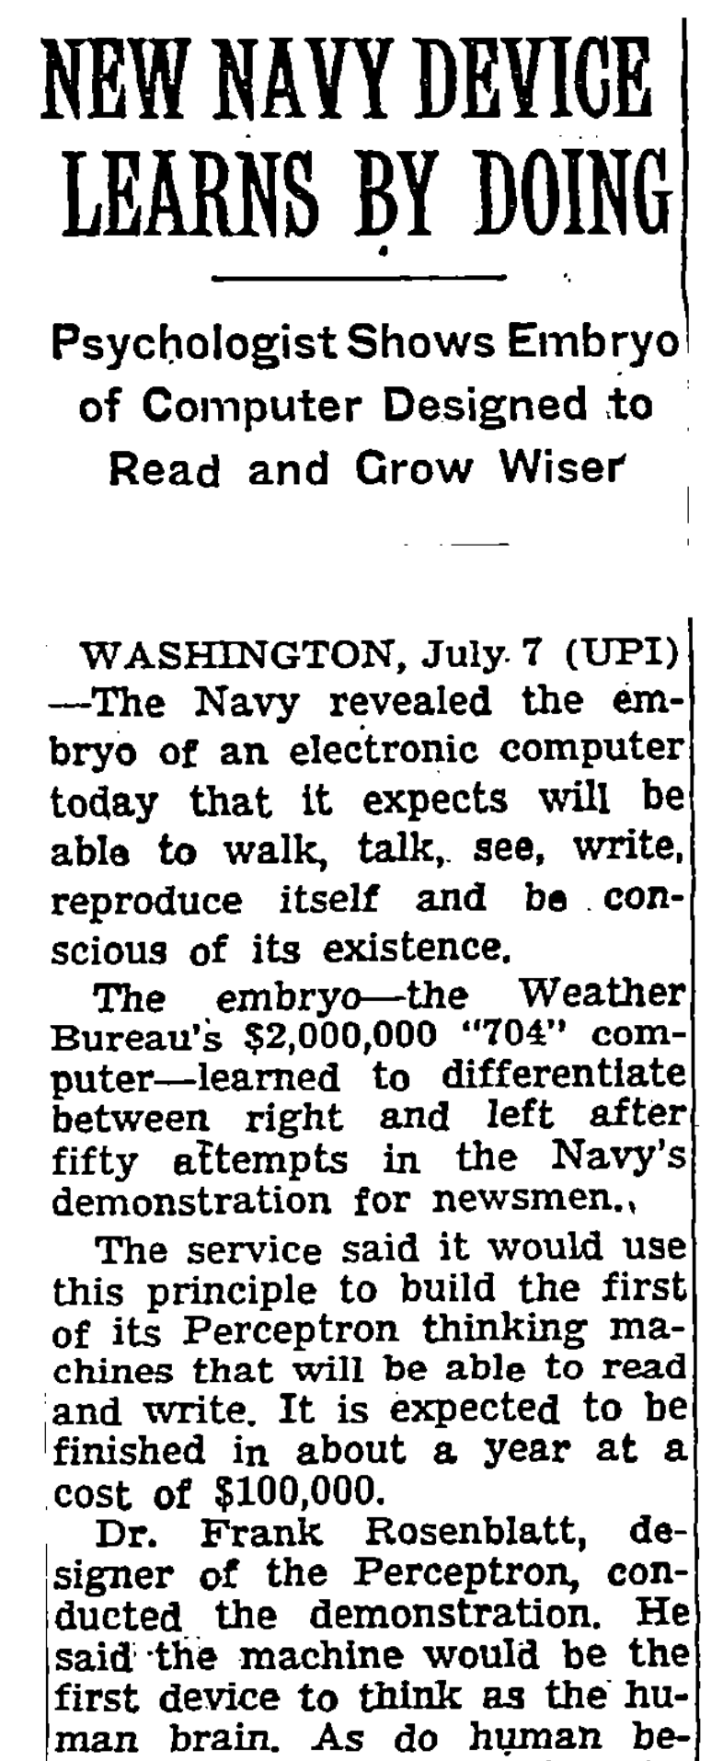
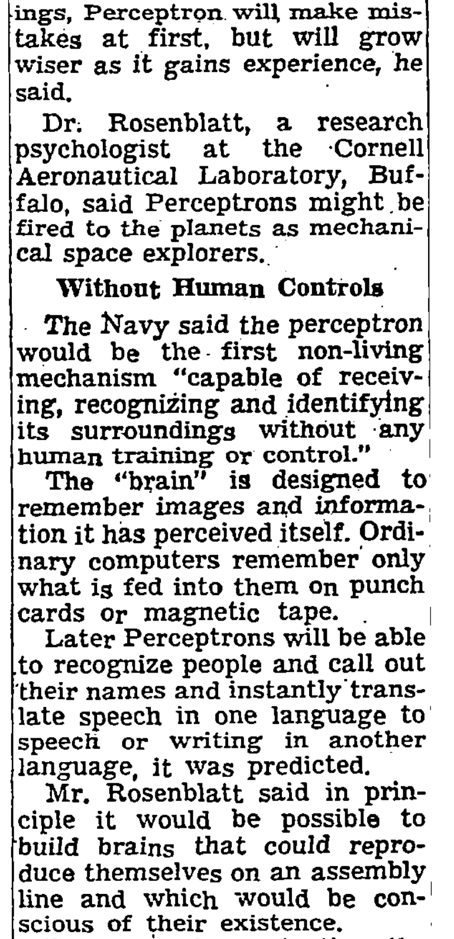
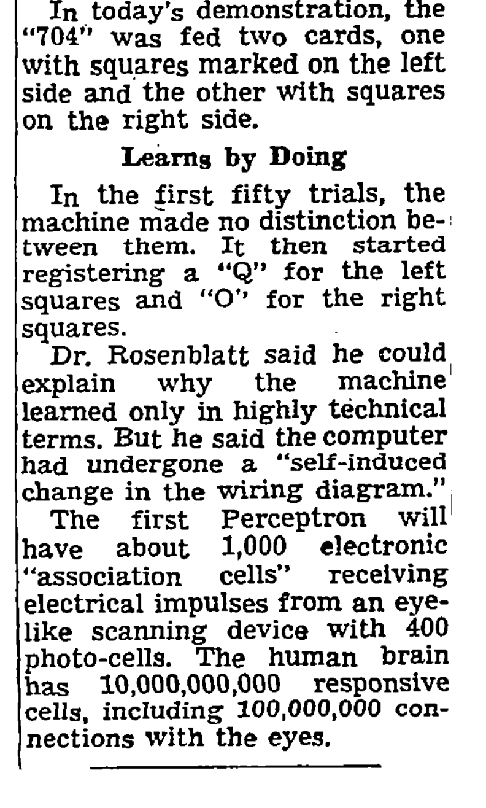
1958 New York Times…

Slide 17
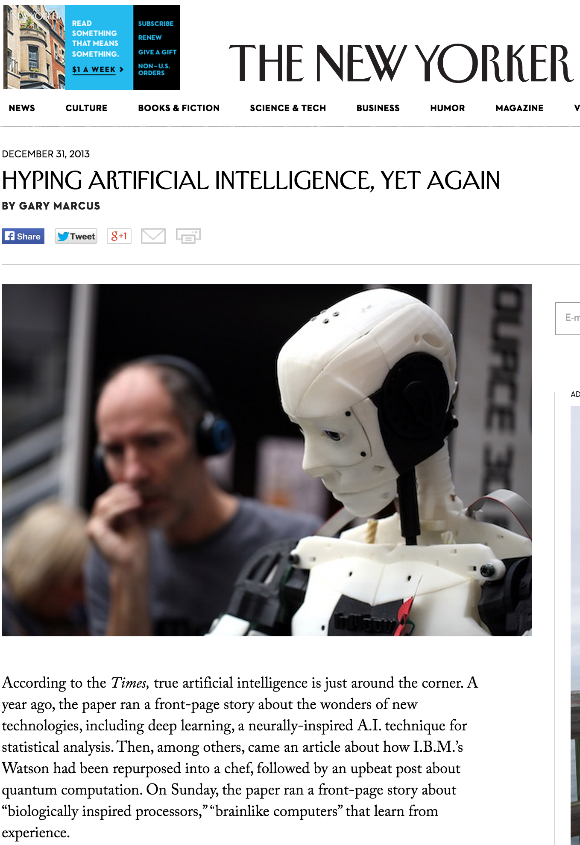
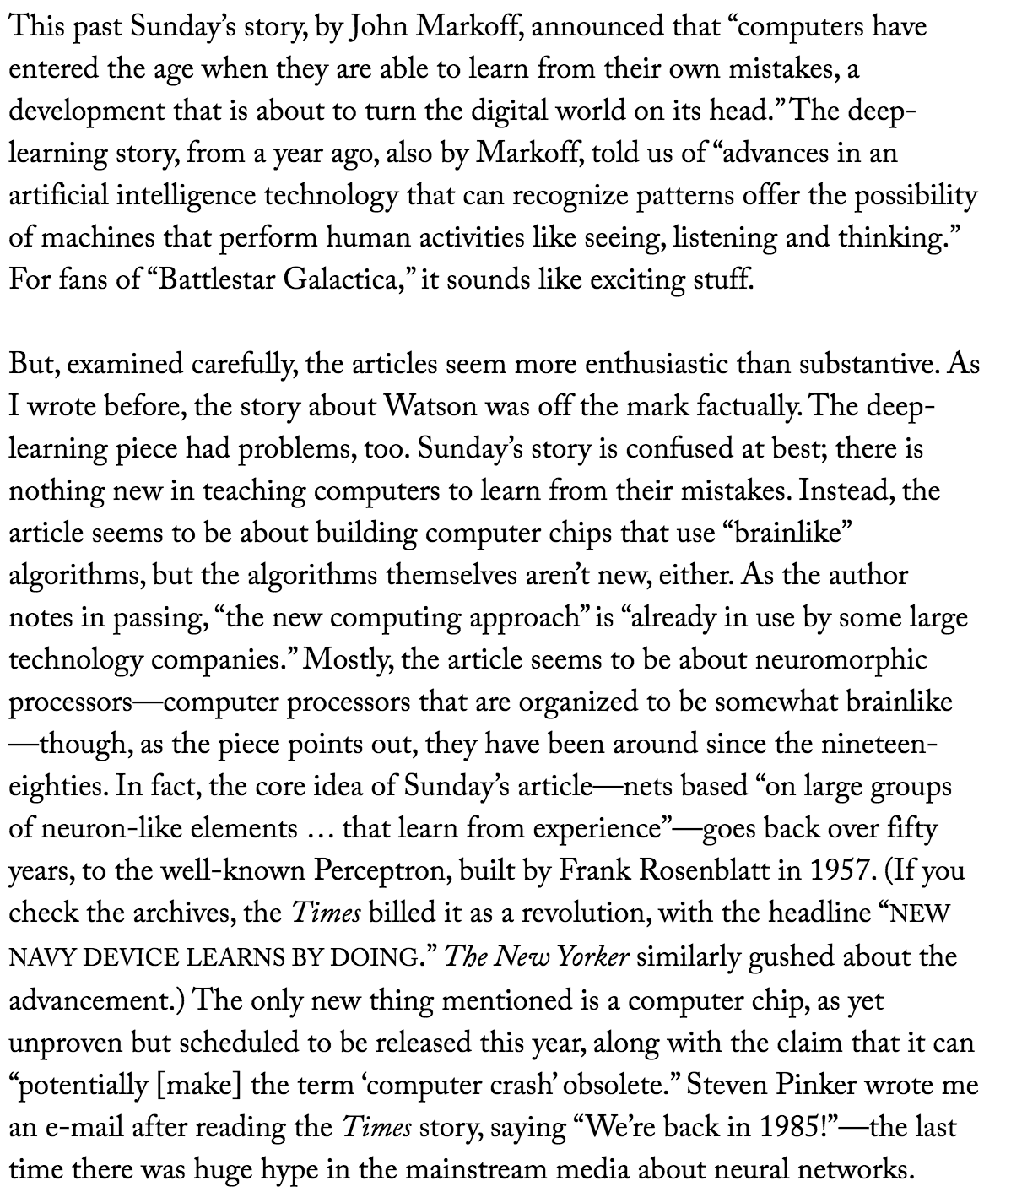
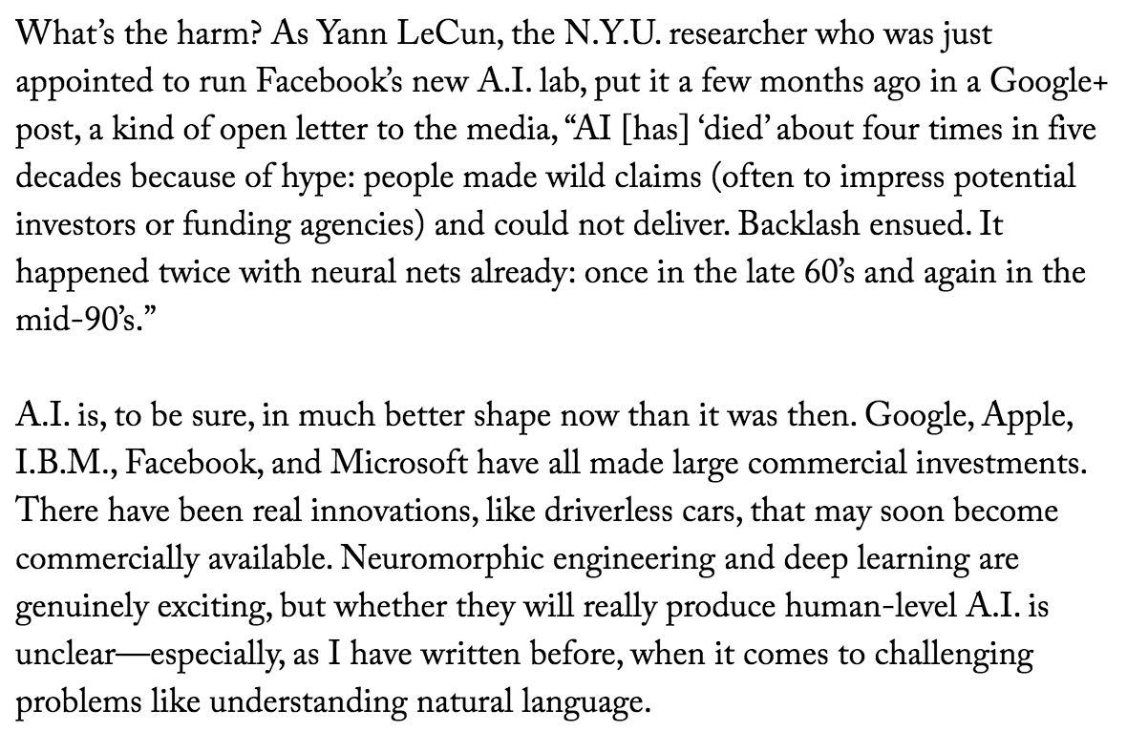

Slide 18
Design quiz…
We already know no linear classifier works…
+
-
and that no additive classifier works…
-
+
Design a two layer network to do it…
Individual nodes like:

Slide 19
Back Propagation is just (sub-)gradient descent
1. Proceed from some measure of error in output,
2. Apply chain rule to compute gradient direction for the w’s to reduce error
3…
4. Profit
Unlike a linear classifier, this is not convex, even
for nice loss functions on the output.
Rectified linear units make convergence much nicer than
sigmoid activation functions.
Still many questions about how to do this optimization well.

Slide 20
For next class
Read the caffe paper from the website.

