Slide 1
Advanced Computer Vision
CSE 615
Alex Berg

Slide 2
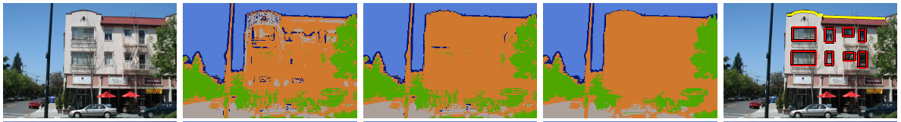
An old problem
I stand at the window and see a house, trees, sky. Theoretically I might say there were 327 brightnesses and nuances of colour. Do I have “327”? No. I have sky, house, and trees.
– Max Wertheimer 1923

Slide 3
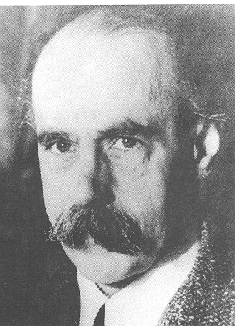
An old problem
I stand at the window and see a house, trees, sky. Theoretically I might say there were 327 brightnesses and nuances of colour. Do I have “327”? No. I have sky, house, and trees.
– Max Wertheimer 1923
1880-1943 One of the founders of Gestalt Psychology. Born Czech, he worked mainly in Germany until 1933 onwards at the New School in New York.
organizations.uncfsu.edu/psichi/History/Gestalt.htm

Slide 4
An old problem
I stand at the window and see a house, trees, sky. Theoretically I might say there were 327 brightnesses and nuances of colour. Do I have “327”? No. I have sky, house, and trees.
– Max Wertheimer 1923

Slide 5
An old problem
I stand at the window and see a house, trees, sky. Theoretically I might say there were 327 brightnesses and nuances of colour. Do I have “327”? No. I have sky, house, and trees.
– Max Wertheimer 1923
Sky
Building
Tree
Street

Slide 6
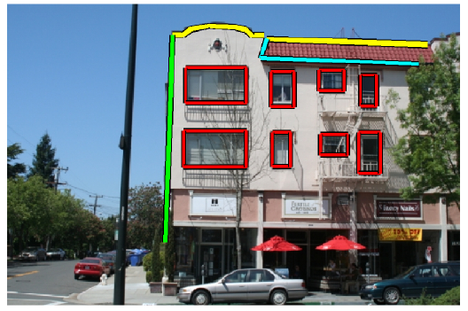
An old problem
I stand at the window and see a house, trees, sky. Theoretically I might say there were 327 brightnesses and nuances of colour. Do I have “327”? No. I have sky, house, and trees.
– Max Wertheimer 1923
Sky
Building
Tree
Street
Use this coarse parsing for
more detailed parsing of buildings

Slide 7


An old problem
I stand at the window and see a house, trees, sky. Theoretically I might say there were 327 brightnesses and nuances of colour. Do I have “327”? No. I have sky, house, and trees.
– Max Wertheimer 1923
Sky
Building
Tree
Street
Roofline
Use this coarse parsing for
more detailed parsing of buildings
Building
Boundary
Roof
Building
Color
Window
Roof
Color

Slide 8
Millions and Billions
Entertainment – graphics, special effects
Surveillance – h/w and software
Inspection – from french fries to chips
(Web) Search – access entertainment / info

Slide 9
What makes computational vision work?
Computers
Models
Data
Machine learning

Slide 10
Course
Explore aspects of computer vision in detail
  Mainly at the level of current research papers
Project oriented
  Work individually or in groups
  Idea is to find a problem you are interested in and implement the methods relevant to that problem
Some (3?) small homework assignments e.g.:
  Hand implement simple rendering and recognition
  Implement, train, and evaluate SVM for structured prediction
  Estimate probability distributions in a Bayes net
  Implement feature transforms
  Collect data using Amazon’s Mechanical Turk
A presentation to the class (e.g. paper or project)
Final Project due by last day of classes
  Multiple project check points over the semester
Please align course project with your own research!
  Either in terms of the data or methods
Grading: Project 50%, HW 25%, Participation 25%

Slide 11
Prerequisites
Programming
  Matlab and/or C++
Some math
    Mainly linear algebra
      Matrix operations, linear transforms, geometry
    Some calculus
      Derivatives & Optimization using gradient descent

Slide 12
Some course contents
Light fields
Features
Detection
Categorization
Retrieval

Slide 13
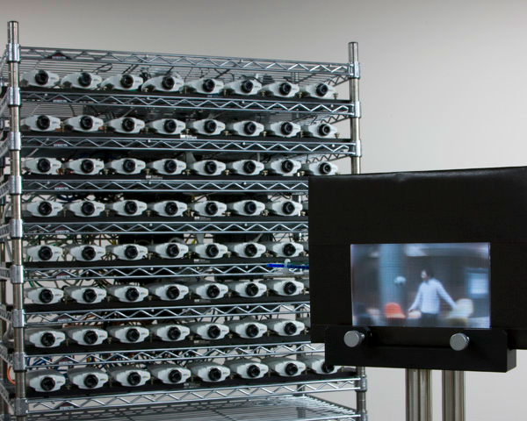
Light fields
http://nae-lab.org/~yuichi/project/TransCAIP/
Notes:
Camera models, point spread functions, depth dependent deblurring, etc.

Slide 14
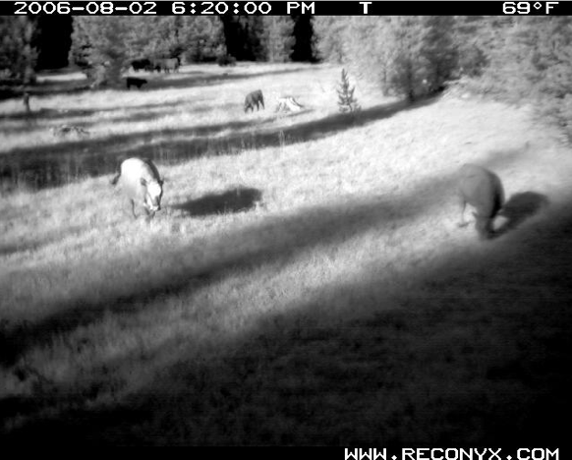
Features / Representation
D(image) = # of cows present
D(image) or D( F(image) )
Really D( F₁(image) ) or D( F₂(image) )
Really D( F₁ ( F₂(image) ) )
Etc.

Slide 15
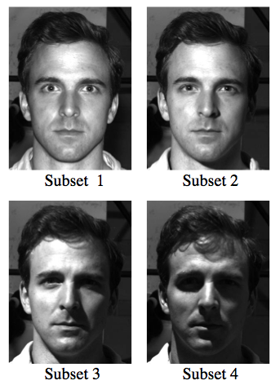
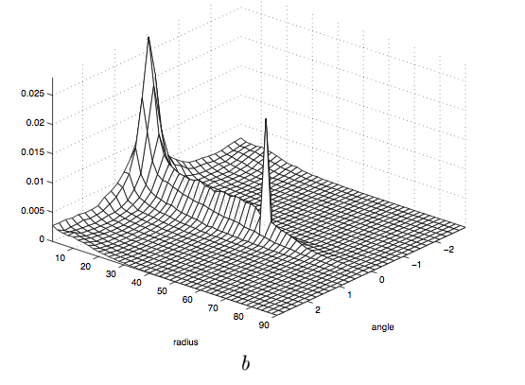
Variation due to illumination
“In Search of Illumination Invariants”
Chen, Belhumeur, Kriegman
CVPR 2000

Slide 16
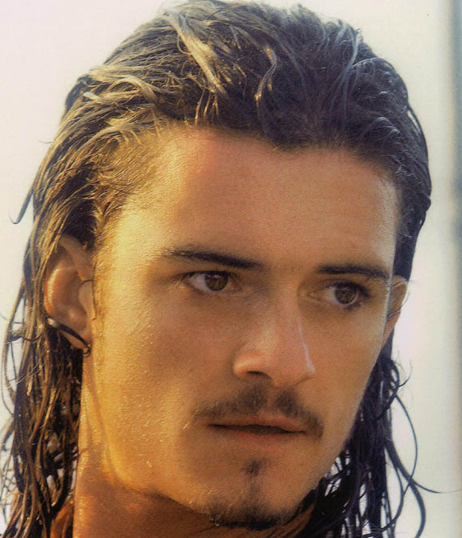
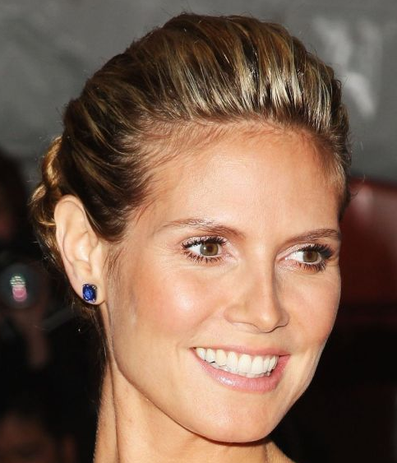
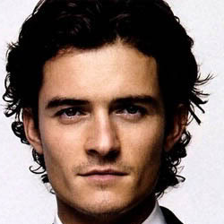
Variation due to pose

Slide 17
Variation due to pose

Slide 18
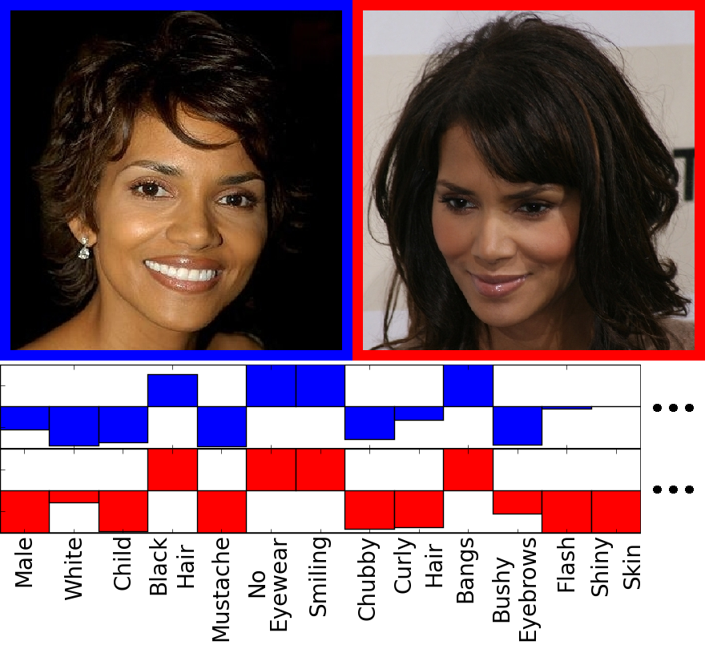
High level attributes as features
Verification
classifier

Slide 19
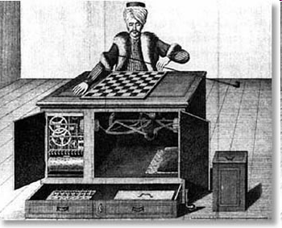
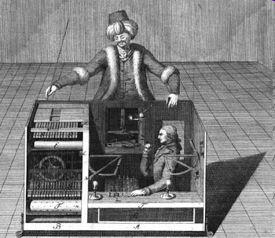
Amazon Mechanical Turk
19

Slide 20
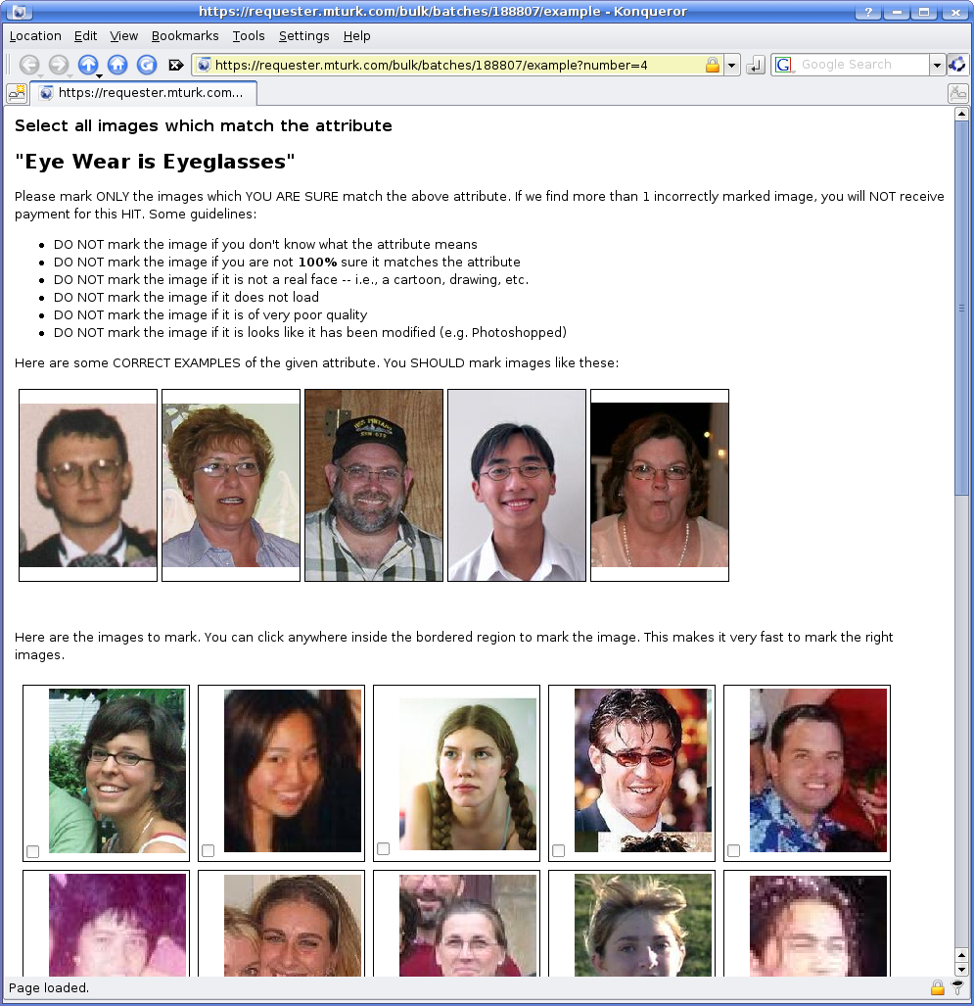
Attribute Labeling Task
20

Slide 21
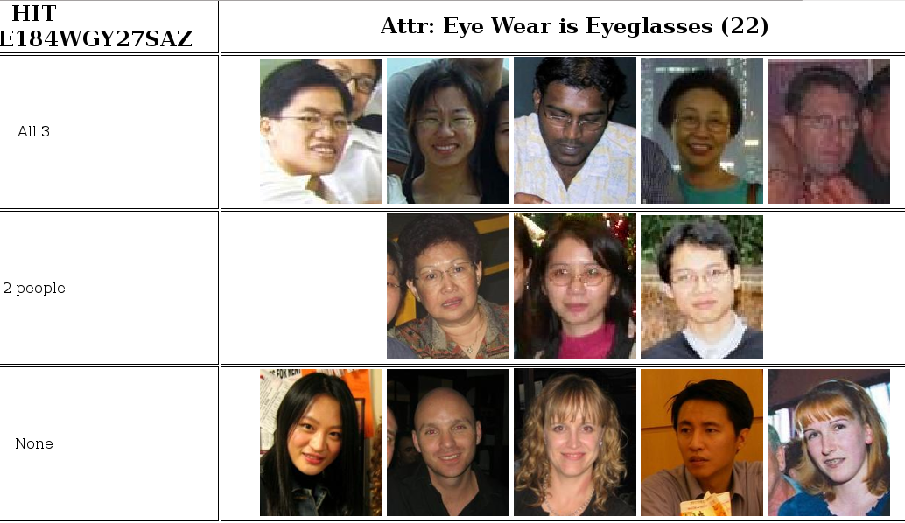
Attribute Labeling Results
21

Slide 22
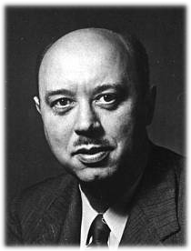
Previous alternative?
Egon Brunswik 1903-1955 Born Budapest,
Worked in Vienna and then U.C. Berkeley from 1935 onward. Worked on perception and ecological statistics.
http://www.albany.edu/cpr/brunswik/

Slide 23
Assignment 1
Render the image on the ground in front of a stained glass window
Do this for two different patterns of stained glass
Come up with a procedure given such an image to predict which pattern of glass was present
Turn in a brief write-up with pictures and code

