Slide 1
Advanced Vision -- Lecture 3
Alex Berg

Slide 2
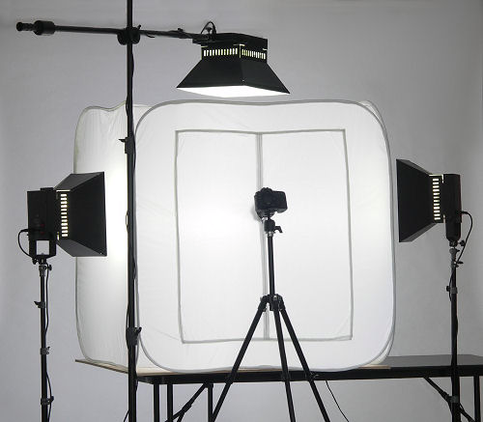
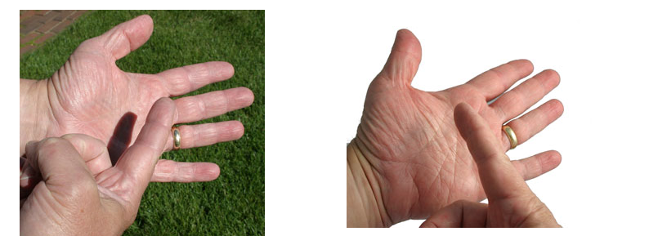
Ganzfeld Illumination
Uniform illumination from all directions
Crevices or wrinkles show up
Shadows are very soft if present
Like product images using a “light tent”
www.alzodigital.com
www.tabletopstudio.com

Slide 3


Sunset Reflection on Water
http://www.santorini-hotels.info/santorini-tours/boat-tours/sunset-cruise.asp
http://www.tripadvisor.com/ReviewPhotos-g482941-d568204-r6440423-Esperas_Traditional_Houses-Oia_Santorini_Cyclades.html#1694157

Slide 4
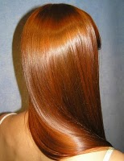
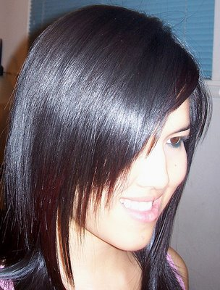
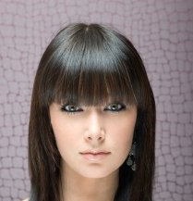
Light on Hair
http://batiaandaleeza.blogspot.com/2010/06/curly-hair-tips-questions-and-answers.html
http://www.rewaj.com/beauty-tips/want-to-make-your-hair-shiny-and-silky.html
http://4.bp.blogspot.com/_UL1wttinT4E/TA4TcAp7TdI/AAAAAAAAAHc/4giHuvK6laU/s1600/Q9+Bangs.jpg

Slide 5
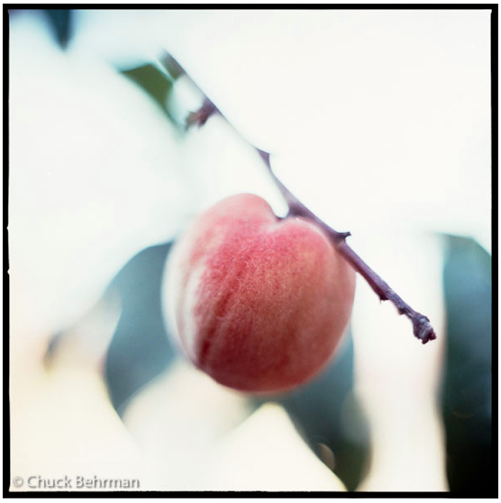
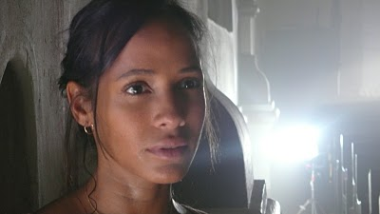
Light on Hair 2
http://fhoto-art.com/chb/galleries/1-limitedEditions-8-20-a/L-scenic-8-21-a/
http://gregbeeman.blogspot.com/2007_11_01_archive.html

